Slide 1
AP STAT
Chapter 11 & 12: Inference as Decision
EQ: What if our inference process leads us to make the wrong conclusion?

Slide 2
Part I:
Type I Error --- reject H₀ when it is
TRUE
Ex. False Positive Breathalyzer for DUI
H₀ driver is sober
H_{a} driver is not sober
Sobriety test is performed, driver is found to be drunk when in fact s/he is sober

Slide 3
Ex. Wrongly Incarcerated Prisoners
H₀ defendant is innocent
H_{a} defendant is not innocent
When trial concludes, jury finds defendant guilty when in fact s/he was innocent.

Slide 4
Type II Error --- fail to reject H₀ when it is FALSE
Ex. False Negative Test for Strep ---
H₀ patient is well
H_{a} patient is not well
The test is performed and patient is found to NOT HAVE strep when in fact s/he DOES HAVE strep.

Slide 5
Ex. OJ Simpson/Casey Anthony ---
H₀ defendant is innocent
H_{a} defendant is not innocent
The defendant is found innocent when in fact s/he is guilty.

Slide 6
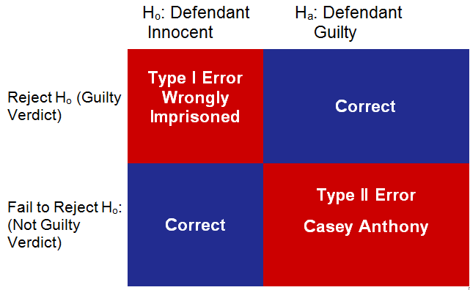
Justice System –Trial
WRONG DECISION
TRUTH
VERDICT
WRONG DECISION

Slide 7
Errors in Hypothesis Testing

Slide 8
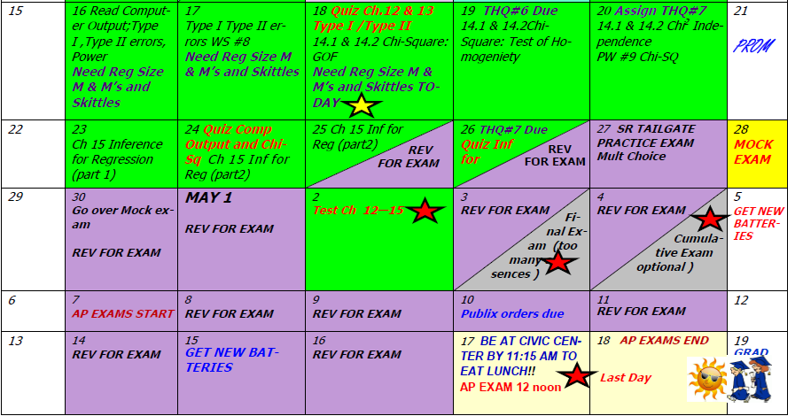
Day 65 Agenda:

Slide 9
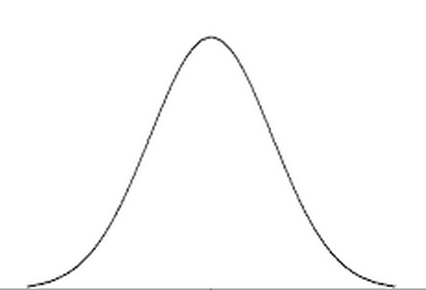
Standard of Judgement
Impact of Testimony

Slide 10
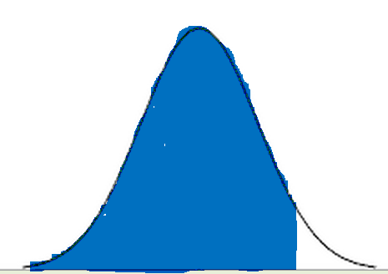
Standard of Judgement
Innocent Person
Arrested
P(TYPE I ERROR) = α
Impact of Testimony

Slide 11
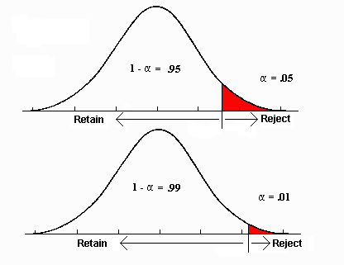
critical value for α
critical value for α
Smaller significance level, less likely to make a
Type I Error.
More serious the consequence, use
smaller value for α.

Slide 13
Seriousness may be relative in this case!

Slide 14
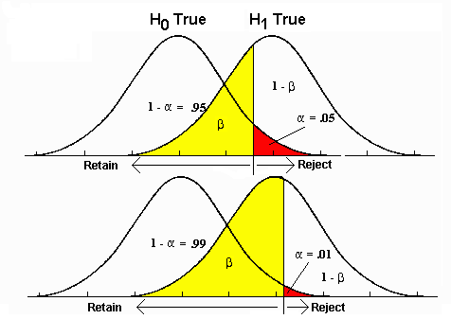
Type II Error
We will name this area soon!
P(Type II Error) = β
We will name this area soon!
P(Type II Error) = β

Slide 15
P(Type II Error) = β
P(Type I Error) = α
P(Type I Error) = α
P(Type II Error) = β
NOTE: α and β ARE NOT COMPLEMENTS
P(Type I error)
P(Type II error)

Slide 16
Identify H₀ and H_{a} then describe a Type I and Type II error and the consequences of these errors in context of each setting.
1. A particular compound is not hazardous in drinking water if it is present at a rate of no more than 25 ppm. A watchdog group believes that a certain water source does not meet this standard. The watchdog decides to gather data and formally conduct a test.
H₀:
water is safe to drink
H_{a}:
water is not safe to drink

Slide 17
states that the evidence indicates the water is not safe when in fact, it is
Type I ---
Consequence:
Type II –
Consequence:
Potentially initiates a clean-up where none was needed ($$ wasted)
states there is no evidence that the water is unsafe when, in fact it is
Opportunity to make corrections to water source missed, could be health issue. People may become sick.
Which is more severe? (You must argue in context of problem.)

Slide 18
2. A lobbying group has been advocating a particular ballot proposal. One week before the election, they are considering moving some of their advertising efforts to other issues. If the proposal has a support level of at least 55%, they will feel it’s “safe” and move money to other campaigns. The lobby group decides to gather data and formally conduct a test.
H₀:
Ballot has a support level of at least 55%
H_{a}:
Ballot does not have enough support

Slide 19
states that the evidence indicates the support level is less than 55% (meaning the proposal is in jeopardy of failing) when that is not the case
Type I ---
Consequence:
Type II –
Consequence:
Keeps advertising dollars aimed at this proposal when in fact it could have been spent elsewhere.
state that the proposal appears to have a “safe” level when in fact that is not the case
Group would shift funds away from supporting this proposal even though it may still be in need of that support.
Which is more severe? (You must argue in context of problem.)

Slide 20
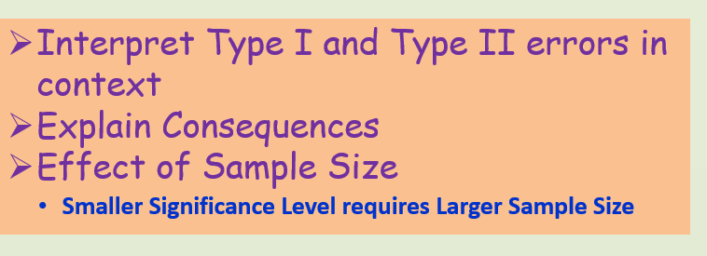
FOR AP EXAM YOU SHOULD BE ABLE TO:

Slide 21
Part II: Power
RECALL:
P(Type I error) = α
Test will reject H₀ when it is TRUE
P(Type II error) = β
Test will fail to reject H₀ when it is FALSE

Slide 22
What if the Alternative Hypothesis
Is In Fact Known to Be TRUE?
Fail to Reject Ho is now an Incorrect Decision
Probability of Failing to Reject Ho
when in fact it is FALSE
TYPE II ERROR = β

Slide 23
Reject Ho is now a Correct Decision
Probability of Rejecting Ho when in fact Ha is true
This is called the POWER of a Test
Power of a Test --- the probability that a fixed α will reject Ho when a particular Ha is actually TRUE

Slide 24
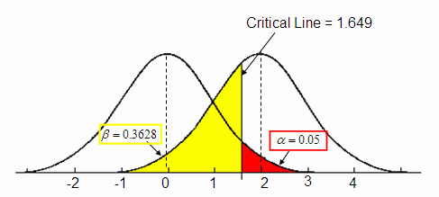
RECALL: P(Type I Error) and P(Type II Error)

Slide 25
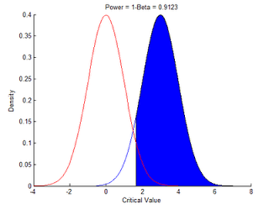
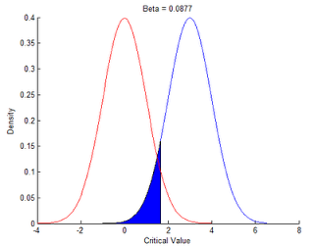
Power = 1 - P(TYPE II ERROR ) = 1 - β

Slide 26
P(Type II error)
Power
Good Standard Value for Power 80%
Power by:
a) increasing sample size
b) decrease σ
c) increase α

Slide 29
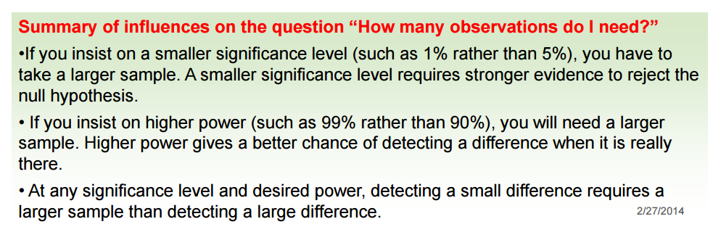

Slide 30
WHAT YOU SHOULD KNOW ABOUT
POWER ON AP EXAM:
Interpret Power in context
Effect of Sample Size(see slide 29)
Assignment p. 727 #49 - 51
p. 731 #53 (a – d)
p. 763 #19 (a, b)
Assignment p. 771 #25, 26

Slide 31
Assignment p. 727 #49 - 51
p. 731 #53 (a – d)
p. 763 #19 (a, b)
Assignment p. 771 #25, 26

