Slide 1

Day 6 Agenda:
DG3 --- 20 minutes
THQ#1 due Tues

Slide 2





Advanced Placement Statistics
Chapter 2.2: Normal Distributions
EQ: What are the characteristics of a Normal Distribution?

Slide 3
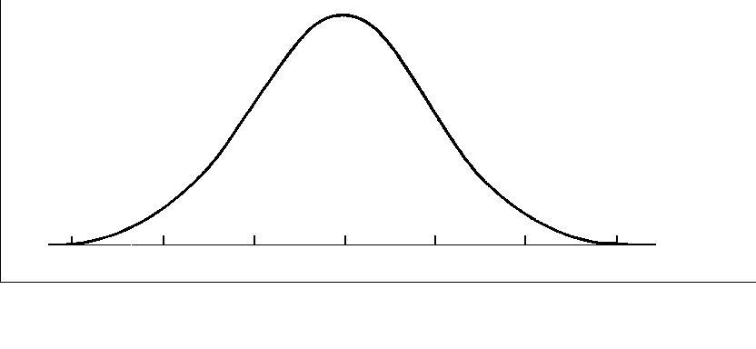
Normal Distribution Curve:
Notation for
Normal Distribution:
N(μ, σ)
Mean
Standard Deviation

Slide 4
Characteristics of a Normal Distribution Curve:
1. bell-shape
*** Must be told distribution is normal, cannot assume.
RECALL T or F?
All bell-shaped distributions are normal.
All normal distributions are bell-shaped.

Slide 5
2. symmetric to the y-axis
3. asymptotic to the x-axis
4. entire area between the curve and the x-axis is 1

Slide 6
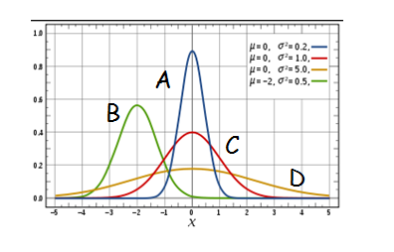
Compare these distributions:

Slide 7
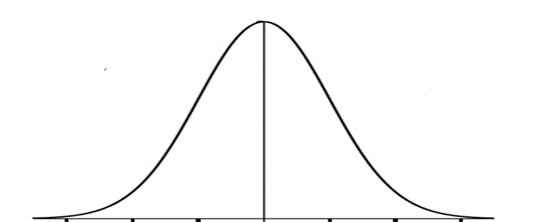

Locations of Standard Deviations

Slide 8

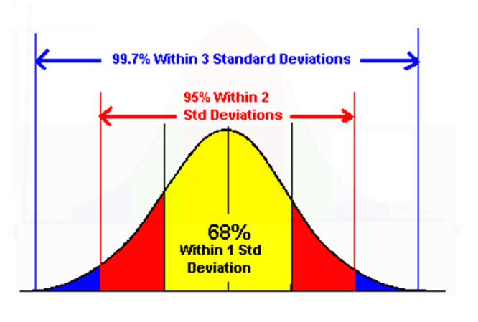

Slide 9

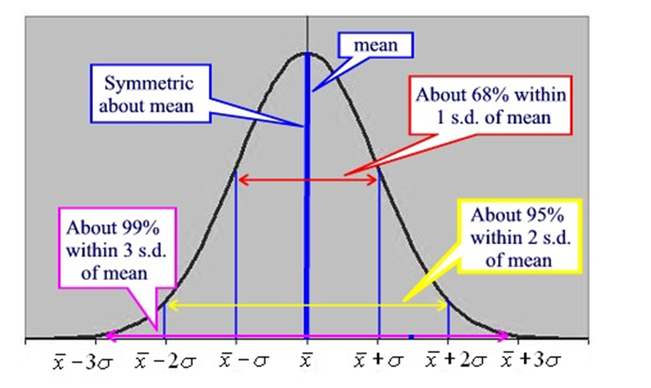

Slide 10
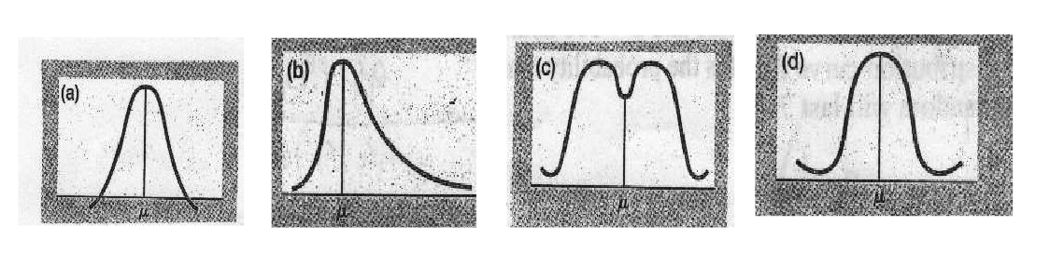
Examples
Give a reason why these curves would fail to represent a normal distribution.
crosses x-axis
not symmetric
not bell-shaped
not asymptotic

Slide 11
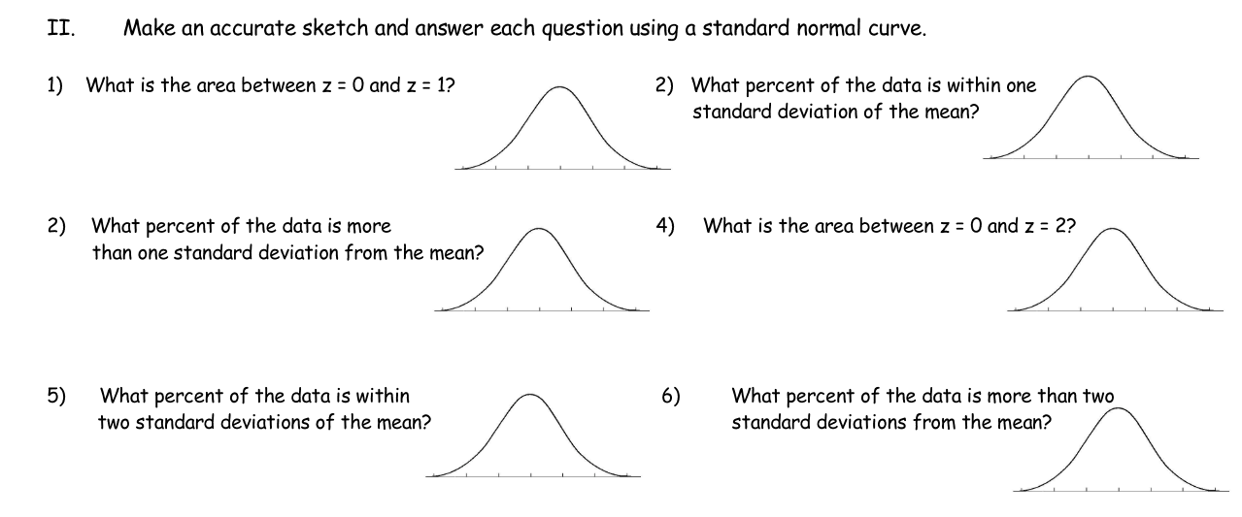
Examples
P(0 < z < 1) = 34%
P(-1 < z < 1) = 68%
P(z < -1) or P(z > 1) = 100% - 68% = 32%
P(0 < z < 2) = 95% ÷ 2
= 47.5%
P(-2 < z < 2) = 95%
P(z < -2) or P(z > 2)= 100% - 95% = 5%

Slide 12
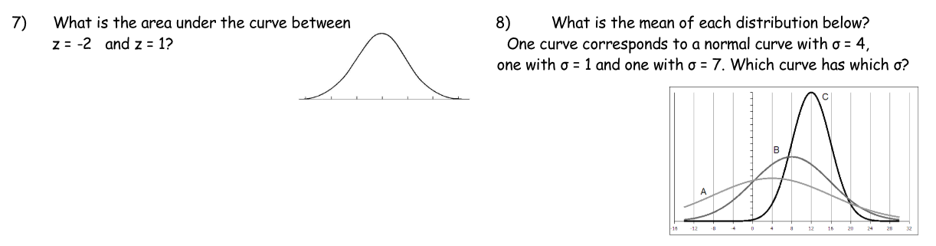
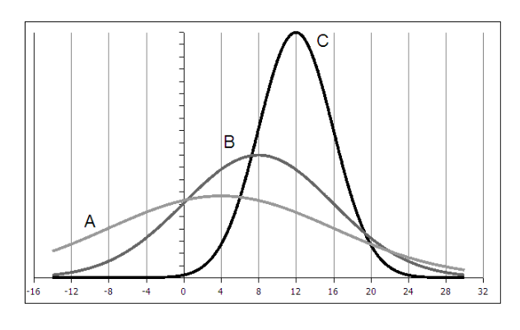
P(-2 < z < 1) = 47.5% + 34% = 81.5%
Distribution A has the smallest mean but largest spread, therefore μ = 4 and σ = 7. N(4, 7)
Distribution B has μ = 8 and σ = 4. N(8, 4)
Distribution C has the largest mean but smallest spread, therefore μ = 12 and σ = 1. N(12, 1)

Slide 13
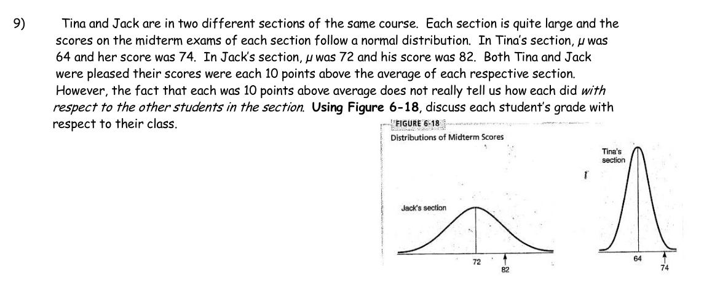
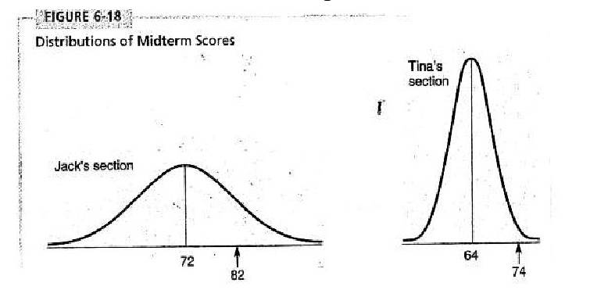
Although Jack had a higher numerical grade than Tina, with respect to their class, Tina performed better on the test. Her grade is farther right on her class’ distribution curve than Jack’s is on his class’.

Slide 14
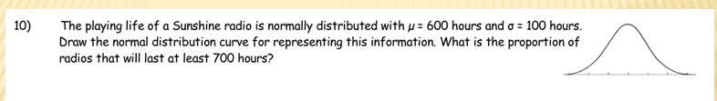

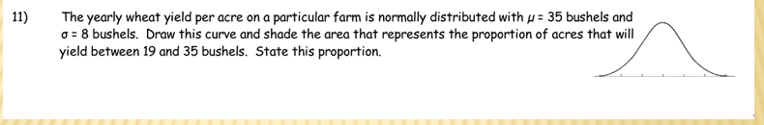

300 400 500 600 700 800 900
P(X > 700) = 16%
16% of the radios will last at least 700 hours.
P(19 < X < 35) = 47.5%
11 19 27 35 43 51 58
47.5% of the acres will yield between 19 and 35 bushels.
Assignment:
p. 137 #23 – 26

Slide 15
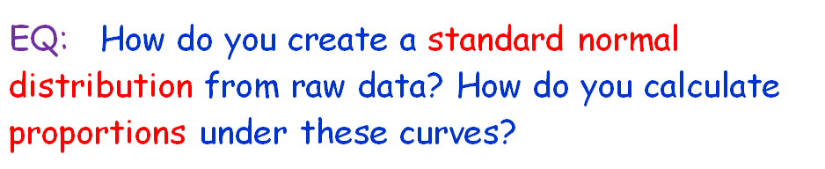
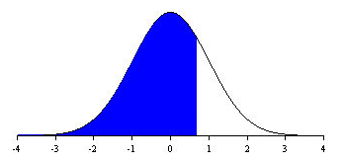
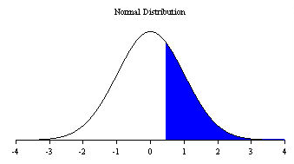
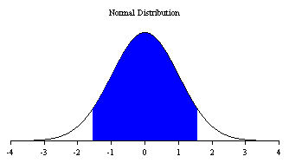
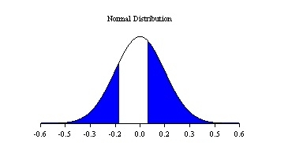
Recall: Area (Probability) Under Normal Distribution

Slide 16

Stating Area Under The Curve
*** Always sketch the shaded curve. ***

Slide 17
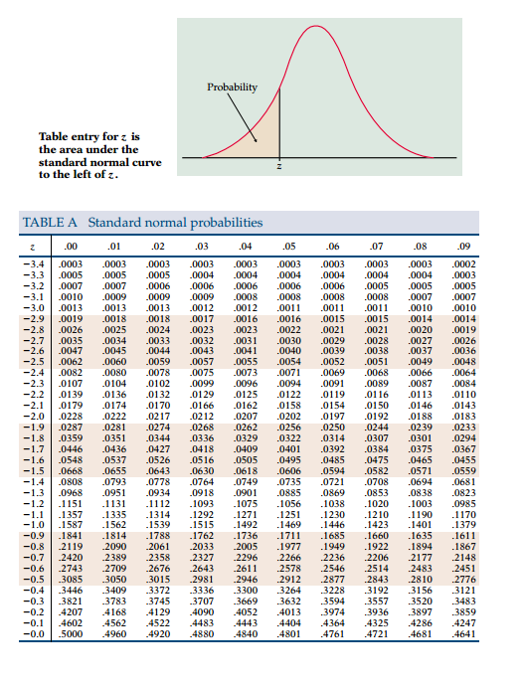
percent under the curve
z-score

Slide 18
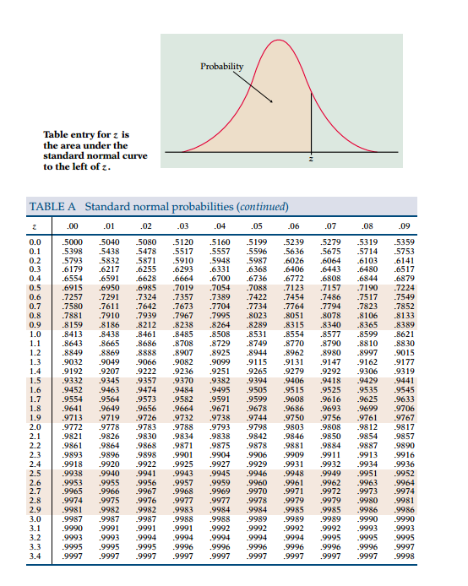

Slide 19
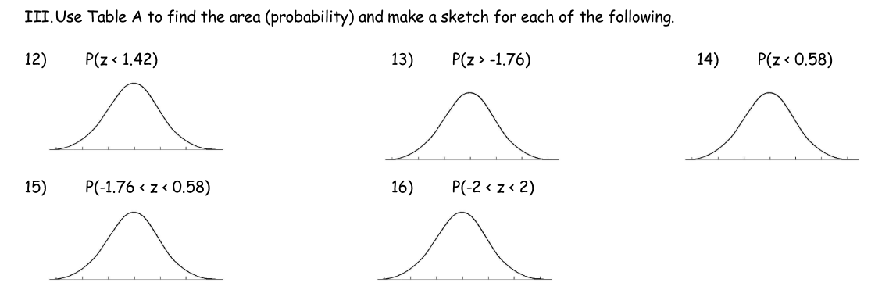


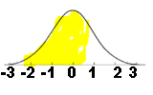


Examples
= 92.22%
= 96.08%
= 71.90%
-3 -2 -1 0 1 2 3
-3 -2 -1 0 1 2 3
-3 -2 -1 0 1 2 3
= 67.98%
= 95.44%
Empirical Rule gives 95%
-3 -2 -1 0 1 2 3
-3 -2 -1 0 1 2 3
This means place integer values on the x-axis and shade your curve.

Slide 20
Calculator Functions
normcdf
“normal cumulative density function”
Arguments For a
Nonstandard Normal Distribution:
normcdf (low bound, high bound, µ, σ)

Slide 21
Calculator Functions
0
1
RECALL: for a SND, µ = ____and σ = ____
Arguments For a Standard Normal Distribution
normcdf (low bound, high bound)
** normcdf is CALCULATOR JARGON. **
DO NOT WRITE THIS NOTATION AS YOUR “WORK” ON A TEST.

Slide 22
Day 7 Agenda:
THQ #1 due beginning of class Tues

Slide 23
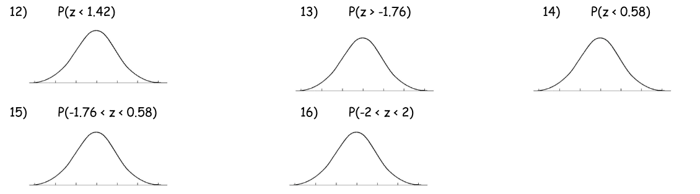
Examples

Slide 24

How can you find a raw score from a z-score?
Recall: z-score = ______________

Slide 25
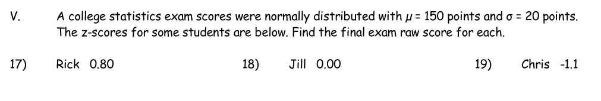

Examples

Slide 26
How do you find the z-value when given the area?
Calculator Function
For ND: invnorm(%, µ, σ)
For SND: invnorm (%)
CALC JARGON

Slide 27
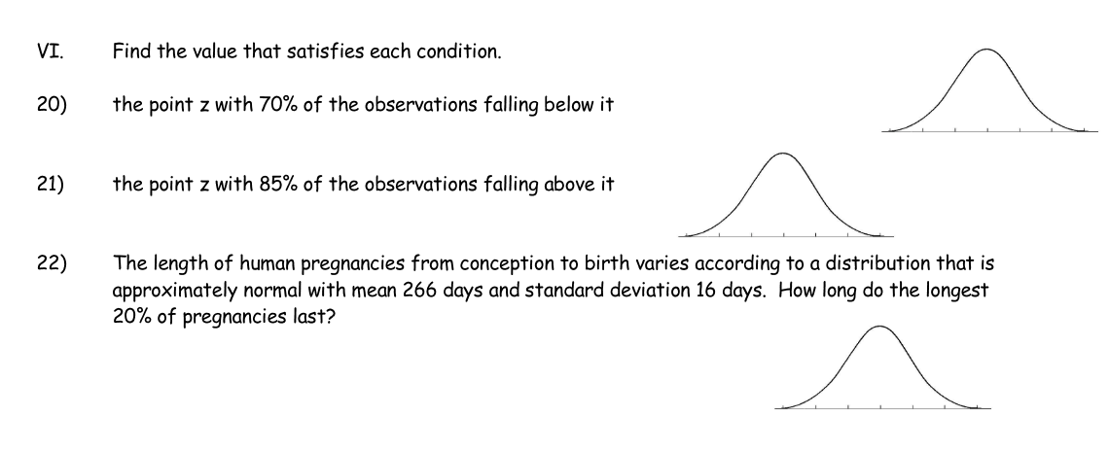

Examples
20. P( z < .5244) = 70%
21. P( z > -1.04) = 85%
Must use Compliment invnorm(.15)
22. P( z < .84) = .80
The longest 20% of
pregnancies will last at
at least 279.44 days.

Slide 28
Methods to Assess Normality:
1) told in problem --- MOST COMMON ON EXAM
2) observe graphs --- histogram, stem
plot, dot plot
should not show significant departures from trend; could only state “may be” …
NO skewness or outliers
Should be bell-shaped and symmetric about the mean

Slide 29
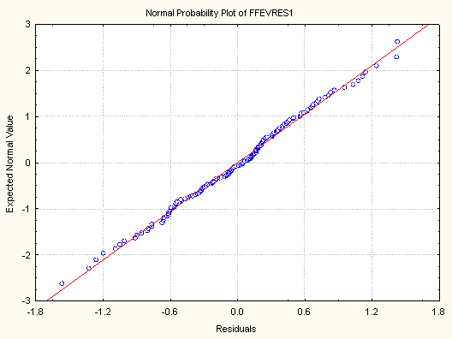
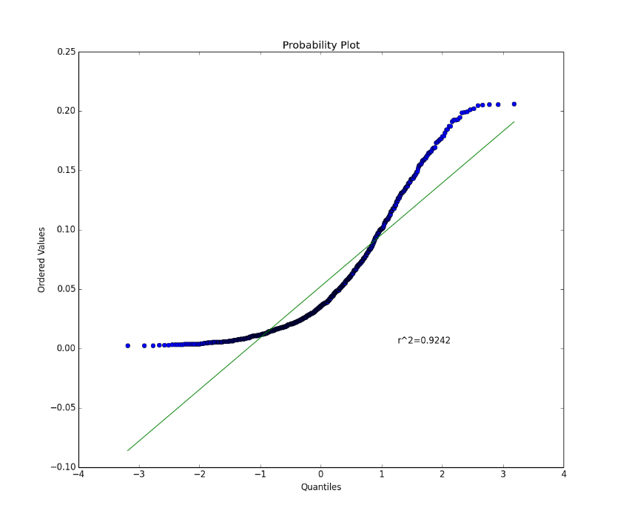
3) Compare distribution to
68% - 95% - 99.7% EMPERICAL Rule
Requires you to do ALGEBRA!
4) Interpret Using a Normal Probability
Plot
What do these NPP tell you???

Slide 30
How would you describe the shape of this distribution?
The shape of this distribution is approximately symmetric.

Slide 31
This is the Normal Probability Plot created from the given histogram:
Notice the Normal Probability Plot (NPP) is basically straight. The points lie close to a straight-line (with the exception of a few outliers).
Indicates distribution is approximately Normal.

Slide 32
NPP Straight
Approx Normal
Distribution
NPP Not Straight
Non-Normal
Distribution; Skewed

Slide 33
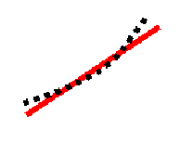
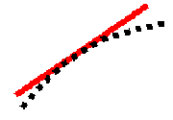
If larger observations fall systematically above the line, the NPP indicates the data are right-skewed.
If smaller observations fall systematically below the line, the NPP indicates the data are left-skewed.
Right Skew --- plotted points appear to bend up and to the left of the normal line indicating a long tail to the right
Left Skew --- plotted points appear to bend down and to the right of the normal line indicating a long tail to the left

Slide 34
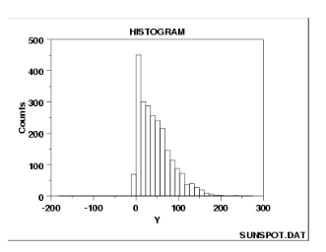
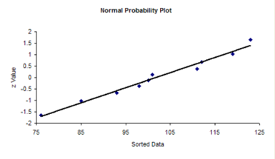
Examples
VI. Determine whether a normal distribution would be appropriate based on the graphs given.
YES
NO
NO
YES

Slide 35
If you know that a distribution is Normal or approximately Normal, then what values can you use to discuss the distribution?
***Normality allows you use standardized values,
i.e. z-scores.

Slide 36
Assignment:
p. 142 #29, 30
p. 147 #31, 32, 34
p. 156 #38
p. 157 #43 – 45, 49, 50

