Slide 1
CONGRATULATIONS!!
YOU HAVE REACHED THE FINAL OBJECTIVE OF THE COURSE

Slide 2
AP STAT
Section 12.1: Tests of Population Means
EQ: What is the difference between a one-sided hypothesis test and a two-sided hypothesis test?

Slide 3
RECALL: Statistical Inference Part I
Confidence Interval
uses probability to estimate a parameter point (µ or p) within an interval of values

Slide 4
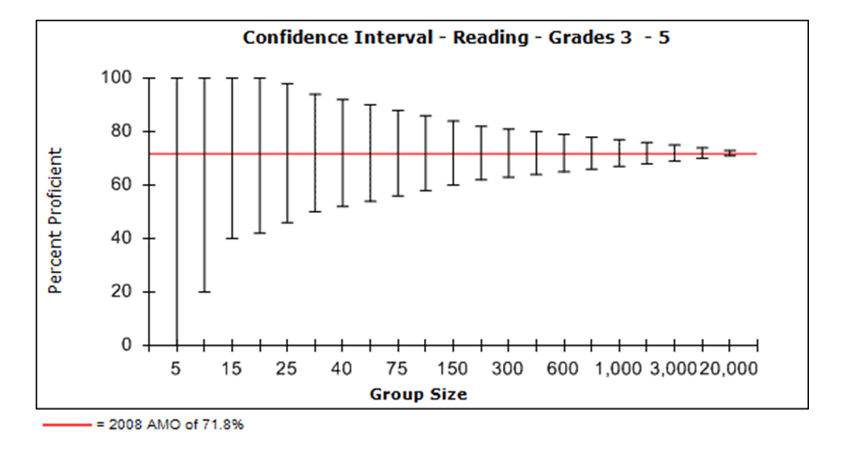
RECALL: As sample size increases, margin of error
decreases.

Slide 5
Statistical Inference Part II: Significance Tests
Significance Tests
– uses probability to compare observed data with a hypothesis whose truth we want to assess
Hypothesis
– numerical value making a statement about a population

Slide 6
Null Hypothesis
– statement being tested
H₀ represents a single value
always “ = “
H₀: μ = ____

Slide 7
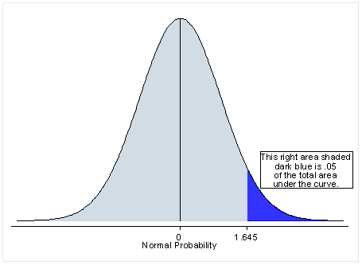
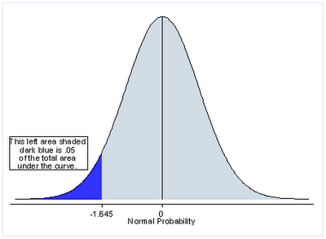
Alternate Hypothesis
– claim about population for which we are trying to find evidence
H_{a} represents a range of values
one-sided
H_{a}: μ > ____
H_{a}: μ < ____

Slide 8
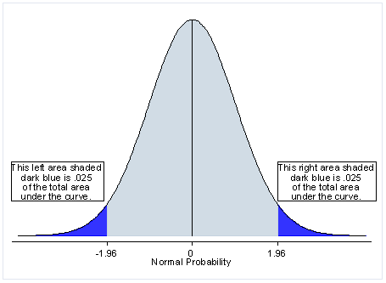
two-sided
H_{a}: μ ≠ ____
two-sided --- results in either of two directions are
considered extreme

Slide 9
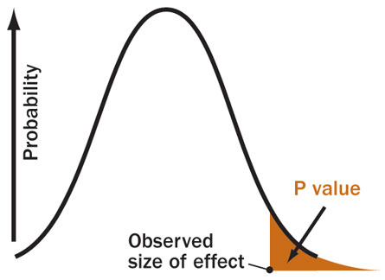
p-value
– probability that observed outcome takes a value as extreme or more extreme than that actually observed
Sampling Distribution of a Test Statistic:
H₀
test
statistic

Slide 10
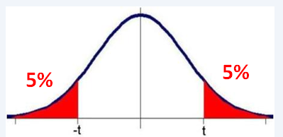
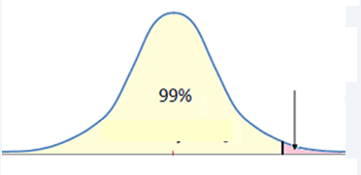
In class p. 745
#1a)
#1b)
#2a)
#2b)
1%

Slide 11
Statistically Significant
--- p-value is as small or smaller than specified α level

Slide 12
Larger p-value
→ evidence to fail to reject H₀; though not enough evidence to conclude H_{a}
Smaller p-value
evidence to reject H₀; enough
evidence to possibly conclude H_{a}

Slide 13
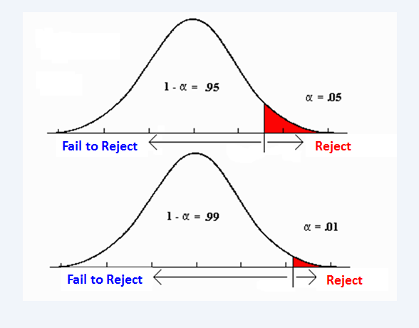

Slide 14
NEVER “ACCEPT” H₀
ONLY “FAIL TO REJECT IT”
Burden of Proof lies on H_{a}.
H₀ is innocent until proven guilty.

Slide 15
Day 59 Agenda:

Slide 17
AP STAT EXAM Scoring Rubric for Significance Testing:

Slide 18
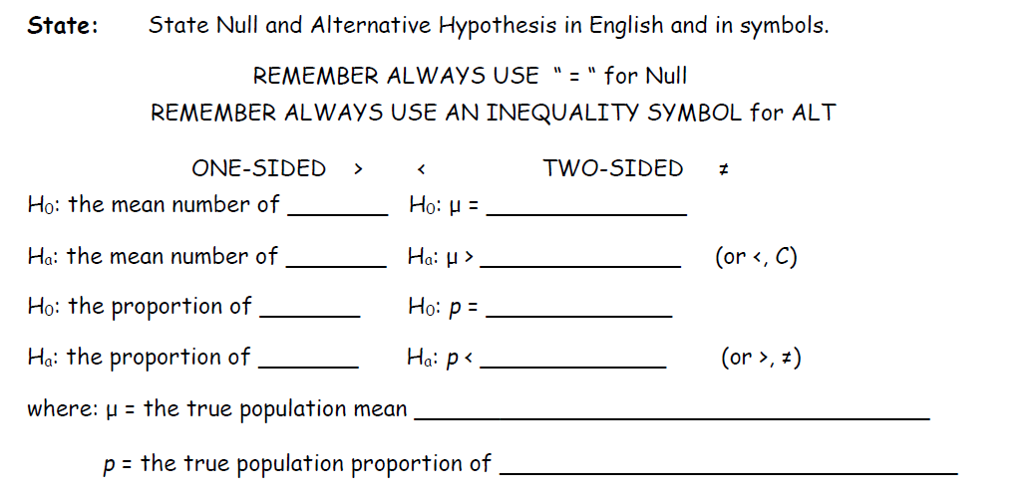
See Template for Significance Testing:

Slide 19
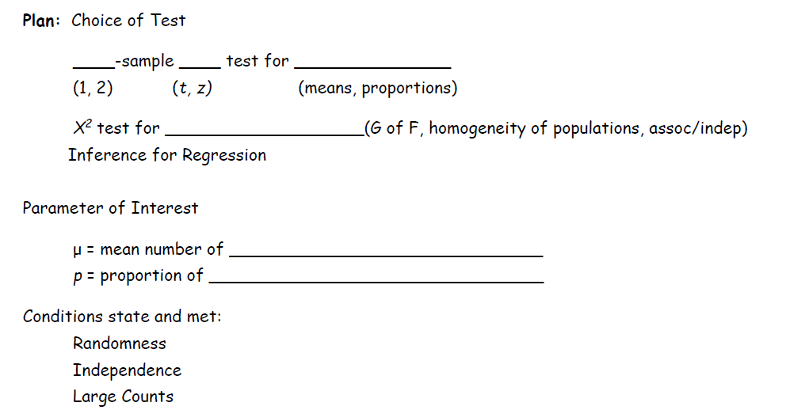

Slide 20
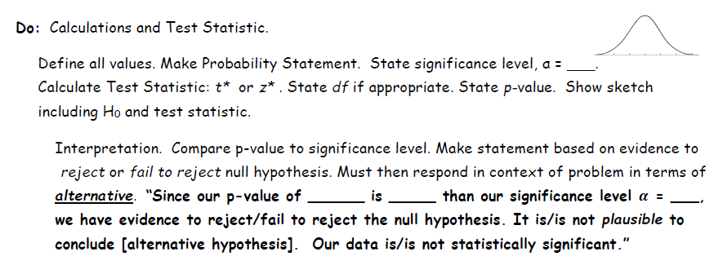

Slide 21
In class p. 754 Use Handout
#5 (I will give you the summary statistics.)
State:
H₀ :
H_{a} :
H₀ :
H_{a} :
µ = 1200 mg
µ < 1200 mg
the true mean calcium intake for females 18 to 24 years old is 1200 mg
the mean calcium intake for females 18 to 24 years is less than 1200 mg

Slide 22
In class p. 754 Follow Template
#5 (I will give you the summary statistics.)
Plan:
Parameter of Interest:
µ = true population mean daily calcium intake for women age 18 to 24 years old
Choice of Test:
1-sample t-test for means

Slide 23
Conditions:
Randomness --- The problem does not state the 38 women were randomly selected. However no reason to assume these women are not representative of population of all women 18 to 24 years old.
Independence --- all women age 18 to 24 > 10(38)
Condition met
Large Counts --- n = 38 38 > 30
CLT says sample size large enough to use
Normal approximation.

Slide 24
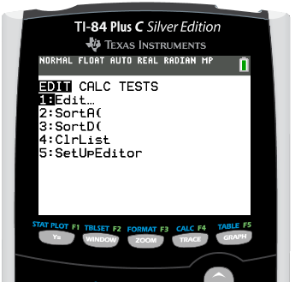
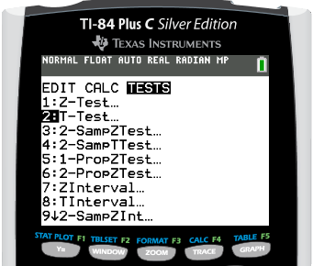
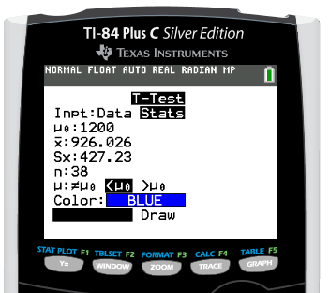
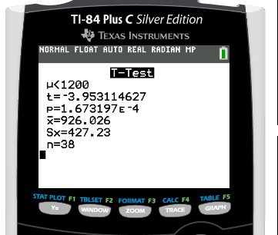
Calculations:

Slide 25
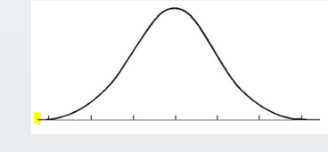
Calculations:
-3.95

Slide 26
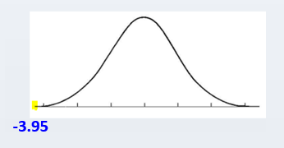
Conclusion:
Since the p-value of 0.00017 is less than the significance level α = 0.05, we have evidence to reject the null hypothesis. We have evidence that it may be plausible for the true mean daily caloric intake of calcium for women 18 to 24 years old to be less than 1200 mg. Our data are statistically significant.
*** NOTE: The conclusion must be written in context of the alternative hypothesis.

Slide 27
Practice Worksheet #4: Mean Difference (Matched Pairs)

Slide 28
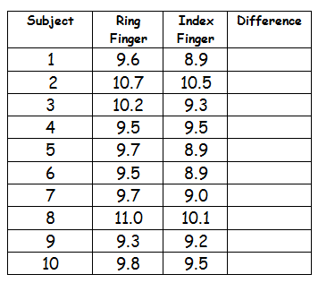
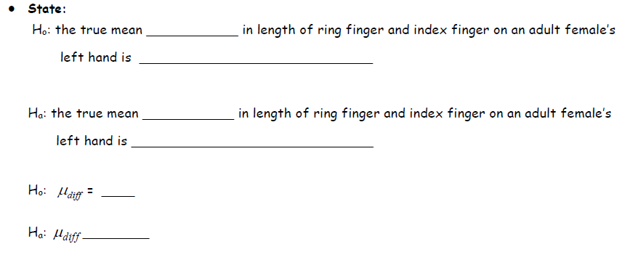
.7
.2
.9
0
.8
.6
.7
.9
.1
.3
L1 L2 L3
difference
0 (“there is no difference” )
difference
greater than 0 (“ring finger is longer than index finger”)
0
> 0

Slide 29
.7
.2
.9
0
.8
.6
.7
.9
.1
.3
Parameter of Interest:
difference
Choice of Test:
1 t means

Slide 30
.7
.2
.9
0
.8
.6
.7
.9
.1
.3
Conditions:
Randomness --- The problem states a SRS of 10 females
was taken.
Independence --- all adult female’s left hand > 10(10)
Condition met for independence.
Large Counts --- The problem states the distribution of
finger lengths is normal.

Slide 31
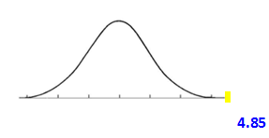
Test Statistic:
10 9 .52
0.05
Conclusion:
Since the p-value of 0.0005 is less than the significance level α = 0.05, we have evidence to reject the null hypothesis. We have evidence that it may be plausible for the true population mean difference in length of the ring finger and the length of the index finger on an adult female’s left hand to be greater than zero. Our data are statistically significant.
*** NOTE: The conclusion must be written in context of the alternative hypothesis.

Slide 32
In Class Assignment: p. 754 #8 (a & b)
Use back of handout for template.

Slide 34
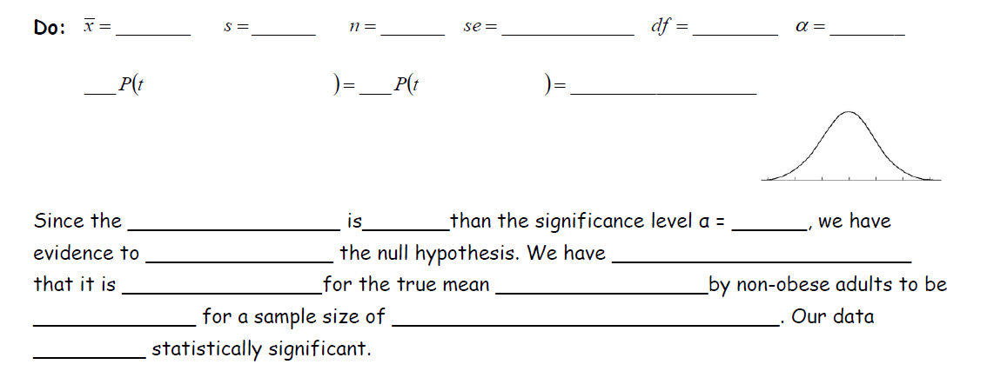
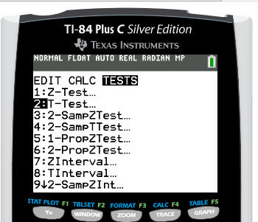
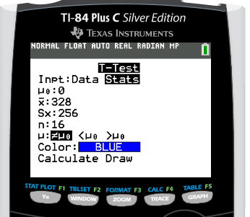
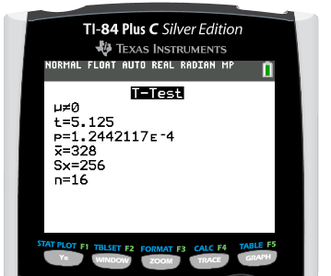
2-sided means the p-value comes from both tails
328 256 16
15
0.05
2
***NOTE: You only calculate area in ONE direction. Inequality is determined by the sign of the test-statistic. Show “double“ the probability to account for both tails. This is just for notation. Calculator gives the doubled p-value when worked for p₀ ≠ or μ_{o} ≠.
p-value is for BOTH tails

Slide 35
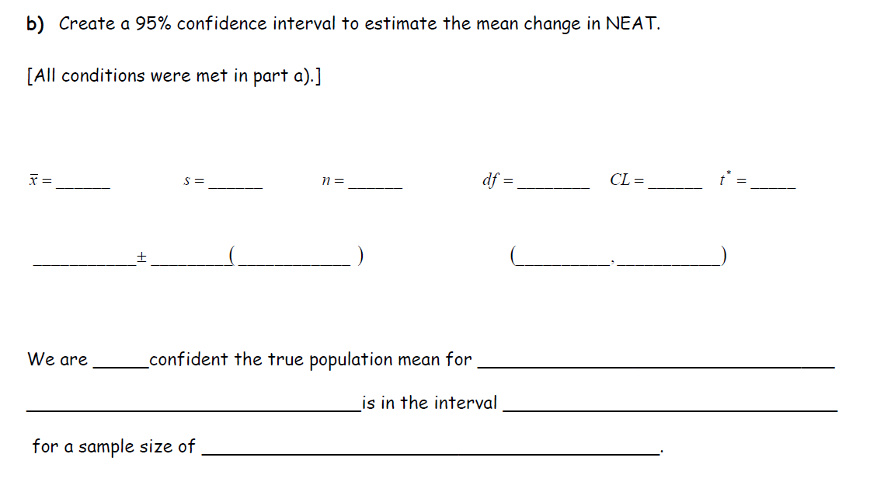
328 256 16 15 .95 2.131

Slide 36
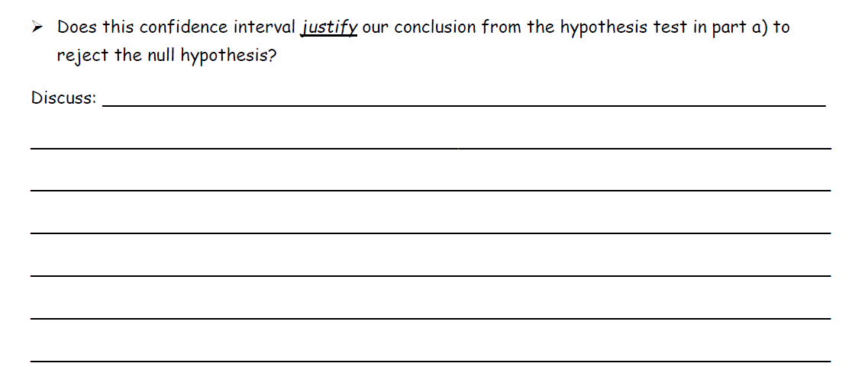

Slide 37
HW “Inference Practice Worksheet #5

