Slide 1
Day 73 Agenda:
Begin Ch 15 Inference For Regression (last topic)

Slide 2
New format for this year’s national exam:
45 minute, online exam. That’s all I know at this time. Topics covered will be released April 3. We are very fortunate to have been on a schedule in which you were able to complete the course. Especially for those of you who may have to take another stat class down the road. Most students will have only completed ½ the course. After spring break, I will include links to released review videos that you can use to help prepare.
All free response. Don’t worry – you have practiced and will continue to practice FR questions.
I will still assign multiple choice during DLD because that is a good way for you to work on your statistical reasoning.
You are doing a great job!! Don’t worry. We got this.

Slide 3
AP STAT
Ch. 15: Inference for Regression Part I
EQ: How do you determine if there is a significant relationship between Y and X in a LSRL?

Slide 4
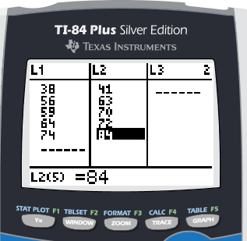
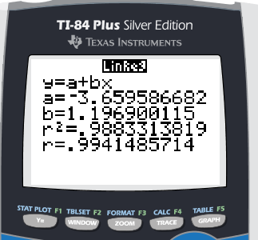
RECALL SOME (REALLY) OLD STUFF:
p. 894 #1
Calculate the LSRL for Humerus length vs Femur length and write it in context.
pred (cm length of humerus) = -3.66 + 1.1969(cm length of femur)

Slide 5
Interpret the slope in context.
On average, for each additional cm length
of the femur, the predicted humerus length increases 1.1969 cm.
Interpret the correlation coefficient in context
The correlation coefficient of 0.994 indicates a strong, positive, linear association between femur length and humerus length. As femur length increases, humerus length increases.

Slide 6
Interpret the coefficient of
determination in context.
On average, approximately 98.8% of the variation in humerus length is accounted for by the LSRL of humerus length on femur length.

Slide 7
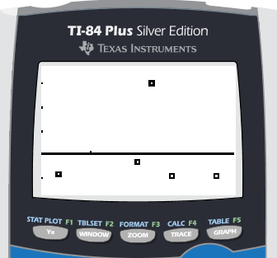
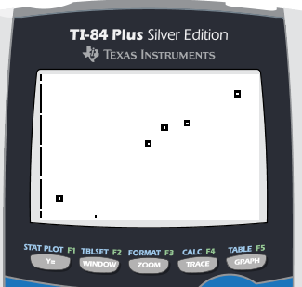
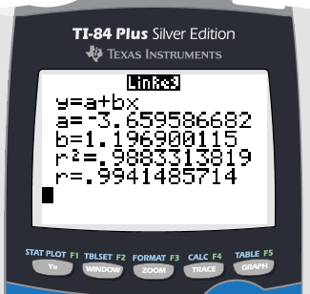
Calculate and graph the residuals. Using the residuals, scatterplot, and the regression analysis, discuss whether you think this linear model is a good fit for this data set.
Residual Plot Scatterplot Regression Analysis
If this linear model best fits this data set, we should see no pattern and/or very small residuals in the residual plot . Our small sample size makes it hard to determine from this residual plot whether a pattern is evident or not. We would need to rely on the scatterplot and regression statistics (coefficient of determination) to help make the decision. Our scatterplot shows a linear trend and the high coefficient of determination of 0.988 indicates this linear model does fit this data set well.

Slide 8
RECALL:
STATISTIC PARAMETER
Now for our last ones … drum roll, please!!

Slide 9
True-Regression Line ---
RECALL:
STATISTIC PARAMETER

Slide 10
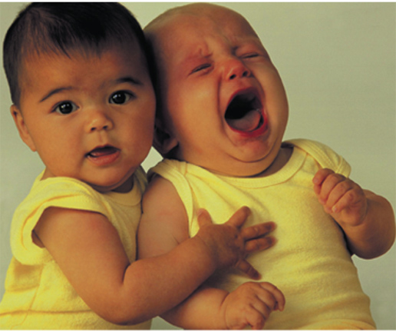
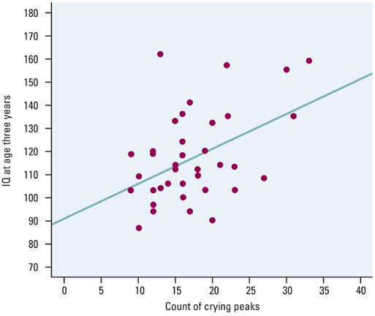
See Ex 1 p. 890
What is the model that we might use to predict IQ from crying peaks?
A baby having 10 crying peaks had an IQ of 87 at 3 years old.
Interpret the selected data point in context of the problem.
Reminder: This is an observed point, not predicted.

Slide 11
Based on this output, what are some statements you can make about the relationship between predicted IQ at three years of age and intensity of their crying as infants?
Discuss Scatterplot :
Discuss Regression
Analysis:
The scatterplot shows a positive, moderately weak, linear relationship between number of crying peaks and IQ. However it contains no extreme outliers or influential points.
Since the scatterplot shows a somewhat linear trend, we can use the correlation coefficient of 0.4549 to describe the direction (positive) and strength (moderately weak) between number of crying peaks and IQ.

Slide 12
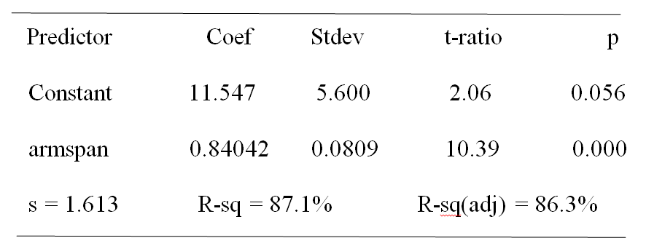
RECALL:
Reading Computer Printout
Refer to p. 895 #2
ZOMBIES
ZOMBIES
Y-intercept
critical value
Coefficient of determination
se_{b}
slope
Standard deviation of the Residuals
p-value

Slide 13
RECALL:
Reading Computer Printout
Refer to p. 895 #2 (follow the questions on the notes)
1) State the equation of the LSRL.
pred (height in inches) = 11.547 + 0.84042(armspan in inches)

Slide 14
2) What is your estimate of β for the true
regression line from the data? Interpret
in context of the problem.
My estimate for β for the true regression line is 0.84042.
On average, for each additional inch in armspan length,
the predicted height increases 0.84042 inches.

Slide 15
3) What is your estimate of the intercept α for the true regression line from the data? Interpret in context of the problem.
My estimate of the intercept α for the true regression line is 11.547 inches. On average, when armspan = 0 inches, the predicted height will be 11.547 inches.
I know --- not possible.

Slide 16
We did this before when we interpreted computer output in Ch 13. See your notes!

Slide 17
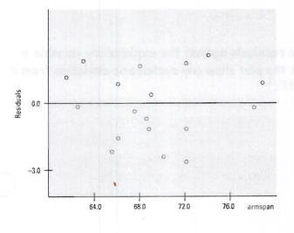
a) Yes, the least-squares line is an appropriate model for the data because the residual plot shows a random scatter of points having small residuals about the zero reference line. Also the coefficient of determination of 87.1% indicates 87.1% of the variation in height is accounted for by the LSRL of height vs predicted arm span.
b) Since 76 is within the data of arm spans examined for this class, it is reasonable to predict the height of a student with 76 in arm span.
RECALL: Interpolation

Slide 18
In Class Example: The following output was created from 20 data samples pairing number of grams of sugar in a cereal with its nutritional rating.
What is your estimate, in context, for the slope, β , of the true regression line?
My estimate for β for the true regression line is -2.4008.
On average, for each additional gram of sugar, the predicted
nutritional rating decreases 2.4008 points.

Slide 19
In Class Example:
2. What is your estimate, in context, for the intercept of the true regression line?
My estimate of the intercept α for the true regression line is 59.284 units. On average, when sugars = 0 g, the predicted nutritional rating will be 59.284 units.

Slide 20
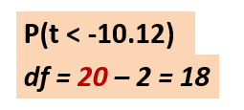
In Class Example
Common MC ? Is to leave values blank.
3. Calculate the missing values in the output.
NOTE: df for Inference for Regression is df = n - 2
Use tcdf(LB, HB, df) to calculate the p-value
tcdf(-100, -10.12, 18)

Slide 21
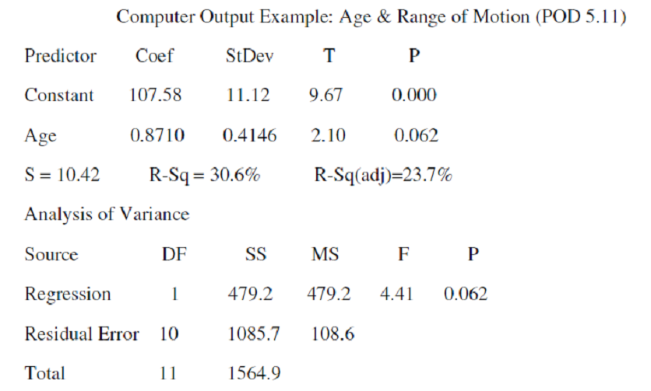
In Class Ex. 2
ZOMBIES!!
ZOMBIES!!
Regression Equation:
S = ___________ SE_{b} =__________
df = n – 2 = ____ therefore n = ___
pred(range of motion) = 107.58 + 0.8710(age)
10.42
0.4146
11
13

Slide 22
Estimate with _____ confidence the slope β of the true regression line:
Confidence Interval:
Conditions for Inference for Regression:
1. Observations are independent.
Can’t have multiple data points about
the same subject.
2. The true relationship is linear.
Check scatterplot for linear trend.

Slide 23
3. The standard deviation of the response
about the line is consistent.
Check residual plot for no pattern and
small residual values.
4. Check for Normalcy.
Make histogram of residuals and check for skewness or outliers (influential points which can alter the slope of the LSRL).

Slide 24
On the AP Stat Exam, they will probably tell you the conditions for Inference for Regression have been met. You will simply need to ACKNOWLEDGE the four conditions.
“Independence, linear relationship, spread about line stays the same, and Normality are stated in problem as having been met”.

Slide 25
State:
We will create a 90% confidence interval to estimate the true average rate of change for height (inches) versus armspan (inches).
Plan:
β = true average rate of change for height (inches) versus in of armspan

Slide 26
Plan:
Conditions:
The problem states that the conditions for inference – independence, linearity, standard deviation constant, and Normality have been met.

Slide 27
Do:
df = 20 – 2 = 18 t*= 1.734 CL = .90
Confidence Interval:

Slide 28
Calculate “long-hand”. No Conf Int for Slope/Regression function on your calculator.
Interpret in context of SLOPE
With 90% confidence, we can estimate that for each additional inch in arm span, the predicted height will increase on average between 0.7001 to 0.9807 inches.

Slide 29
Ex 4 Find a 95% confidence interval for the slope of the true regression line for the age and range of motion problem.
We will create a 95% confidence interval to estimate the true slope of the regression line for predicted range of motion versus age in years.
State:
Plan:
β = true slope of the regression line for predicted range of motion versus age in years

Slide 30
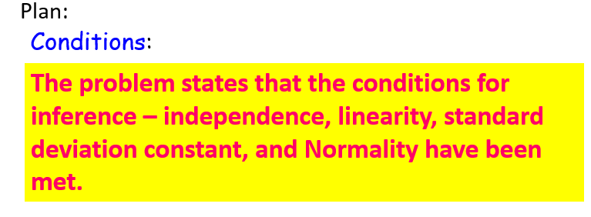

Slide 31
Interpret in context of SLOPE
We are 95% confident for each additional year in age, the predicted range of motion will increase on average -0.0415 to 1.7835 degrees.

Slide 32
Assignment p. 901 #8(a, b, d) #9

