Slide 1
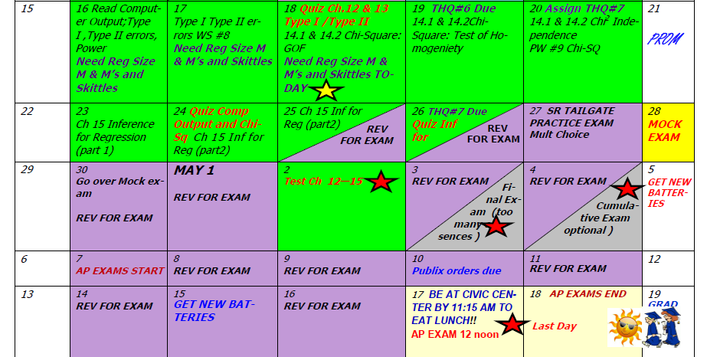
Day 68 Agenda:
30 minute workday on Hypothesis Test --- you have 9 worksheets to use as practice
Begin Ch 15 (last topic)

Slide 2
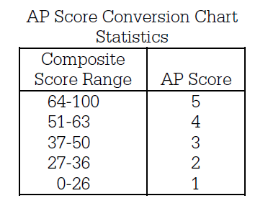
Here are 2 examples of the cut scores needed to make a 1, 2, 3, 4, or 5.
2012 AP Stat Exam
2015 AP Stat Exam

Slide 3
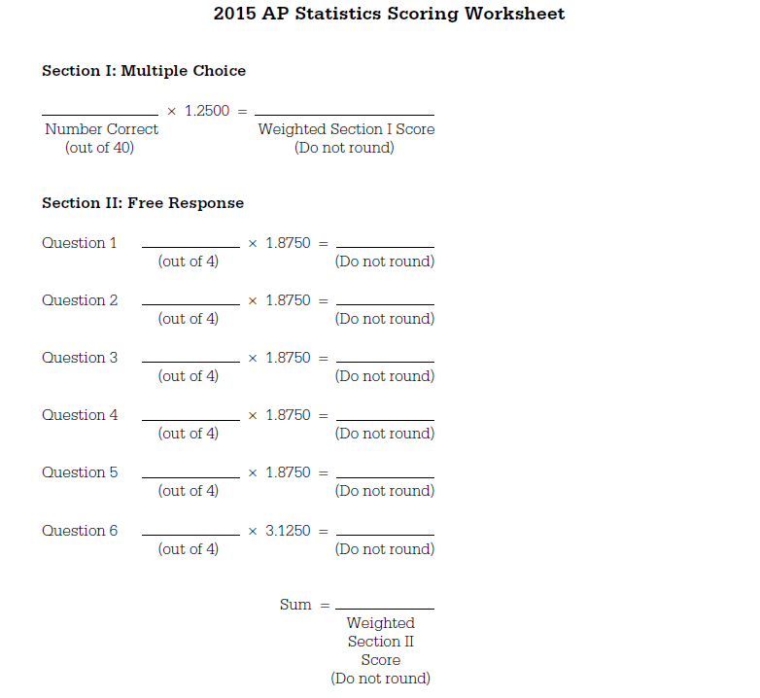

Slide 5
AP STAT
Ch. 15: Inference for Regression Part I
EQ: How do you determine if there is a significant relationship between Y and X in a LSRL?

Slide 6
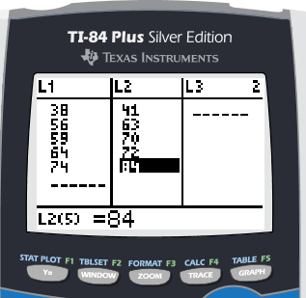
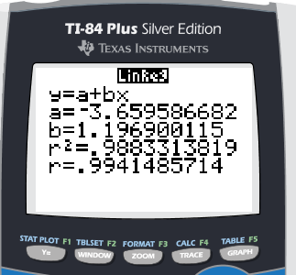
RECALL SOME (REALLY) OLD STUFF:
p. 894 #1
Calculate the LSRL for Humerus length vs Femur length and write it in context.
pred (cm length of humerus) = -3.66 + 1.1969(cm length of femur)

Slide 7
Interpret the slope in context.
On average, for each additional cm of length
for the femur, the predicted humerus length increases 1.1969 cm.
Interpret the correlation coefficient in context
The correlation coefficient of 0.994 indicates a strong, positive, linear association between femur length and humerus length. As femur length increases, humerus length increases.

Slide 8
Interpret the coefficient of
determination in context.
On average, approximately 98.8% of the variation in predicted humerus length is accounted for by the LSRL of humerus length on femur length.

Slide 9
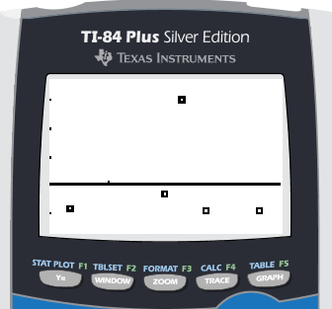
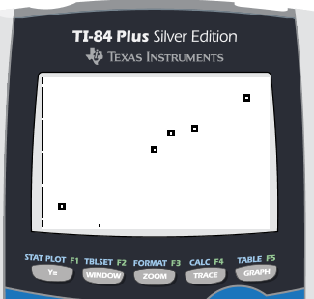
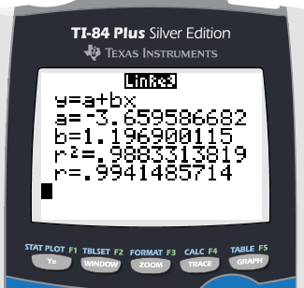
Calculate and graph the residuals. Using the residuals, scatterplot, and the regression analysis, discuss whether you think this linear model is a good fit for this data set.
Residual Plot Scatterplot Regression Analysis
If this linear model best fits this data set, we should see no pattern in the residual plot . Our small sample size makes it hard to determine from this residual plot whether a pattern is evident or not. We would need to rely on the scatterplot and regression statistics (coefficient of determination) to help make the decision. Our scatterplot shows a linear trend and the high coefficient of determination of 0.988 indicates this linear model does fit this data set well.

Slide 10
RECALL:
STATISTIC PARAMETER
Now for our last ones … drum roll, please!!

Slide 11
True-Regression Line ---
RECALL:
STATISTIC PARAMETER

Slide 12
Day 69 Agenda:

Slide 13
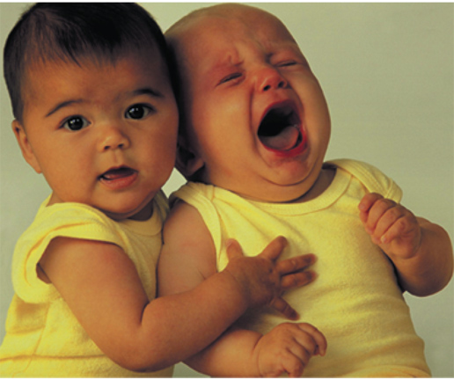
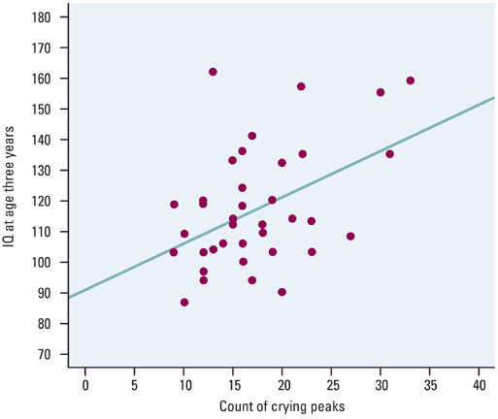
See Ex 1 p. 890
Interpret the selected data point in context of the problem.
What is the model that we might use to predict IQ from crying?

Slide 14
Based on this output, what are some statements you can make about the relationship between predicted IQ at three years of age and intensity of their crying as infants?
Discuss Scatterplot :
Discuss Regression Analysis:

Slide 15
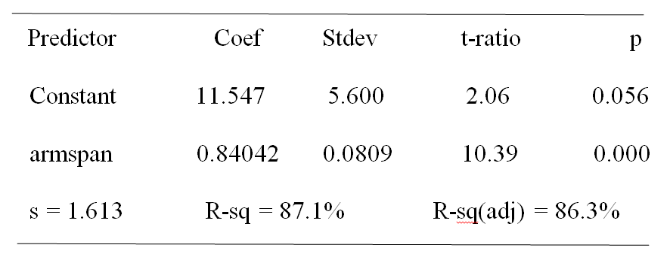
RECALL:
Reading Computer Printout
Refer to p. 895 #2
ZOMBIES
ZOMBIES
Y-intercept
critical value
Coefficient of determination
se_{b}
slope
Standard deviation of the Residuals
p-value

Slide 16
RECALL:
Reading Computer Printout
Refer to p. 895 #2 (follow the questions on the notes)
1) State the equation of the LSRL.
pred (height in inches) = 11.547 + 0.84042(armspan in inches)

Slide 17
2) What is your estimate of β for the true
regression line from the data? Interpret
in context of the problem.
My estimate for β for the true regression line is 0.84042.
On average, for each additional inch in armspan length,
the predicted height increases 0.84042 inches.
3) What is your estimate of the intercept α for the true regression line from the data? Interpret in context of the problem.
My estimate of the intercept α for the true regression line is 11.547 inches. On average, when armspan = 0 inches, the predicted height will be 11.547 inches.

Slide 18
Yes, the least-squares line is an appropriate model for the data because the residual plot shows a random scatter of points about the zero reference line. Since 76 is in within the data of arm spans examined for this class, it is reasonable to predict the height of a student with 76 in arm span.

Slide 19
In Class Example: The following output was created from 20 data samples pairing number of grams of sugar in a cereal with its nutritional rating.
What is your estimate, in context, for the slope, β , of the true regression line?
My estimate for β for the true regression line is -2.4008.
On average, for each additional gram of sugar, the predicted
nutritional rating decreases 2.4008 points.

Slide 20
In Class Example:
2. What is your estimate, in context, for the intercept of the true regression line?
My estimate of the intercept α for the true regression line is 59.284 units. On average, when sugars = 0 g, the predicted nutritional rating will be 59.284 units.

Slide 21
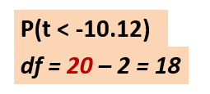
In Class Example
Common MC ? Is to leave values blank.
3. Calculate the missing values in the output.
NOTE: df for Inference for Regression is df = n - 2
Use tcdf(LB, HB, df) to calculate the p-value
tcdf(-100, -10.12, 18)

Slide 22
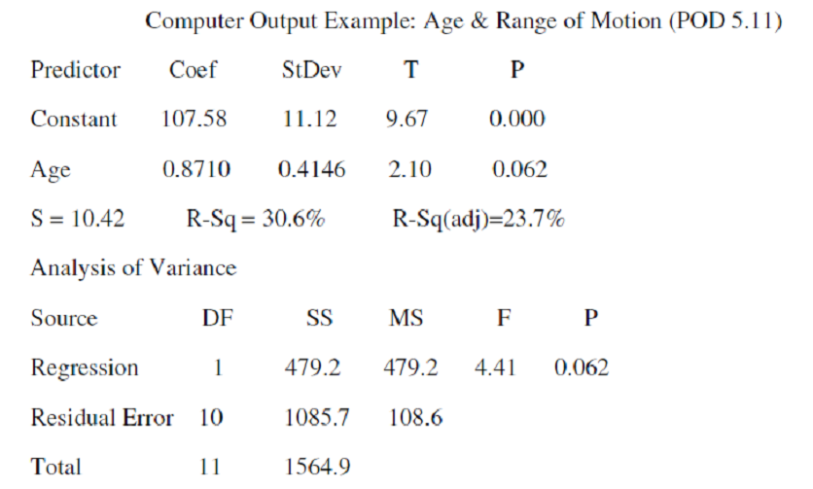
In Class Ex. 2
ZOMBIES!!
ZOMBIES!!
Regression Equation:
S = ___________ SE_{b} =__________
df = n – 2 = ____ therefore n = ___
pred(range of motion) = 107.58 + 0.8710(age)
10.42
0.4146
11
13

Slide 23
Estimate the slope β of the true regression line:
Confidence Interval:
Conditions for Inference for Regression:
1. Observations are independent.
Can’t have multiple data points about
the same subject.
2. The true relationship is linear.
Check scatterplot for linear trend.

Slide 24
3. The standard deviation of the response
about the line is consistent.
Check residual plot for no pattern.
4. Check for Normalcy.
Make histogram of residuals and check for skewness or outliers (influential points which can alter the slope of the LSRL).

Slide 25
On the AP Stat Exam, they will probably tell you the conditions for Inference for Regression have been met. You will simply need to ACKNOWLEDGE the four conditions.
“Independence, linear relationship, spread about line stays the same, and Normality are stated in problem as having been met”.

Slide 26
State:
We will create a 90% confidence interval to estimate the true slope of the regression line for predicted in of height versus in of armspan.
Plan:
β = true slope of the regression line for predicted in of height versus in of armspan

Slide 27
Plan:
Conditions:
The problem states that the conditions for inference – independence, linearity, standard deviation constant, and Normality have been met.

Slide 28
Do:
df = 20 – 2 = 18 t*= 1.734 CL = .90
Confidence Interval:

Slide 29
Interpret in context of SLOPE
With 90% confidence, we can estimate that for each additional inch in arm span, the predicted height will increase on average between 0.7001 to 0.9807 inches.

Slide 30
Ex 4 Find a 95% confidence interval for the slope of the true regression line for the age and range of motion problem.
We will create a 95% confidence interval to estimate the true slope of the regression line for predicted range of motion versus age in years.
State:
Plan:
β = true slope of the regression line for predicted range of motion versus age in years

Slide 31
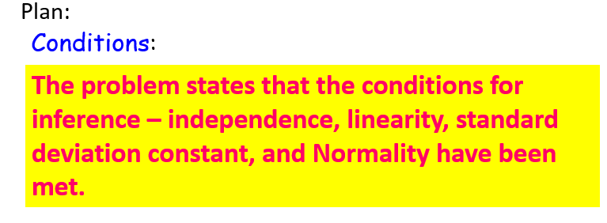

Slide 32
Interpret in context of SLOPE
We are 95% confident for each additional year in age, the predicted range of motion will increase on average -0.0415 to 1.7835 degrees.

Slide 33
Assignment p. 901 #8(a, b, d) #9

