Slide 1
AP STAT
Ch. 15: Inference for Regression
Part II
EQ: How do you spot a meaningless
regression analysis?

Slide 2
Hypotheses for Inf for Reg:
H₀ : there is no true linear relationship
between x and y
H_{a} : there is a true linear relationship between x and y
H₀: β = 0
H_{a}: β > 0 or β < 0 or β ≠ 0
NOTE: You will have to decide direction.

Slide 3
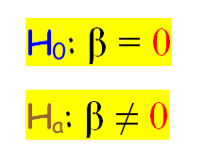
RECALL: Data on Crying Babies
This is a “shell” of how to run the test.”
“there is a difference” --- Just don’t know direction!
H₀ :there is no true linear relationship between cry count of babies and IQ at 3 years old
H_{a} : there is a true linear relationship between cry count of babies and IQ at 3 years old

Slide 4
Conditions: [I forgot to include this part in your notes!]
“Independence, linear relationship, spread about line stays the same, and Normality are stated in problem as having been met”.

Slide 5
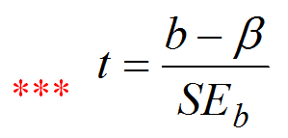


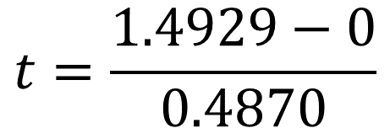
Pay Attention:
Sometimes H₀: β = #
that is not 0!!
df = 38 – 2 = 36 α = 0.05
$$t=\frac{1.4929−0}{0.4870}$$
$$t=3.0655$$
2
> 3.07 0.004

Slide 6
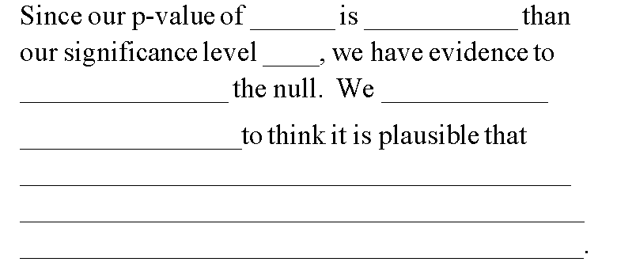
2
> 3.07 0.004
0.004 less
0.05
have
evidence
reject
there is a linear relationship between cry count and IQ of babies. Our data is statistically significant.

Slide 7
Based on this conclusion from the hypothesis test, what values would you expect to be found in a 95% confidence interval?
Since it is plausible that there may be a linear relationship, I would expect 0 to not be included in the confidence interval.

Slide 8
What about the confidence interval could help you decide on a possible direction for the linear relationship?
Positive values captured in the confidence interval would imply a positive linear relationship. As crying counts increase, IQ increases.
Negative values captured would imply a negative linear relationship. As crying counts increase, IQ decreases.

Slide 9

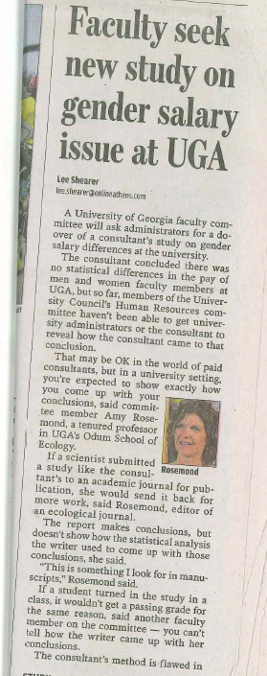

Slide 10
In Class p. 904 #7 BEER & BAC
Place data into L₁ and L₂ if you deleted these lists.
Verify that your information matches that found in the Minitab output on p. 905.
State the LSRL for this data.
_______________________________
pred(BAC) = -0.0127 + 0.0180 (# of Beers consumed)

Slide 11
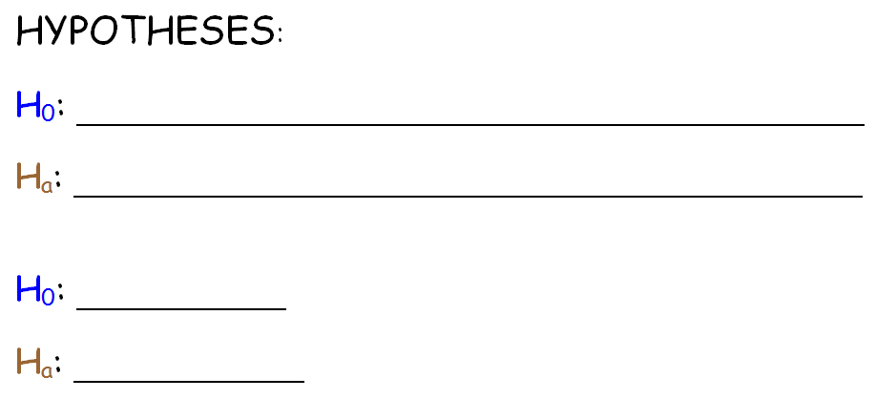
We want to test the claim “the number of beers consumed has no effect on BAC vs the number of beers consumed increases BAC”.
State:
there is no true linear relationship between # of beers consumed and BAC
there is a positive true linear relationship between # of beers consumed and BAC
β = 0
β > 0

Slide 12
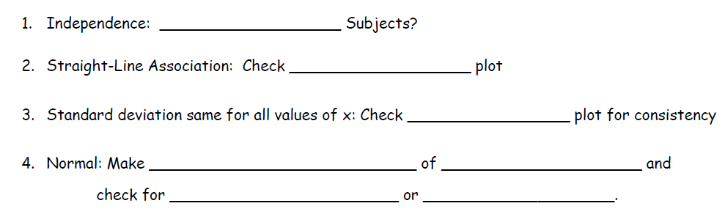
X
“Independence, linear relationship, spread about line stays the same, and Normality are stated in problem as having been met”.

Slide 13
Plan:
t test for slope (regression)
β = the true average rate of change between # of beers consumed and BAC

Slide 14
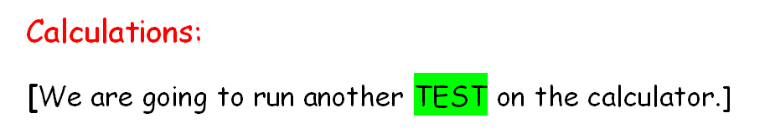
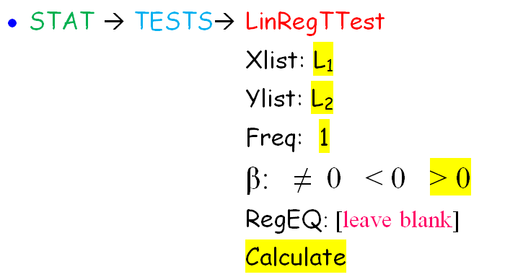
or BEER
or BAC

Slide 15
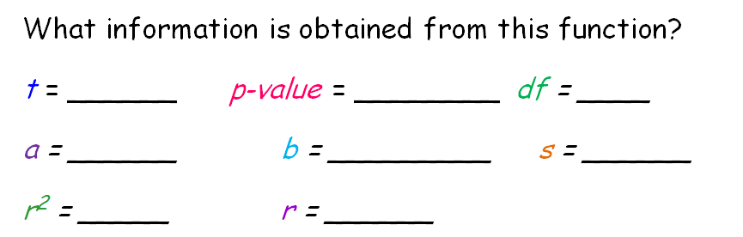


Compare your output to that on page 905.
7.479
0.0000015
14
-0.0127
0.0179
0.0204
0.7998
0.8943
0.0024
> 7.479 0.0000015

Slide 16
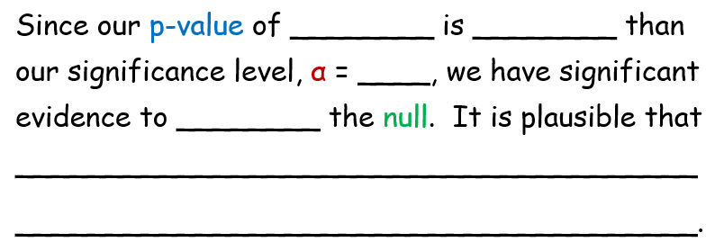
0.00002 less
0.05
reject
there is a true positive linear relationship between number of beers consumed and BAC. We have evidence to conclude it is possible that an increased number of beers consumed does increase BAC. Our data is statistically significant.
In class p. 908 #11, 12

Slide 17
In class p. 908 #11, 12
#11 a)
b)
pred(length of humerus) = -3.6596 + 1.1969(length of femur)
3
c) Given n = 5, then df = _____ ? Use the
t-distribution function to calculate a p-value.
d) Interpret your p-value in context of the problem.
P(t > 15.94) =0.00027
P(t > 15.94)
Recall: df for regression
is n - 2
tcdf(15.94, 100, 3)

Slide 18
#11 d) Interpret your p-value in context of the problem
P(t > 15.94) =0.00027
Since our p-value of 0.00027 is smaller than any significance level (i.e. α = .01), we have evidence to reject the null. We have evidence that it may be plausible that there is a positive linear relationship between length of femur and length of humerus. That is, that the line may be useful in predicting the length of the humerus when given the length of the femur. Our data is statistically significant.

Slide 19
e) Calculate and interpret a 99% confidence interval for the true slope if the regression line.
df = 3 t* = 5.841
There is not a conf int function on your calculator for this. You must calculate long hand.
From t-distribution table

Slide 20
e) Calculate and interpret a 99% confidence interval for the true slope if the regression line.
Interpret: REMEMBER YOU ARE CREATING A CONFIDENCE INTERVAL FOR SLOPE.
We are ___________ confident that, on average, for each additional __________in ________________, the predicted ___________________ will ______________ between _______________ and _______________.
99%
centimeter
femur length
humerus length
increase
0.7582 cm
1.63562 cm

Slide 21
#12 a)
b)
The Correlation Coefficient of r = 0.9989, indicates an almost perfect linear association between running speed and steps per second.
The p-value is very small, less than 0.001, which gives strong evidence to reject the null and conclude it is plausible that there exists a straight-line association between running speed and steps per second.
The parameter that gives the rate is the slope, β. This value is 0.080284.

Slide 22
#12
Calculate:
We are ___________ confident that, on average, for each additional ___________per ______________ of running speed, the predicted steps per second will _____________
between _____________and __________.
df = 5 t* = 4.032
99%
foot
second
increase
0.0738
0.0867

Slide 23

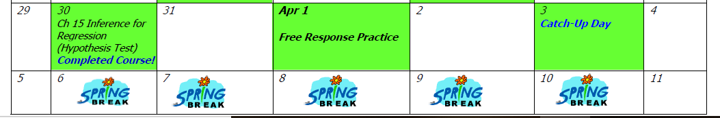

Slide 24
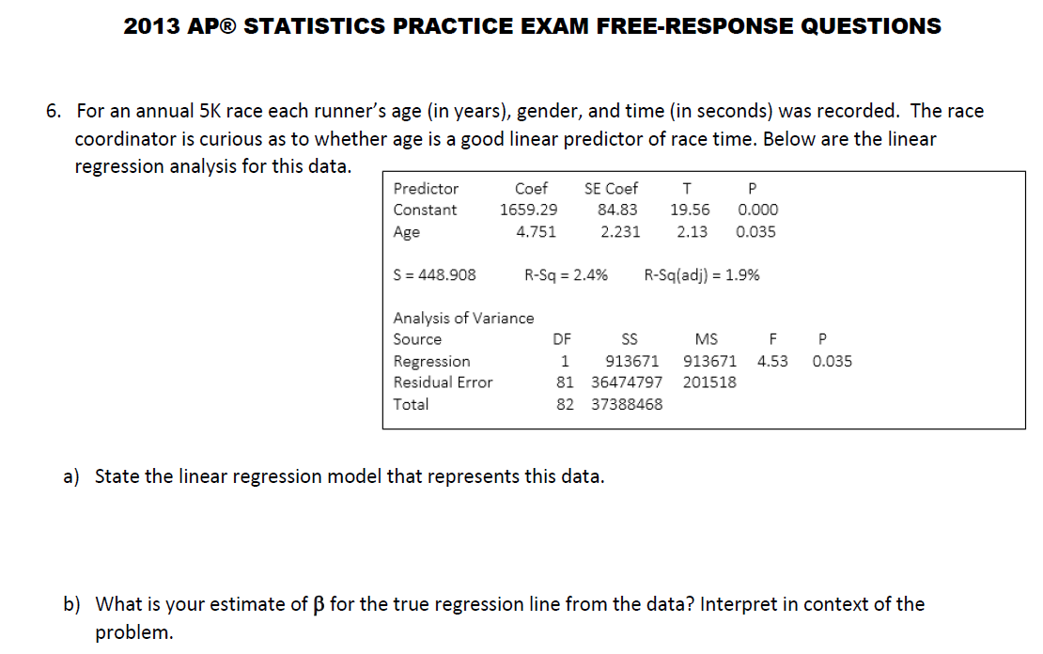

Slide 25
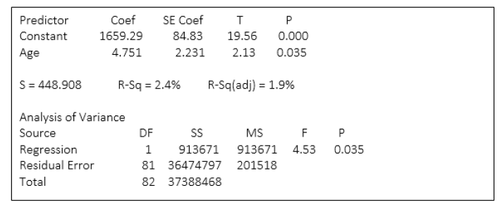
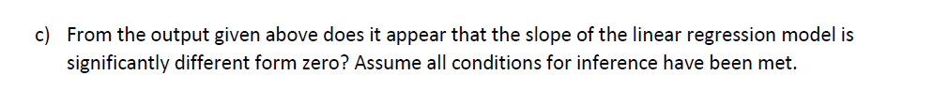

Slide 26
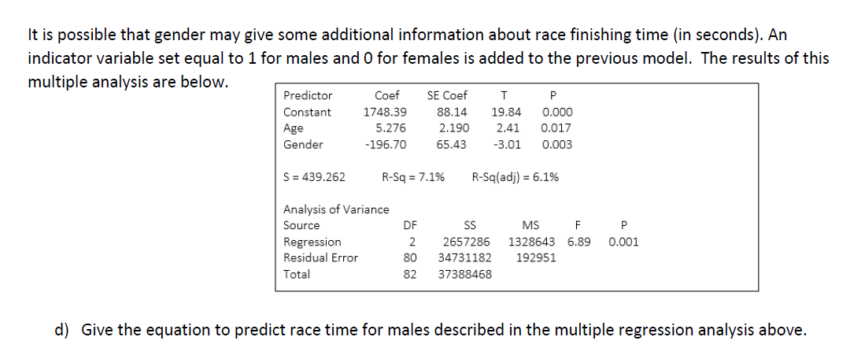
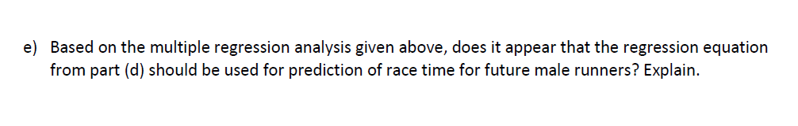

Slide 27
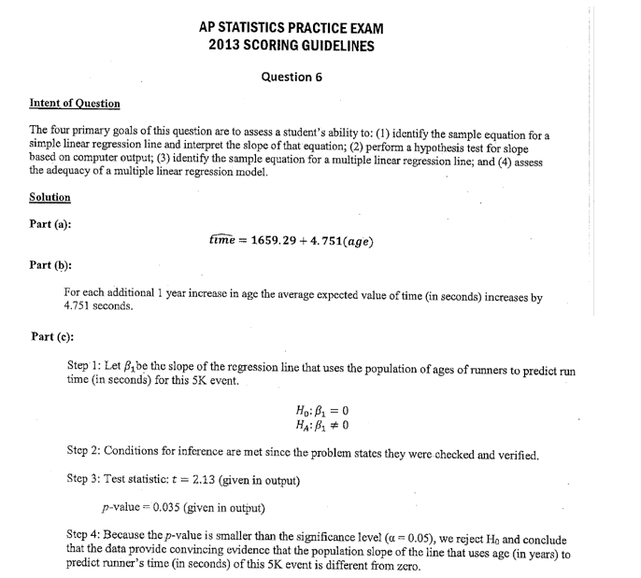

Slide 28
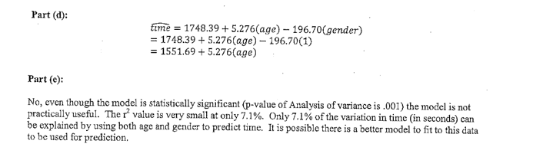

Slide 29
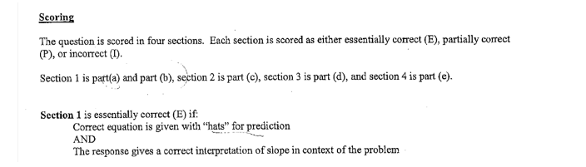
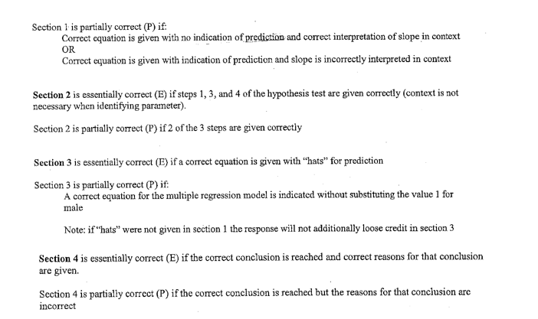

Slide 30
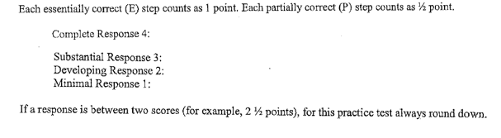

Slide 31
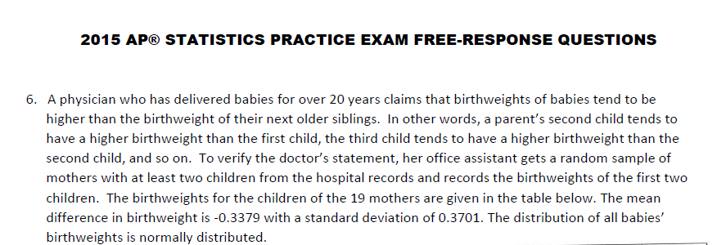

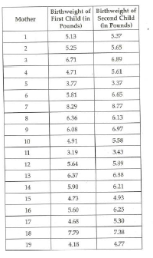

Slide 32
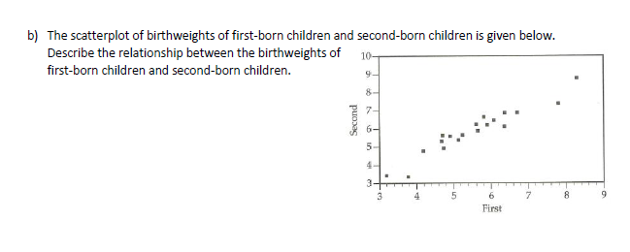

Slide 33
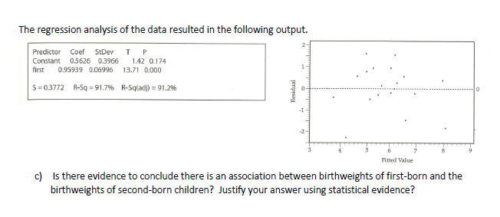

Slide 34
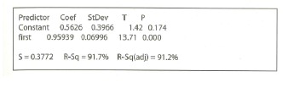
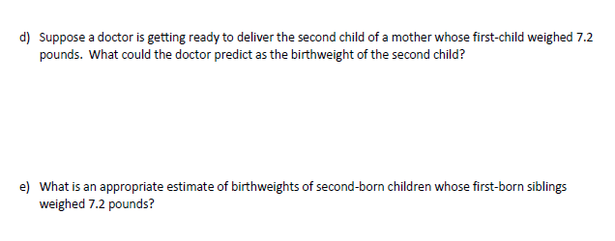

Slide 35
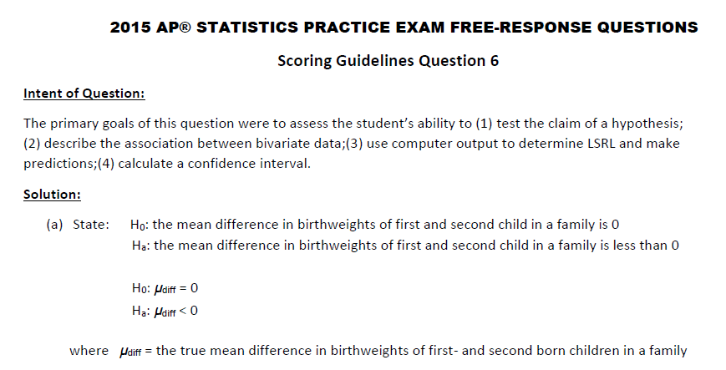

Slide 36
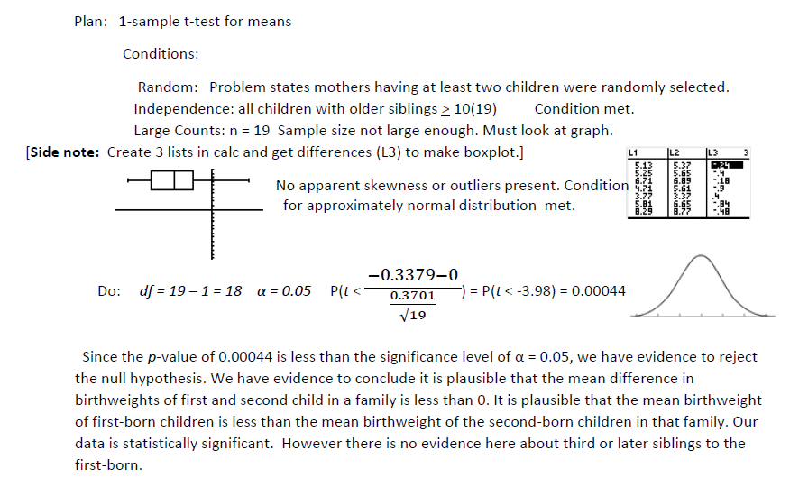
SKETCH

Slide 37
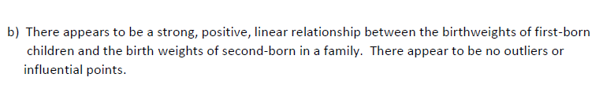
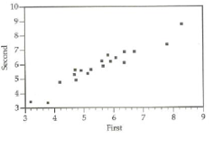
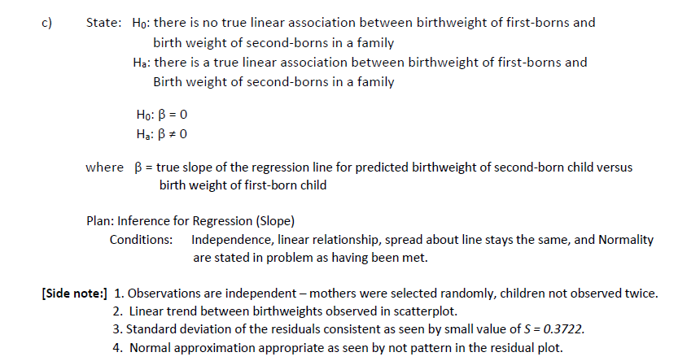
t-test for slope

Slide 38
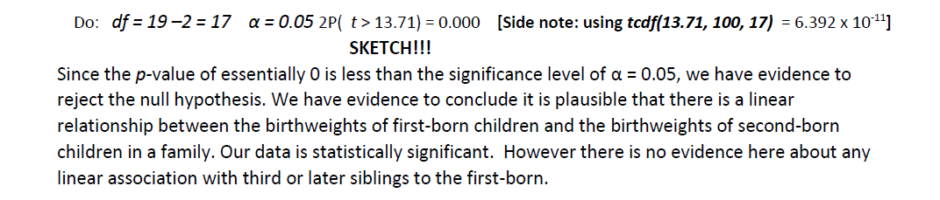
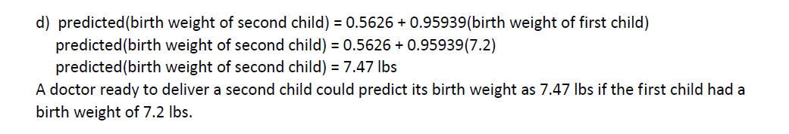

Slide 39
