Slide 1
Day 64 Agenda:
AP Stat Ch 13.2
Interpreting Computer Output

Slide 2
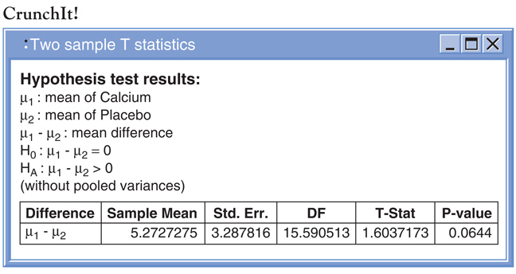
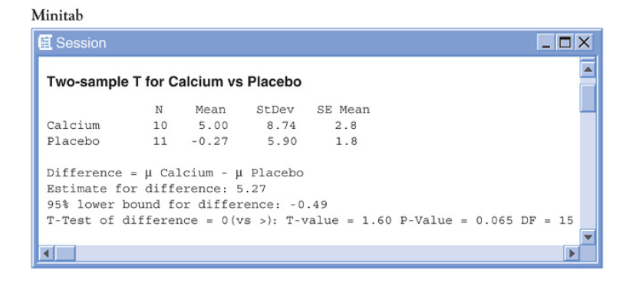
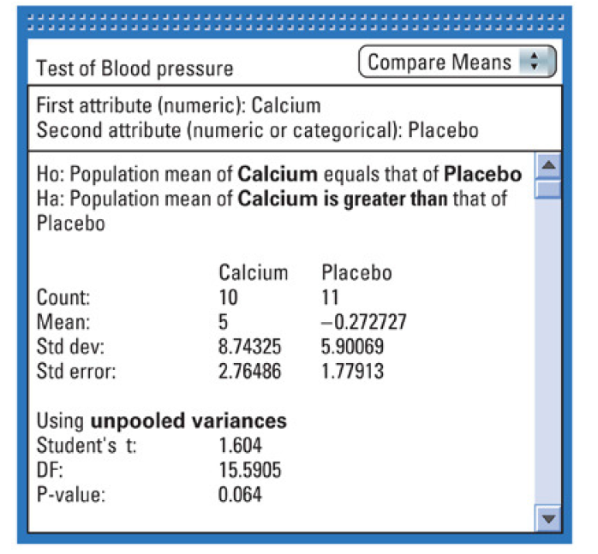
Reading Computer Output:
What type of significance test is this?
2. Is this a one-sided or two-sided test? How can you tell?
2 sample t-test for means
One-sided
> used in alternative
“calcium is greater than”

Slide 3
Reading Computer Output:
3. What does 5.272727 represent and how was it calculated?
4. What numbers in the output are used to calculate the
t-statistic?
Difference in the sample means

Slide 4
Reading Computer Output:
5. Write the probability statement represented by this output.
6. Does our data show significance at the 5% level?
Since our p-value of 0.064 is greater
than α=0.05, we have evidence to fail to reject the null. We do not have enough evidence to conclude it is plausible calcium levels are greater than placebo levels. Our data are not statistically significant.

Slide 5
Reading Computer Output:
7. Use this output to create a 90% confidence interval.
Remember: t* for 2-sample means is in calculator, not from table

Slide 6
Reading Computer Output:
7. Use this output to create a 90% confidence interval.
We are 90% confident the true difference in
mean levels of calcium and a placebo
are in the interval -.478 units to
11.02. Since this confidence interval captures
0, it supports our conclusion to fail to reject the
null. We do not have enough evidence to conclude
it is plausible the population mean Calcium levels
are greater than the population mean placebo level Placebo. Our data are not statistically significant.

Slide 7
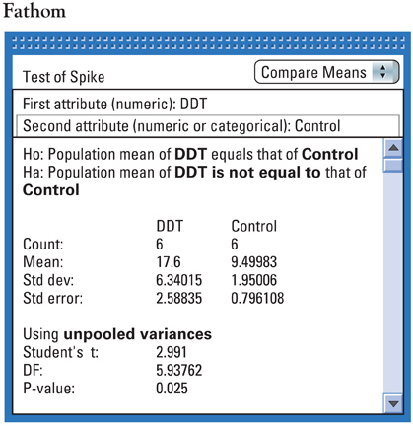
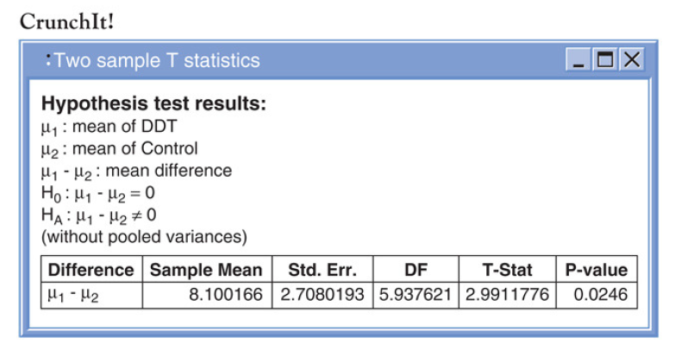
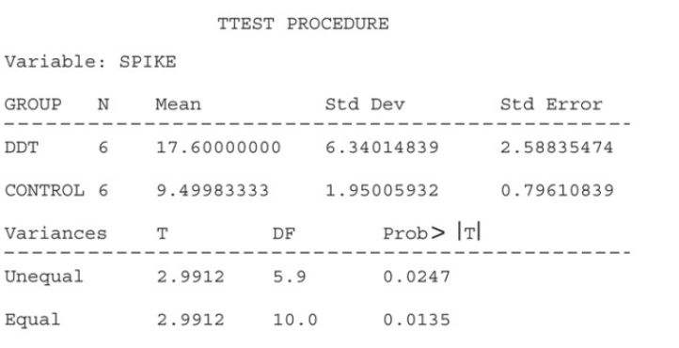
8. What type of significance test is this?
9. Is this a one-sided or
two-sided test? How can you tell?
2 sample t-test for means
two-sided ≠ used in alternative
“DDT is not equal to”

Slide 8
10. Write a probability statement that represents this output. Interpret your p-value at a
10% significance level.
Since our p-value of 0.0247 is less
than α=0.10, we have evidence to
reject the null. We can conclude it is plausible the population mean of DDT levels is not equal to the population mean of the Control levels. Our data are statistically significant.

Slide 9
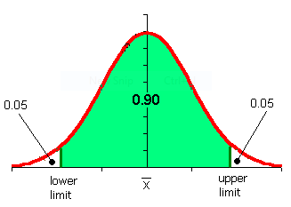
11. What is an appropriate confidence level to use to calculate a confidence interval for this output? Calculate this interval.
Since our significance level is 10%, an appropriate confidence level would be 90%.

Slide 10
11. What is an appropriate confidence level to use to calculate a confidence interval for this output? Calculate this interval.

Slide 11
11. What is an appropriate confidence level to use to calculate a confidence interval for this output? Calculate this interval.
Since this confidence interval
captures only values greater than 0, it
supports our conclusion to reject the
null and conclude it is plausible there is a difference in the mean levels of DDT and the placebo. Our data are statistically significant

Slide 12
Assignment
p. 801 - 805 #15 (a), 16 (a, b), 23
THQ#6 Due Thurs, April 19, 2018
AP STAT Mock Exam Sat, April 28, 2018

