Slide 1
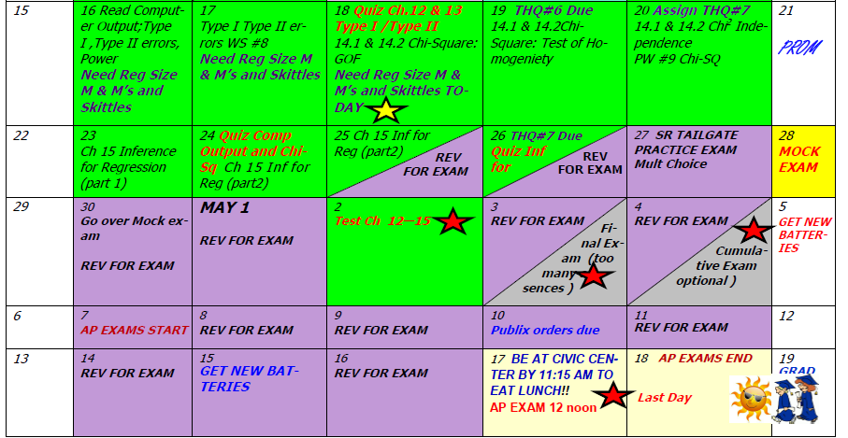
Day 67 Agenda:
Submit THQ #6 Answers

Slide 2
AP STAT
Ch. 14.: X² Tests
1. Goodness of Fit
2. Homogeneity
3. Independence
EQ: What are expected values and how are they used to calculate Chi-Square?

Slide 3
Chi-Square Hypothesis Testing PART 2:
Goodness of Fit ☑
Test of Homogeneity of Populations
--- use the χ² test function on the calculator; enter your contingency table in Matrix A.

Slide 4
Use when separate surveys are conducted on different populations and you want to test whether they are homogeneous with respect to one variable
Calculate the expected frequencies for each cell using
[(row total)(column total)]/grand total
*** These values will be found in
MATRIX B after you run the χ² test function

Slide 5
Calculate (Obs – Exp)²/Exp for each cell then add them to get the χ²test statistic.
df = (row – 1)(column – 1)
Data is conveyed in a contingency table
(at least 2 rows and 2 columns)

Slide 6
In Class Example:for Chi-Square Test of Homogeneity:
p. 866 #15 (refers to p. 855 & 856 #11)
p₁
p₂
p₃
p₄
p₁
p₂
p₃
p₄
the proportion of smokers who quit smoking is the same for each group
the proportion of smokers who quit smoking is not the same for each group
the true proportion of smokers who quit smoking using a nicotine patch
the true proportion of smokers who quit smoking using a drug
the true proportion of smokers who quit smoking using a patch and drug
the true proportion of smokers who quit smoking using a placebo

Slide 7
Homogeneity
1. SRS --- The problem states…
2. all expected counts must be > 1
80% of expected counts values in cells must be > 5

Slide 8
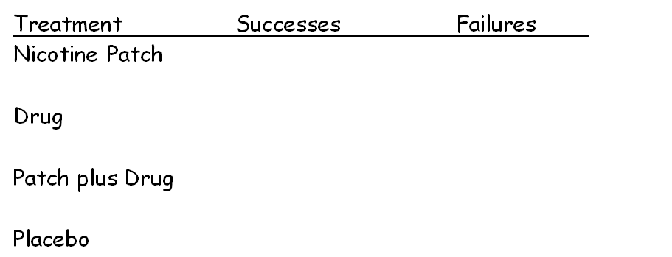
SRS --- The problem states…
all exp counts must be > 1
80% of exp counts values in cells must be > 5
40 204 244
74 170 244
87 158 245
25 135 160
226 667 893

Slide 9
SRS
all expected counts must be > 1
80% of exp counts values in cells must be > 5
Conditions met, see table.
(182.25)
40 204 244
(61.75)
(182.25)
74 170 244
(61.75)
(62)
(183)
87 158 245
(40.49)
(119.51)
25 135 160
226 667 893

Slide 10
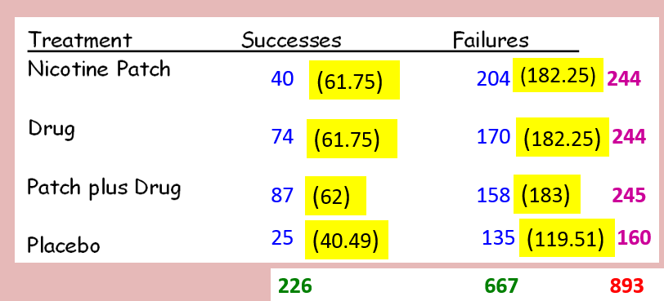
RECALL: Formula for Expected Value using Marginal Totals
Calculate the expected frequencies for each cell using [(row total)(column total)]/grand total
61.75
Ex. [(226)(244)]/893 = _______

Slide 11
df = (4 – 1)(2 – 1) = 3 α = .05
34.937
1.256 x 10⁻⁷
Since our p-value of 0.00000013 is less than our significance level of 5%, we have evidence to reject the null. We can possibly conclude that the proportion of smokers who quit smoking are not the same. Our data is statistically significant.

Slide 12
This would just be a 2 sample z-test for proportions!
But you would have to POOL the 2 sample z-test .
So the converse of this is…
*** If the 2 sample z-test for proportions is TWO-SIDED,
You can run it as a chi-square test.

