Slide 1
Day 74 Thurs Mar 26 AGENDA:
Submit THQ # 6 by 7 pm Thurs, Mar 26

Slide 2
Chi-Square Hypothesis Testing PART 3:
I. Goodness of Fit ☑
Test of Homogeneity of Populations ☑
III. Test for Independence/Association --- use the χ² test function on the calculator; you will need to enter your contingency table in Matrix A.

Slide 3
Use when one population is surveyed and you are testing the independence or association of two categorical variables within that population
Calculate the expected counts for each cell using
[(row total)(column total)]/grand total
*** These values will be found in Matrix B once you run the χ² test.

Slide 4
Calculate (Obs – Exp)²/Exp for each cell then add them to get the χ²test statistic.
df = (row – 1)( column – 1)
Data is conveyed in a contingency table (at least 2 rows and 2 columns)

Slide 5
Only change in Template is in Hypothesis:
H_{o}: there is not an association between [variable 1] and [variable 2]
H_{a}: there is an association between [variable 1] and [variable 2]
Only written in words, not symbols. But must be written in context of the problem.

Slide 6
In Class Assignment: p. 875 #24
(refers to #22)
State:
H_{o}: ____________________________
H_{a}: _____________________________
there is no association between the smoking habits of parents and the smoking habits of their children
there is an association between the smoking habits of parents and the smoking habits of their children
Plan: χ²- test for __________
Independence/association

Slide 7
Conditions:
____________________________
2. ____________________________
SRS --- The problem states…
all expected counts must be > 1
80% of expected counts values in cells must be > 5

Slide 8
Student Smokes Student Does Not Smoke
Both Parents Smoke
One Parent Smokes
Neither Parent Smokes
(1780)(1004)/5375 = 332
(1448)
400 1380 1780
(332)
(418)
(1821)
416 1823 2239
(1103)
188 1168 1356
(253)
1004 4371 5375
Create Matrix A, run the χ²-test , get your expected counts from Matrix B.

Slide 9
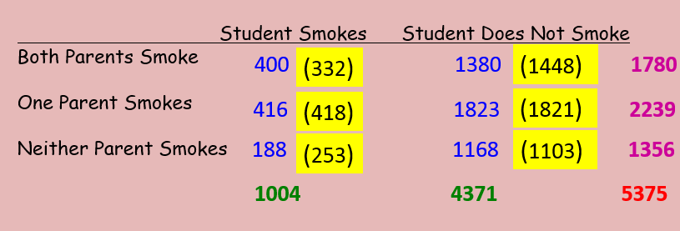
Conditions:
____________________________
2. ____________________________
SRS --- The problem states…
all exp counts must be > 1
80% of exp counts values in cells must be > 5
Condition
met, see
table.

Slide 10
df = (3 – 1)(2 – 1) = 2 α = .05
Calculation: χ² = __________________
P( χ² > _______) = __________
37.57
0.000000007
From the calculator after you run the test.

Slide 11
Since our p-value of 0.000000007 is less than our significance level of 5%, we have evidence to reject the null. We have evidence to conclude it is plausible there is an association between the smoking habits of parents and the smoking habits of their children. Our data are statistically significant.

Slide 12
Know the difference between the types of χ² tests:

Slide 13
Assignment p. 878 #29, 31 (a, c)
Inference Practice Worksheet #9

