Slide 1
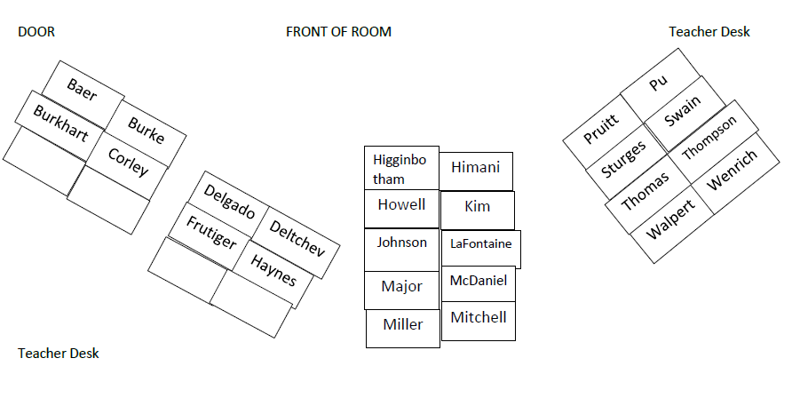
Welcome to Advanced Placement Statistics

Slide 2
WELCOME TO
AP STATISTICS
Course Objective: The student will master the statistics concepts taught in this course and possibly earn college credit by obtaining a passing grade of 3, 4, or 5 on the National Advanced Placement Statistics Examination.

Slide 3

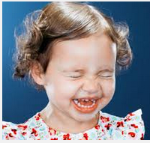
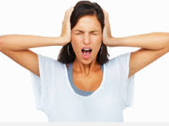
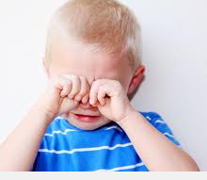
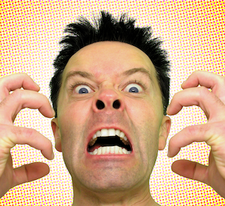

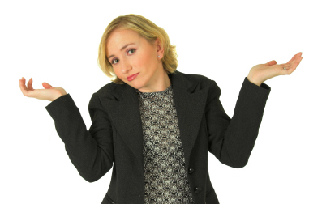

You will have a
Rollercoaster of Emotions this semester in AP Stat:

Slide 4
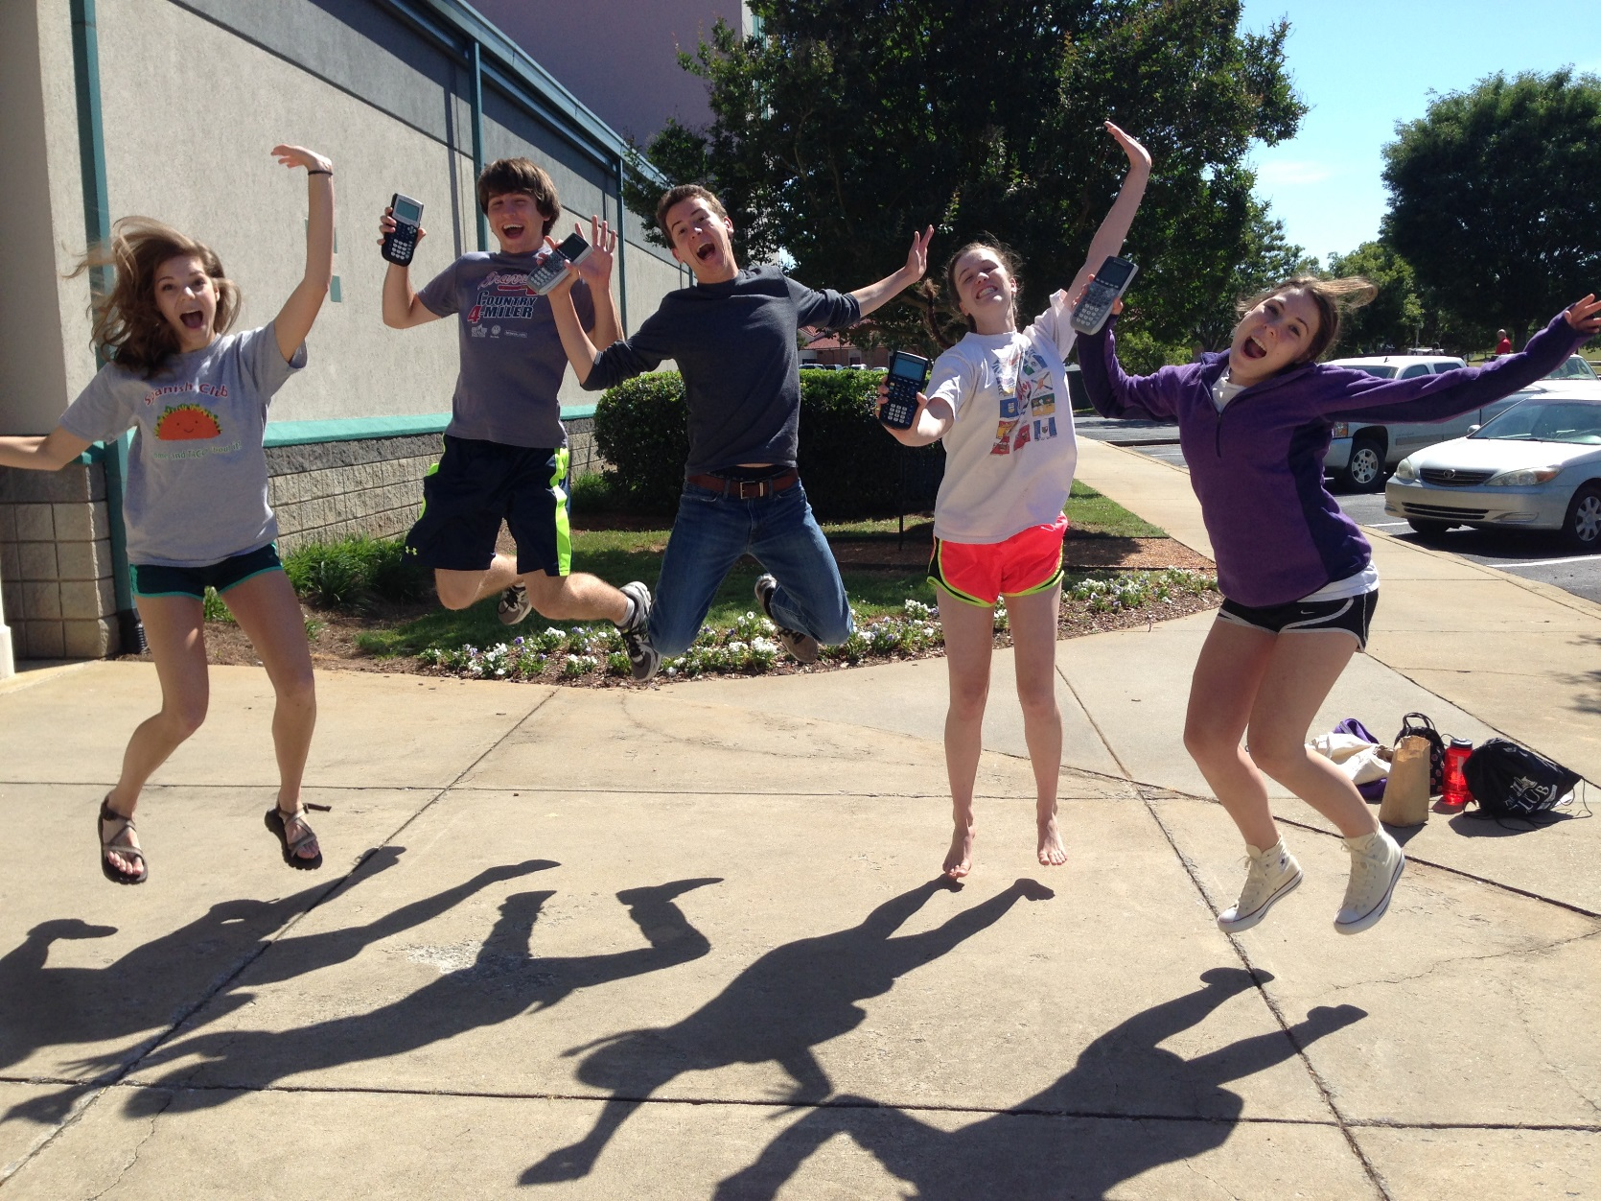


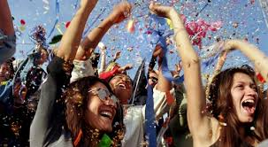


But on the day of the AP Stat exam, you will feel….

Slide 5
Some of the college majors requiring at least one statistics course:
Veterinary Science
Math Credit for Liberal Arts Majors
Psychology
Civil Engineering
Mechanical Engineering
Nursing
Chemical
Engineering
Animal Science
Nutritional Science
Education
Marketing
Pharmacy
Economics
Business Management
PreMed
Biology
Aerospace
Engineering
Sociology
Accounting
Finance

Slide 6
Taking AP classes is more than just trying to make a good grade in the class:
Colleges want to see that you can pass a Cumulative National Exam covering specific course material.
RED FLAGS FOR COLLEGE ADMISSION:
A or B in an AP Course, but scores 1 or 2 on AP Exam
C or F in AP Course and passes AP Exam
Not taking the AP Exam
AP credit does not count towards the 127 hours for HOPE.
Going into college with AP credit gives you some cushion so you can to take a smaller load during harder semesters .
Going into college with AP credit gives you the opportunity to participate in co-ops, internships, and study abroad programs without possibly getting behind towards graduation.

Slide 7
HOW CAN YOU BE SUCCESSFUL ON THE AP STAT EXAM?
RULE #1: Show work the way Mrs. Dillon tells you to.
RULE #2: Write verbal responses the way Mrs. Dillon shows you how to write them.
RULE #3: Practice the assigned problems Mrs. Dillon gives you. The course is cumulative; all concepts are built upon prior topics.
RULE #4: Be “committed” and “invested” in this course. Mrs. Dillon is “all in” from Jan 4 to May 11 and she expects you give your best every day.

Slide 8
Grading Policy:
Test (A final exam is given to students who do not meet exemption policy; counts as a test grade) 50%
Midterm Exam (no exemption allowed)
Cumulative Final Exam (optional; required) 10%
Quiz (Take Home Quizzes are due at BEGINNING OF CLASS on due date, even if you are absent) 30%
Daily Grades (designed to help you keep up with material on a daily basis) 10%

Slide 9
Important Class Information:
A graphing calculator must be brought to class every day and is necessary to complete all assessments. Go ahead and purchase extra batteries to have in your book bag. See me about renting one for the semester.
Notes, worksheets, assignments, and problem answers will be posted daily on my blog:
www.mathwithdillon.weebly.com
A formula sheet is allowed on the exam. Print a copy of the formula sheet from the blog. Bring it to class each day.

Slide 10
Important Class Information:
I use REMIND to communicate class information throughout the semester. If you are interested in receiving periodic text messages from me (reminders about quizzes, tests, THQ’s, AP Stat exam info, etc) following these directions:
Text 81010
Message to join Stat Group @dillonstat
Message to join GMLT Group @ochsgmlt16

Slide 11

www.mathwithdillon.weebly.com

Slide 12


Slide 13
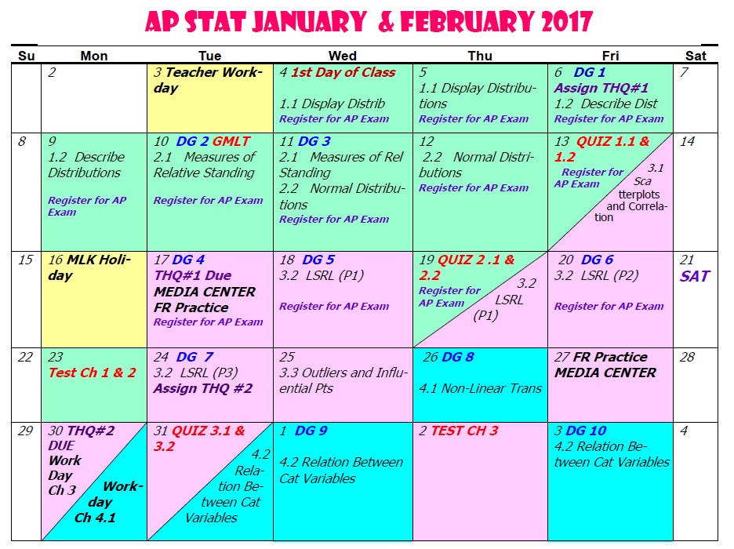

Slide 14
AP STAT EXAM DAY INFORMATION:
DATE & TIME: Thurs, May 11, 2017 12:00 noon
LOCATION: Oconee County Civic Center
COST: $97
All AP Stat students are expected to take the national exam on May 11, 2017. If you have a conflict (school competition), you are expected to take the makeup exam.

Slide 15
It is now time, ladies and gentlemen, to start your engines.
I mean calculators!
AND HERE WE GO…….

Slide 16
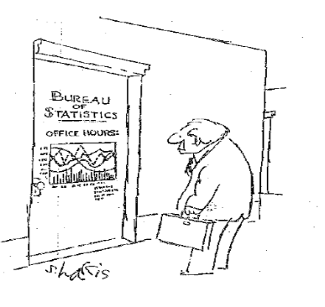
Part 1:
Exploring Data
AP Stat
Ch 1.1: Displaying Distributions with Graphs
EQ: How do we categorize data?

Slide 17
  In Class Calculator Activity:
Creating and Sorting Lists in Your Graphing Calculator
ASSIGNMENT: Follow the directions on page 59 (step 1 only) and use the data in Table 1.4 on p. 57 of your textbook to create and name a calculator list of president’s age at inauguration, adding Barack Obama, age 47 and Donald Trump, age 70. Keep this list in your list of lists until I tell you to delete it.

Slide 18
Recall:
Variables --- measureable or observable characteristic of interest
Data --- actual observations made of a variable
Individuals ---objects from which data is collected; humans are called “subjects”
Statistics --- collecting, organizing and analyzing data

Slide 19
Ex. Complete the following table:
VARIABLE DATA
5’9”
Height _______
Gender
_____________ Male
NO!
Opinion on smoking in restaurants _______
2
Number of children per family ______

Slide 20
Recall: Two Types of Data
Qualitative
Variable
Data
Quantitative
Qualitative vs. Quantitative
categorical, verbal
Can be ordinal or nominal
numerical; Arithmetic
operation can be performed.
Quantitative:
Discrete vs. Continuous
countable
not countable

Slide 21
Ex. Identify the type of data for each variable as qualitative, quantitative discrete, or quantitative continuous.
1. model of cars found in the student parking lot
qualitative
2. height of a falling object at any given time
quantitative continuous
3. age, in years, of current racecar drivers
quantitative discrete
number of teachers whose ages fall in the categories under
30 yrs old, 31 – 40 yrs old, over 41 yrs old
quantitative discrete
5. final score of every 2016 UGA football game
quantitative discrete
6. name of AP courses offered at OCHS
qualitative
7. race results for a 5k road race (1st, 2nd, etc.)
qualitative

Slide 22
EQ: How do we represent data in an appropriate graph?
Relative Frequency vs. Cumulative Frequency
proportion relative
to whole
summation of relative
frequency up to a particular
value

Slide 23
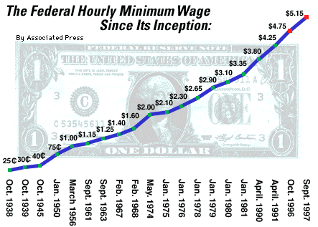
Let’s Look at Different Types of Distributions:
Distribution Shows Raw Data ? Purpose?
Time Plot
Yes and No
Show Trends

Slide 24
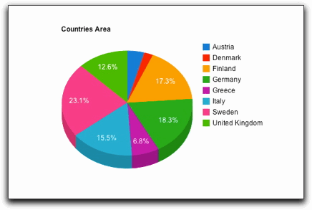
Let’s Look at Different Types of Distributions:
Distribution Shows Raw Data ? Purpose?
Pie Graph
No
Compare Relative Frequencies

Slide 25
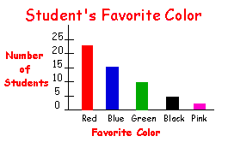
Let’s Look at Different Types of Distributions:
Distribution Shows Raw Data ? Purpose?
Bar Graph
Yes and No
Compare Frequencies

Slide 26
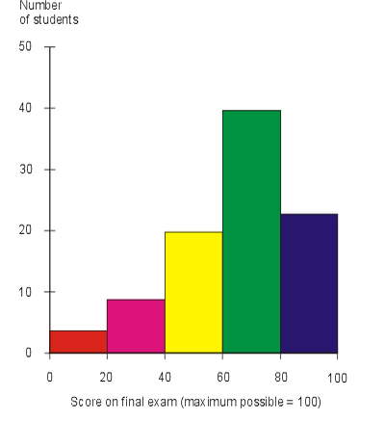
Let’s Look at Different Types of Distributions:
Distribution Shows Raw Data ? Purpose?
Histogram
No
Shows Shape of Distribution

Slide 27
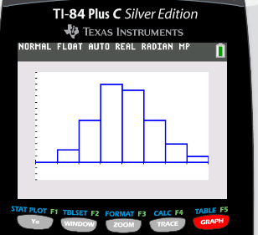
Creating Histogram Using TI-83/TI-84
Use directions for Technology Toolbox p. 59 – 60
to create a histogram of PREZ.
Turn to the last page of your notes and sketch the histogram on the first graph. We will finish this part of the notes tomorrow.
Ours will look different from the one in the book because we added Obama and Trump’s ages.

Slide 28
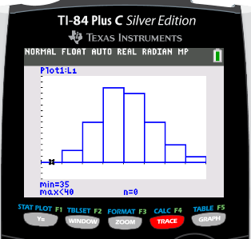
Hit the TRACE button and discuss what information appears on the screen.

Slide 29
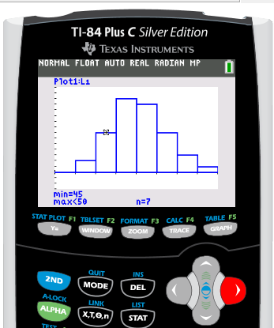
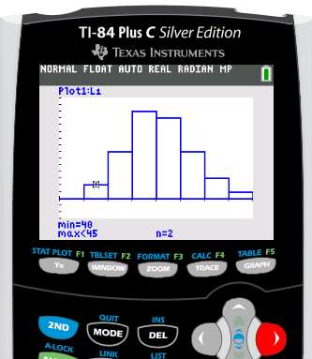
Hit the right arrow button and discuss the information that appears on the screen.

Slide 30
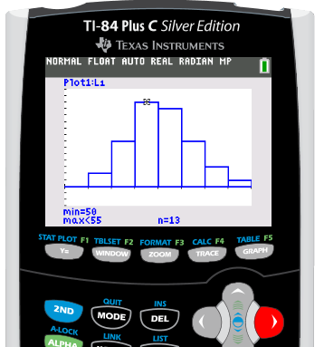
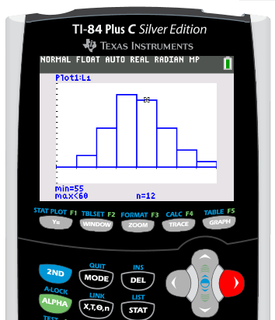

Slide 31
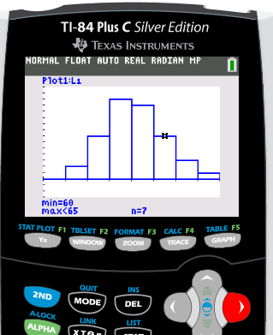
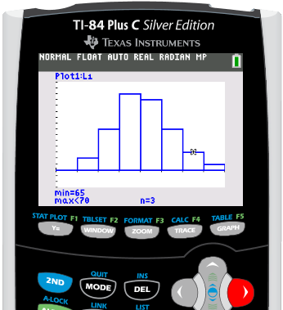
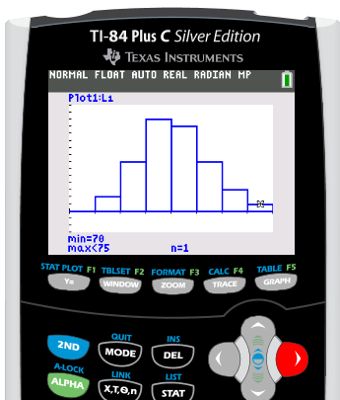

Slide 32
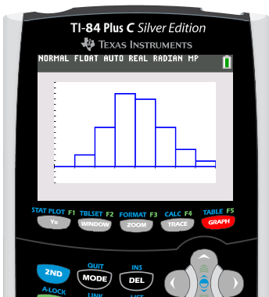
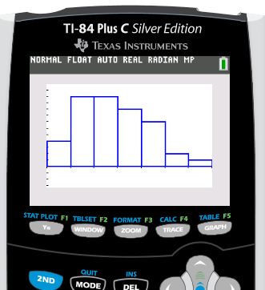
Now create a Histogram of PREZ using ZOOM9.
Sketch this graph on the second graph in your notes.
We will discuss these graphs later in the notes.

Slide 33
From now on, use the ZOOM9 function to create all histograms on your graphing calculator.

Slide 34
Back to the examples (#6) for distributions.

Slide 35
Take up syllabus signature page.
Check for formula sheet.

Slide 36
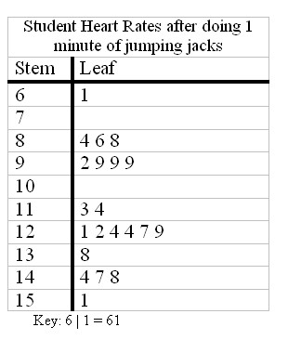
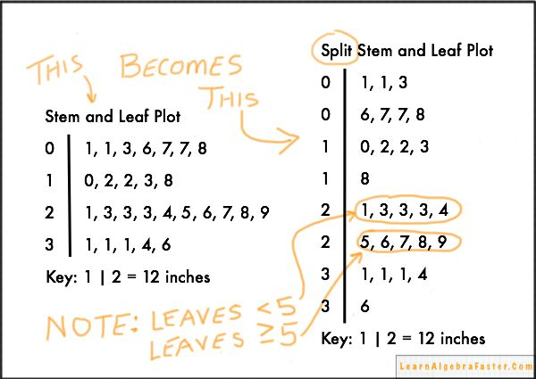
Let’s Look at Different Types of Distributions:
Distribution Shows Raw Data ? Purpose?
Stem Plots
Yes
Shows Shape of Distribution

Slide 37
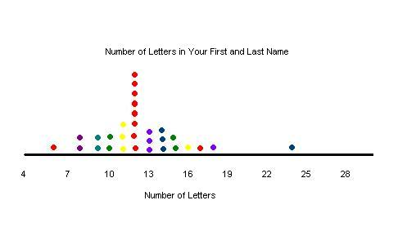
Let’s Look at Different Types of Distributions:
Distribution Shows Raw Data ? Purpose?
Dot Plots
Yes
Shows Shape of Distribution

Slide 38
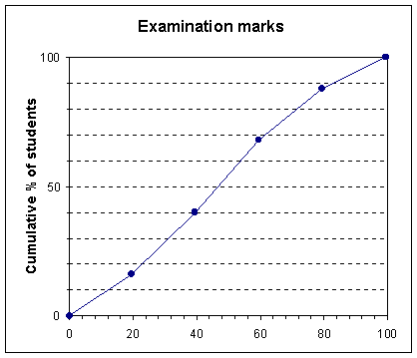
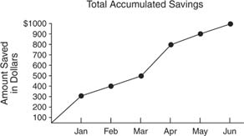
Let’s Look at Different Types of Distributions:
Distribution Shows Raw Data ? Purpose?
Ogive
No
Shows Cumulative Frequency or
Cumulative Relative Frequency

Slide 39
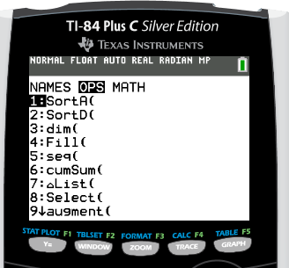
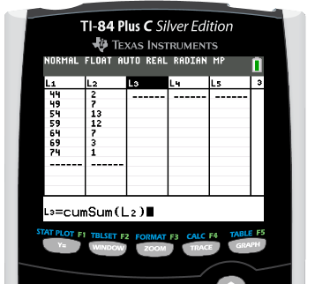
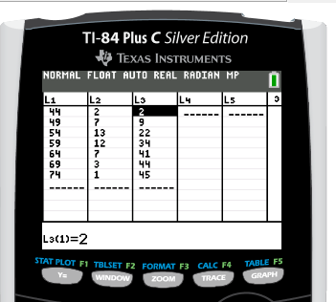
Creating An Ogive
Ex. 1.9 p. 60 – 61 Set up 5 lists in your calc.
Place the upper value of each class in L1
Place the frequency for each class in L2
Place the cumulative frequency for each class in L3. Hint: use the cumSum function.

Slide 40
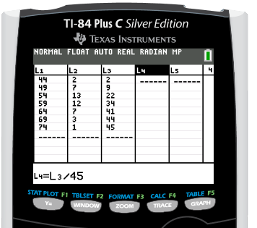
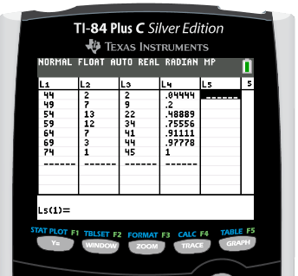
Creating An Ogive
Place the cumulative relative frequency of each class in L4.

Slide 41
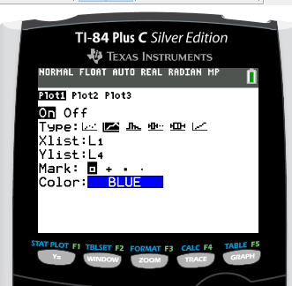
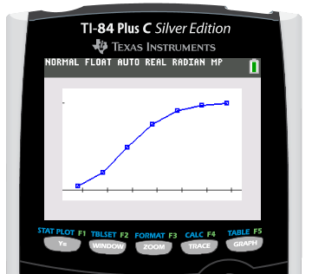
Creating An Ogive
Go to STAT PLOT and cut on Plot 1
Select the second graph; let your domain be the upper limit ages (L1) and the range be cumulative relative frequency (L4).
Use ZOOM9 to create graph

Slide 42
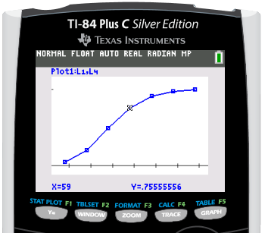
Creating An Ogive
Use TRACE and the arrow buttons to move along the graph. What information is given at the bottom of the screen?

Slide 43
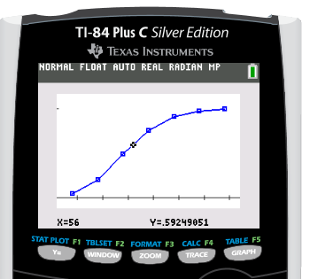
Creating An Ogive
Hit the clear button and use only the arrow keys to move up and down the graph.

Slide 44
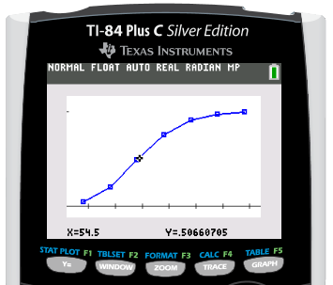
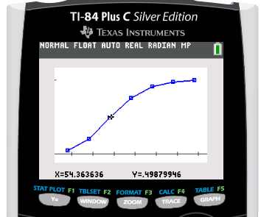
Creating An Ogive
Fifty percent of our presidents have been at most what age?
Approximately 50% of our presidents have been at most (and at least) 54 years old.

Slide 45
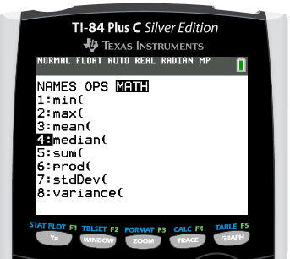
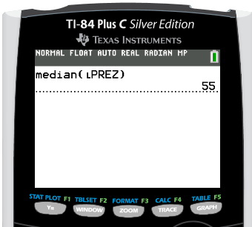
Creating An Ogive
RECALL: 50% of your data lies at what statistical measure of center?
MEDIAN
Use a calculator function to locate the median of L1.

Slide 46
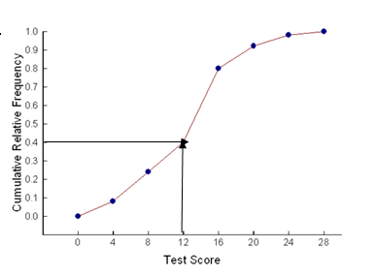
Interpret the indicated point
on the given ogive.
40
____% of the
____________________
had a ______________ of
at most ____.
students taking the test
test score
12

Slide 47
AP STAT EXAM GOLDEN RULE #1:
When creating graphs of data:
TITLE GRAPH
LABEL BOTH AXES
COUNT BY CONSTANT INTERVALS

Slide 48
In Class Discussion p. 47 #3
1.0
1.6
2.0
Cumulative frequency
to median from each end
Leaf
Stem

Slide 49
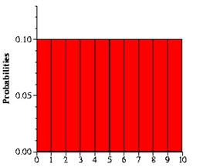
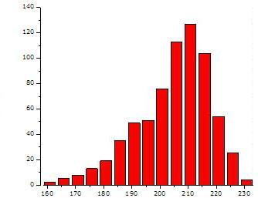
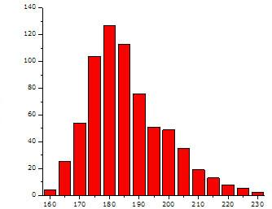
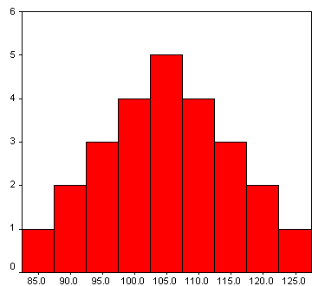
RECALL: Describing the Shape of Distributions:
Symmetric, Uniform
Skewed Left
Skewed Right
Symmetric, Bell-shape

Slide 50
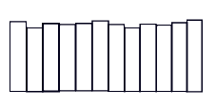
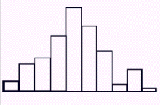



ACRONYMS TO DESCRIBE DISTRIBUTIONS
SHAPE
CENTER
S --- ____________ C --- ________________
O --- ____________ U --- ________________
C --- ____________ S --- ________________
S --- ____________ S --- ________________
OUTLIER
UNUSUAL VALUES
CENTER
SHAPE
SPREAD
SPREAD
uniform
skewed
symmetric
Shape --- ____________, _____________, _____________

Slide 51



ACRONYMS TO DESCRIBE DISTRIBUTIONS
SHAPE
CENTER
S --- ____________ C --- ________________
O --- ____________ U --- ________________
C --- ____________ S --- ________________
S --- ____________ S --- ________________
OUTLIER
UNUSUAL VALUES
CENTER
SHAPE
SPREAD
SPREAD
uniform
skewed
symmetric
Shape --- ____________, _____________, _____________
Outliers --- _________ clearly _______ from body of data
points
away

Slide 52



ACRONYMS TO DESCRIBE DISTRIBUTIONS
SHAPE
CENTER
S --- ____________ C --- ________________
O --- ____________ U --- ________________
C --- ____________ S --- ________________
S --- ____________ S --- ________________
OUTLIER
UNUSUAL VALUES
CENTER
SHAPE
SPREAD
SPREAD
uniform
skewed
symmetric
Shape --- ____________, _____________, _____________
Outliers --- _________ clearly _______ from body of data
Center --- _____________ data; ____________ point
points
away
typifies
balancing

Slide 53



ACRONYMS TO DESCRIBE DISTRIBUTIONS
SHAPE
CENTER
S --- ____________ C --- ________________
O --- ____________ U --- ________________
C --- ____________ S --- ________________
S --- ____________ S --- ________________
OUTLIER
UNUSUAL VALUES
CENTER
SHAPE
SPREAD
SPREAD
uniform
Shape --- ________, __________, _____________
Outliers --- ______ clearly _____ from body of data
Center --- _________ data; __________ point
Spread --- _________ of data; _____,
____________
skewed
symmetric
points
away
typifies
balancing
variation
gaps
clusters

Slide 54
Now let’s use SOCS to describe the distribution
of president’s age at inauguration:
You can write a paragraph or you can just do “bullets”. Make sure you cover all terms.
Write complete sentences in context of the distribution.
SHAPE
OUTLIERS
Center
Spread

Slide 55
SHAPE
The distribution of president’s age at inauguration
appears to be right skewed indicating there has been
a higher frequency of younger presidents
at inauguration.
OUTLIERS
Center
Spread

Slide 56
SHAPE
The distribution of president’s age at inauguration
appears to be right skewed indicating there has been
a higher frequency of younger presidents
at inauguration.
OUTLIERS
There appear to be no outliers in distribution of president’s age at inauguration. [We will discuss how to determine if there are/are not in the next lesson.]
Center
Spread

Slide 57
SHAPE
The distribution of president’s age at inauguration
appears to be right skewed indicating there has been
a higher frequency of younger presidents
at inauguration.
OUTLIERS
There appear to be no outliers in distribution of president’s age at inauguration. [We will discuss how to determine if there are/are not in the next lesson.]
Center
Since the distribution of president’s age at inauguration
appears to be right skewed, the best measure of center is the median.
[State the value of possible.]
Spread

Slide 58
SHAPE
The distribution of president’s age at inauguration
appears to be right skewed indicating there was a
higher frequency of younger presidents.
OUTLIERS
There appear to be no outliers in
distribution of president’s age at inauguration.
[We will discuss how to determine if there are/are not in the next lesson.]
Center
Since the distribution of president’s age at inauguration appears to be right skewed, the best measure of center is the median.[State the value if possible.]
Spread
Since the distribution of president’s age at inauguration appears to be right skewed, the best measure of spread is the IQR.
[State the value if possible.]

Slide 59
From now on, use the ZOOM9 function to create all histograms on your graphing calculator.

Slide 60


Determine if the following statements are true or false.
1) All bell-shaped distributions are symmetric.
2) All symmetric distributions are bell-shaped.
YES
NO

Slide 61
From now on, use the ZOOM9 function to create all histograms on your graphing calculator.
Assignment:
p. 46 - 48 #2, 6
p. 55 #7, 8, 10
p. 64 #13
DO NOT DO p. 67 yet. Do this page after the next lesson.

