Slide 1
Accel Precalculus
Unit 8: Extended Trigonometry
Lesson 4: Polar Coordinates (Part 2)
EQ: How do you convert from polar coordinates to rectangular coordinates and vice-versa?

Slide 2
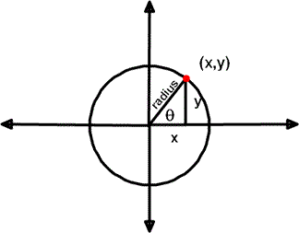
PART II
Polar Coordinates
Rectangular Coordinates
Recall:
Right Triangle Trig

Slide 3
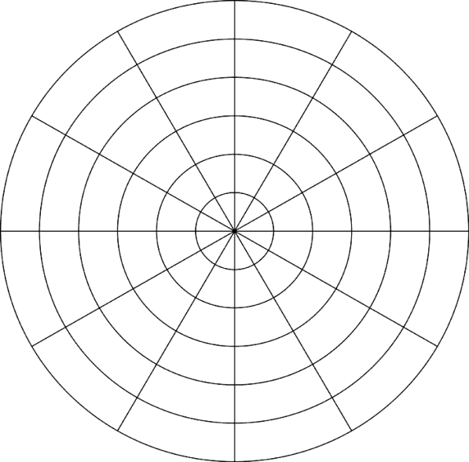
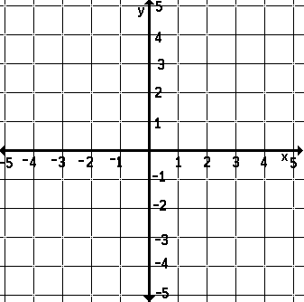
Ex. Convert polar coordinates to rectangular coordinates. [Check quadrant!]

Slide 5
Recall (look back at right triangle):
Pythagorean Theorem

Slide 6
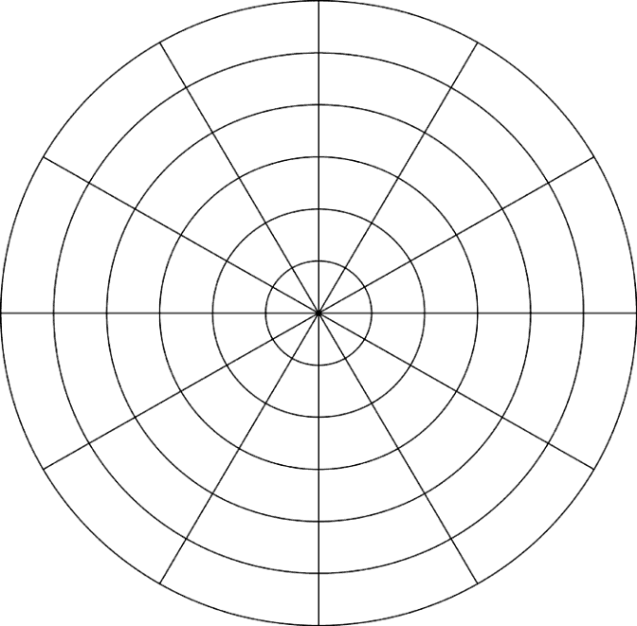
Ex. Convert rectangular coordinates to a polar coordinates. Give four answers for each. [Check quadrant!]

Slide 8
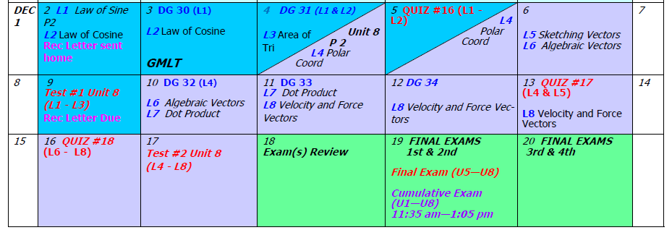
Assignment:
PW #1 #29 – 43 odd, #45 – 55 odd (4 answers)
PW #2 Parts III & IV
PW #3

