Slide 1
Accel Precalc
Unit 8: Extended Trigonometry
Lesson 4: Polar Coordinates (Part 1)
EQ: How do you graph polar coordinates and how do you write alternative forms of a polar coordinate?

Slide 2
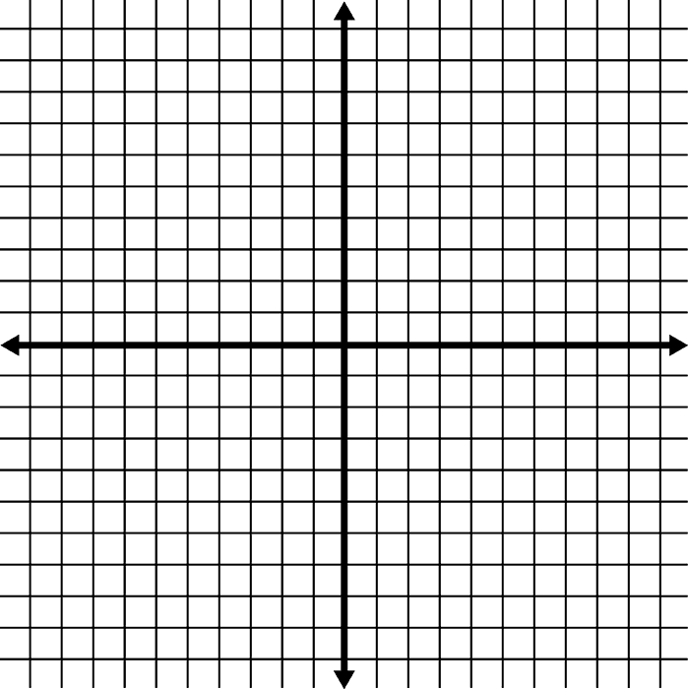
Part 1: Graphing Polar Coordinates
Recall:
Rectangular Coordinate Plane
II
I
origin
P(x, y)
quadrants
coordinates
III
IV
How many ways are there to define a point in the rectangular plane?

Slide 3
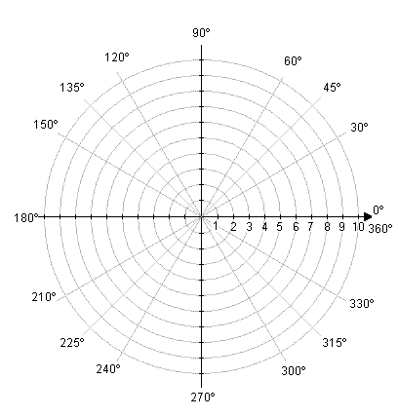
Polar Coordinate System
pole
coordinates
r, θ
P(__, __)
r
Positive direction from the pole
Negative direction from the pole
-r

Slide 4
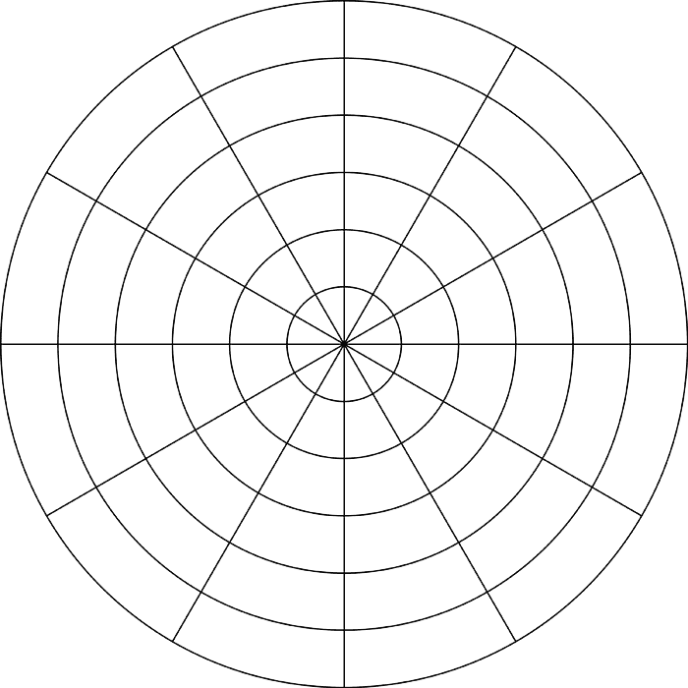
Ex. Graph these points.

Slide 10
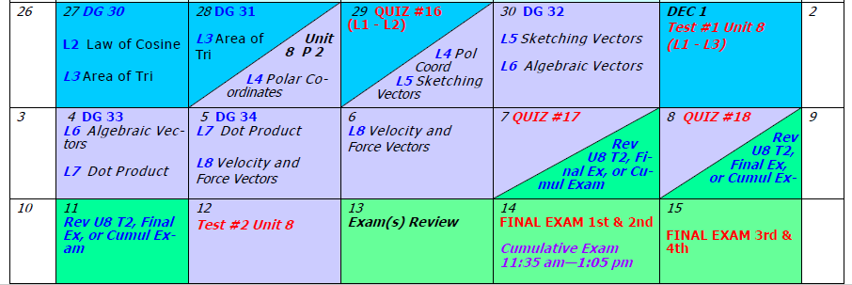
Day 76 Agenda:
Quiz 16 --- 30 minutes

Slide 11
Alternative Forms of the Coordinate of a Point:
Given P(3, 60°),state 4 pair of polar coordinates meeting the following conditions:
r > 0 and 0° < θ < 360°
________________
P(3, 60°)
r < 0 and 0° < θ < 360°
________________
P(-3, 240°)
r > 0 and -360° < θ < 0°
_____________
P(3, -300°)
P(-3, -120°)
IV. r < 0 and -360 < θ < 0° _____________

Slide 12
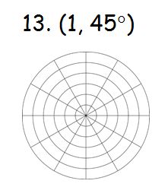
Ex. Rename (r, θ) using the given conditions.

Slide 13
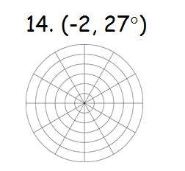
Ex. Rename (r, θ) using the given conditions.

Slide 14
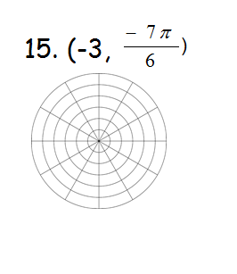
Ex. Rename (r, θ) using the given conditions.

Slide 15
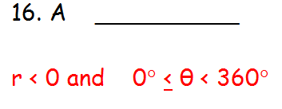
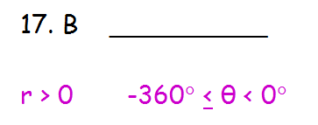
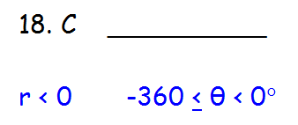
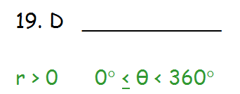
Ex . State coordinates for each point meeting the
given conditions.
C
A
D
B

Slide 16
ASSIGNMENT:
PW #1 Polar Coordinates #1 - 28

