Slide 1
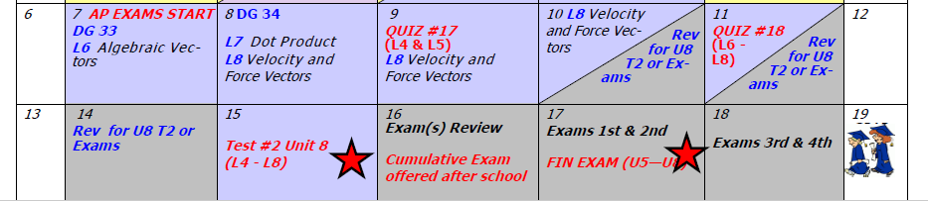

Day 81 Agenda:
Quiz #17 --- 30 minutes
ALMOST THERE!!
HANG ON!

Slide 2
Accel Precalc
Unit #8: Extended Trigonometry
Lesson 8: Velocity and Force Vectors
EQ: What are velocity and force vectors and how are they used to solve real world problems?

Slide 3
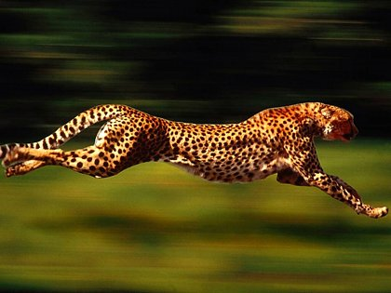
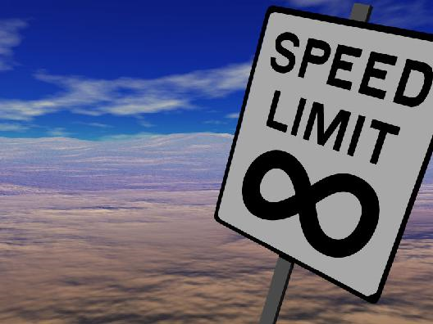
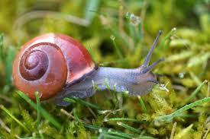
Terms to Know:
Speed
--- scalar quantity that refers to how fast an object is moving; the rate at which an object covers a distance; does not keep track of direction

Slide 4
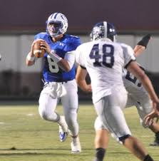
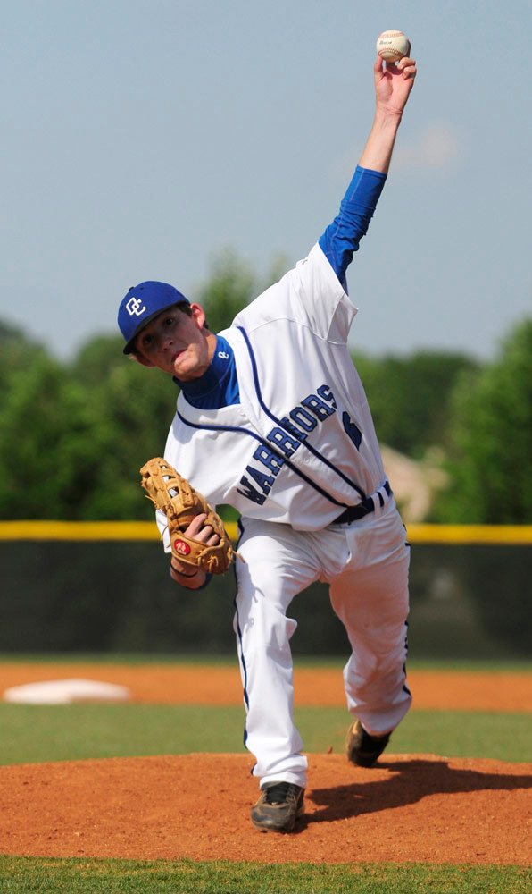
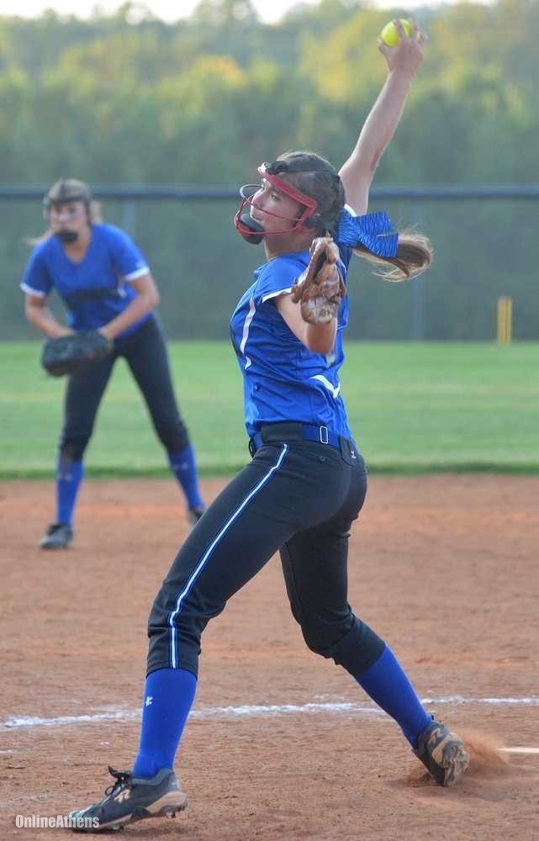
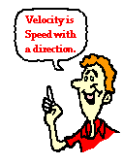
Velocity
-- the rate at which an object changes its position; vector quantity therefore direction aware;

Slide 5
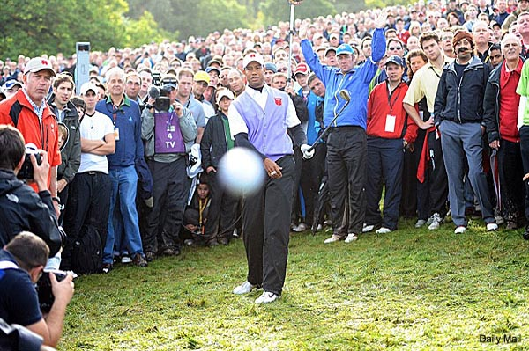
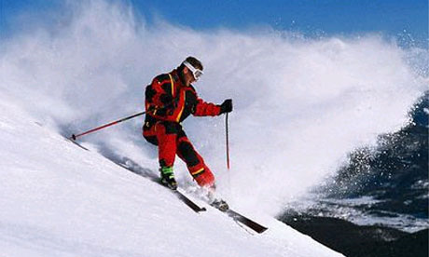
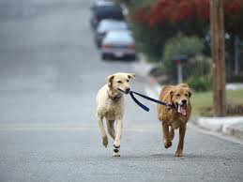
SPEED vs VELOCITY
55 mph 55 mph east
Force Vector
--- represents direction and amount of force acting on an object; includes a horizontal component and a vertical component

Slide 6
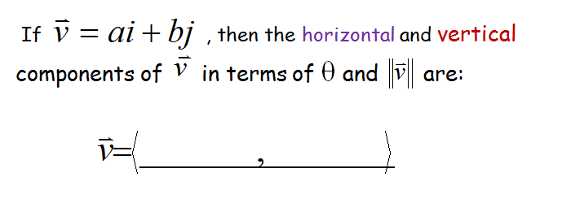




Slide 7
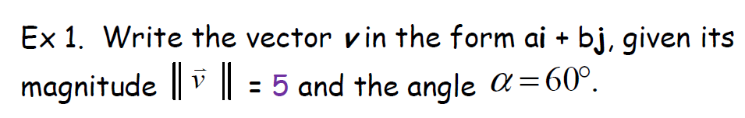
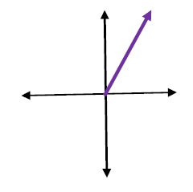
5
60°

Slide 8
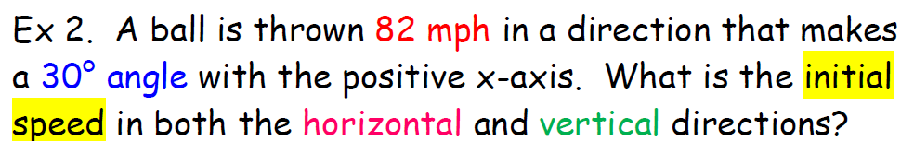
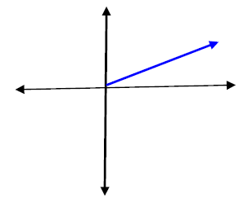
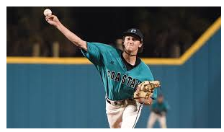
82
30°

Slide 9
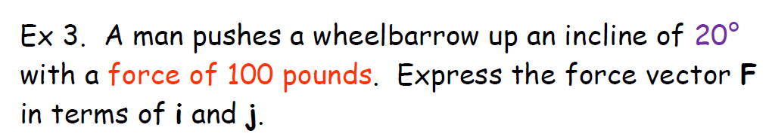
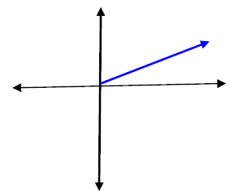
20°
100
20°

Slide 10

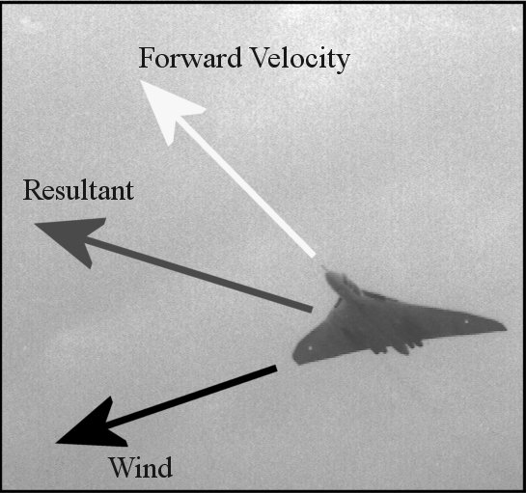
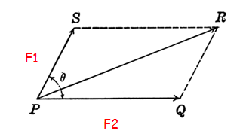

F₁ + F₂

Slide 11
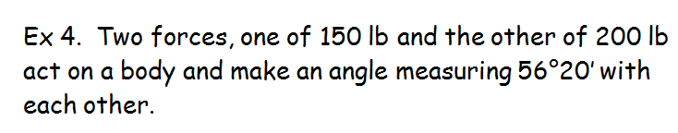
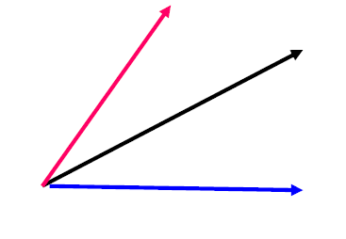
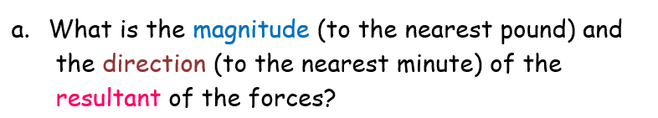
200
x
200
56°20’
123°40’
150

Slide 12
200
309
200
θ
123°40’
150

Slide 13
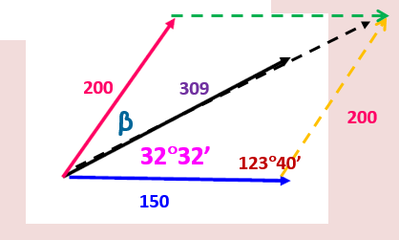
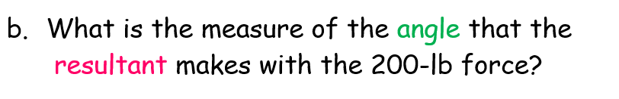
200
309
β
200
23°45’
32°32’
32°35’
123°40’
150

Slide 14
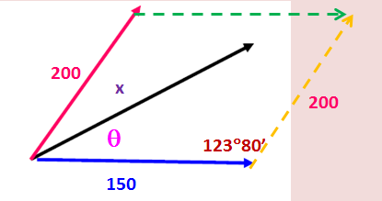
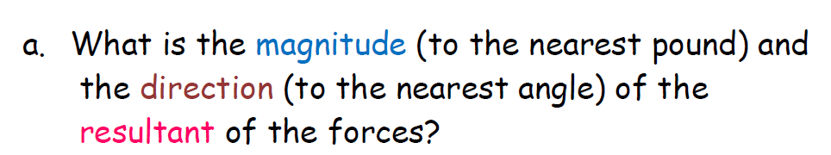
METHOD 2:
123°40’

Slide 15
METHOD 2:
166.46
123°40’
260.87

Slide 16
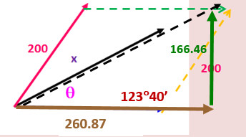
METHOD 2:

Slide 17
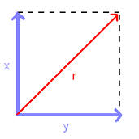
METHOD 2:
β
θ
166.46
260.87

Slide 18
METHOD 2:
β
θ
166.46
260.87

Slide 19
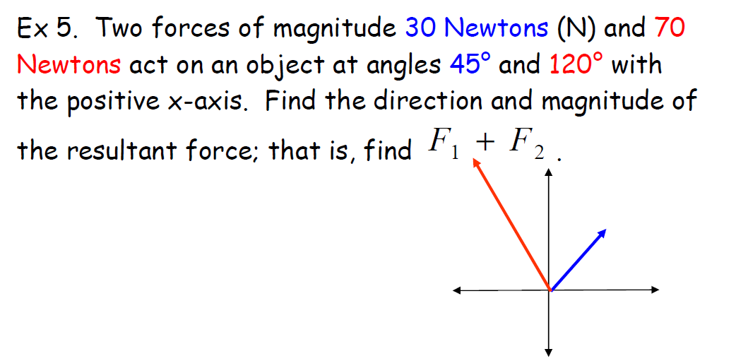

70
82.99
105°
120°
75°
α
30
45°

Slide 20
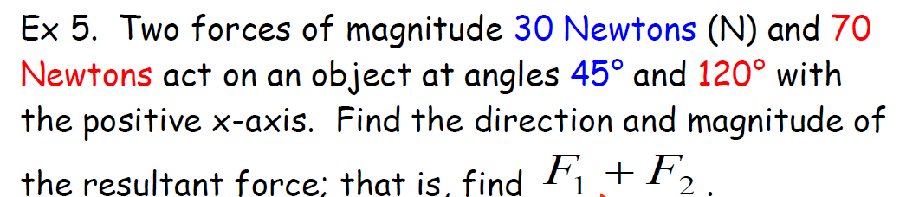
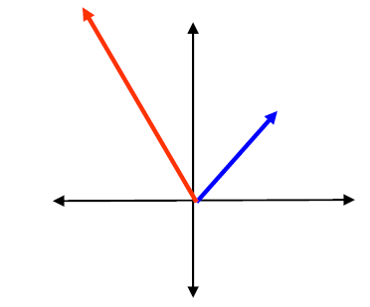
Now rework this example using Method 2:

Slide 21
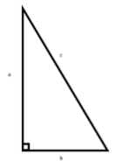
Now rework this example using Method 2:
β
81.83 N
θ
-13.7 N

Slide 22

Day 82 Agenda:
Finish Unit 8 Lesson8 --- end of course
Workday preparing for upcoming final assessments --- quiet study hall

Slide 23
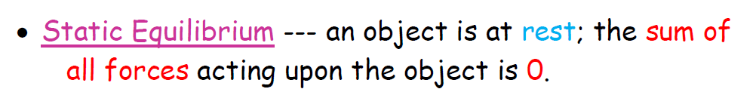
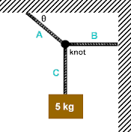
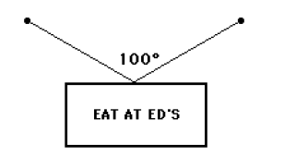
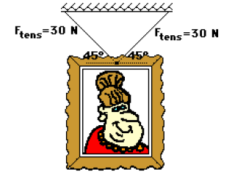

Slide 24



Slide 25
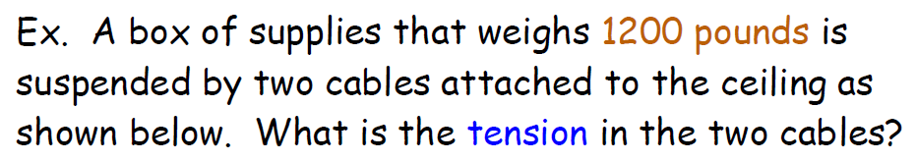
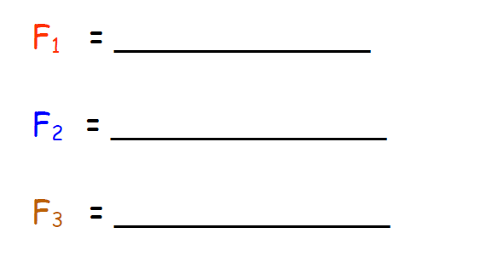
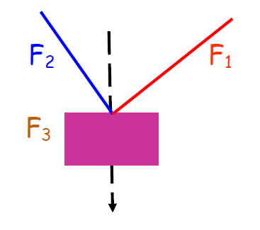
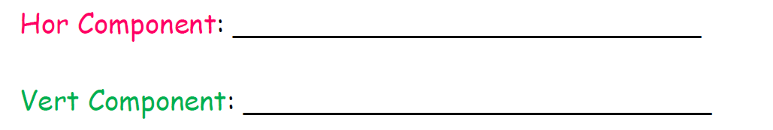
150°
60°
30°
60°
1200
270°

Slide 26
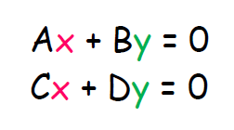


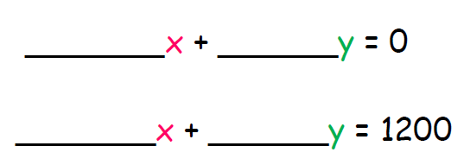

0.5 -0.866
0.866 0.5

Slide 27

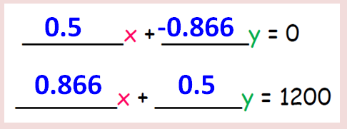

Slide 28
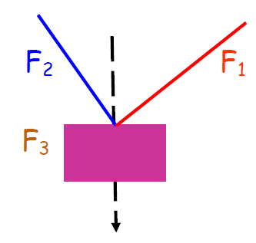
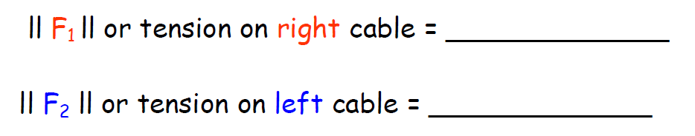
1039 lb
600 lb

Slide 29
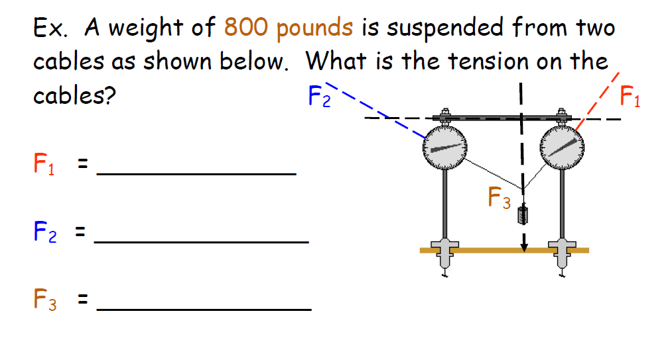
TRY THIS ONE ON YOUR OWN:
45°
50°

Slide 30
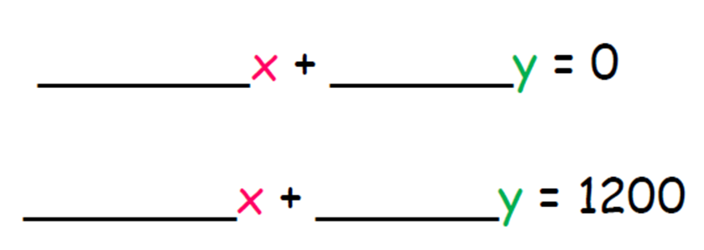
0.6428 -0.7071
0.766 0.7071
800
RECALL: Use Matrices to Solve Systems of Equations

Slide 31

567.8 lb
516.2 lb

Slide 32

And the Trig students lived happily ever after….
Practice Worksheets: Force Vectors And
Static Equilibrium

