Slide 1
Accel Precalc
Unit #6: Graphs and Inverses of Trig Functions
Lesson 9: Simple Harmonic Motion
EQ 1: How can you create trig models to represent real world data?

Slide 2
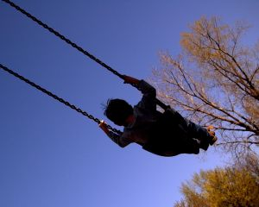
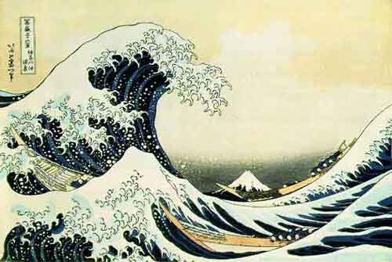

Slide 3
Simple Harmonic Motion Models:
Terms:
|A| = amplitude Maximum displacement
from point of equilibrium
Equilibrium --- object is at rest; zero point
Period --- time it takes to complete one cycle

Slide 4
Ex. 1 A buoy marking a channel in the harbor bobs up and down as the waves move past. Suppose the buoy moves a total of 6 feet from its high point to its low point and returns to its high point every 10 seconds. Assuming that at t = 0 the buoy is at its high point and the middle height of the buoy’s path is d = 0, write an equation to describe its motion.
Go to the video I created explaining how to work all of these examples.

Slide 5
Ex. 1 A buoy marking a channel in the harbor bobs up and down as the waves move past. Suppose the buoy moves a total of 6 feet from its high point to its low point and returns to its high point every 10 seconds. Assuming that at t = 0 the buoy is at its high point and the middle height of the buoy’s path is d = 0, write an equation to describe its motion.

Slide 6
Ex. 2 A weight on a spring bounces a maximum of 8 inches above and below its equilibrium (zero) point. The time for one complete cycle is 2 seconds. Write an equation to describe the motion of this weight, assume the weight is at equilibrium when t = 0.

Slide 7
Ex. 2 A weight on a spring bounces a maximum of 8 inches above and below its equilibrium (zero) point. The time for one complete cycle is 2 seconds. Write an equation to describe the motion of this weight, assume the weight is at equilibrium when t = 0.

Slide 8
Ex. 3 In a particular harbor, high and low tides occur every
12 hours. Find f(t) = Acos[B(t – C)] + D where h(t) is the
water level, in feet, t hours after midnight given the
following:
a) high tide is 10 ft and low tide, which occurs at 6 am , is 2 ft

Slide 9
Ex. 3 In a particular harbor, high and low tides occur every
12 hours. Find f(t) = Acos[B(t – C)] + D where h(t) is the
water level, in feet, t hours after midnight given the
following:
a) high tide is 10 ft and low tide, which occurs at 6 am , is 2 ft

Slide 10
Ex. 3 In a particular harbor, high and low tides occur every
12 hours. Find f(t) = Acos[B(t – C)] + D where h(t) is the
water level, in feet, t hours after midnight given the
following:
b) high tide is 12 ft and low tide, which occurs at 4 am , is 6 ft

Slide 11
Ex. 3 In a particular harbor, high and low tides occur every
12 hours. Find f(t) = Acos[B(t – C)] + D where h(t) is the
water level, in feet, t hours after midnight given the
following:
b) high tide is 12 ft and low tide, which occurs at 4 am , is 6 ft

Slide 12
Ex. 3 In a particular harbor, high and low tides occur every
12 hours. Find f(t) = Acos[B(t – C)] + D where h(t) is the
water level, in feet, t hours after midnight given the
following:
c) The average water level is 5 ft and high tide is 10 ft, which
occurs at 7 pm.

Slide 13
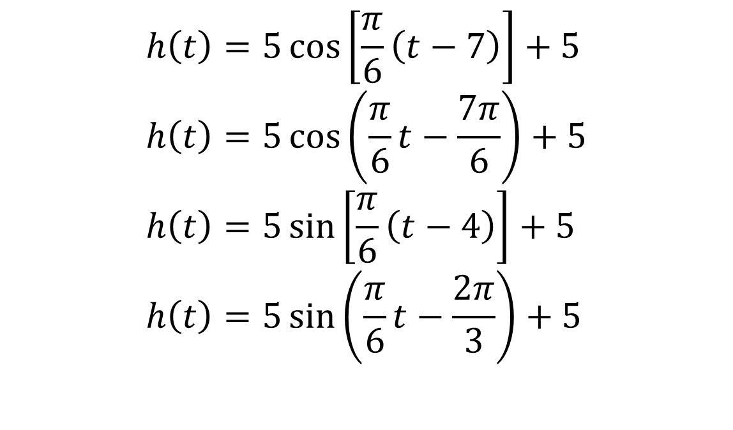
Ex. 3 In a particular harbor, high and low tides occur every
12 hours. Find f(t) = Acos[B(t – C)] + D where h(t) is the
water level, in feet, t hours after midnight given the
following:
c) The average water level is 5 ft and high tide is 10 ft, which
occurs at 7 pm.
$$h\left(t\right)=5\cos\left[\frac{π}{6}\left(t−7\right)\right]+5 \\ h\left(t\right)=5\cos\left(\frac{π}{6}t−\frac{7π}{6}\right)+5 \\ h\left(t\right)=5\sin\left[\frac{π}{6}\left(t−4\right)\right]+5 \\ h\left(t\right)=5\sin\left(\frac{π}{6}t−\frac{2π}{3}\right)+5$$

Slide 14
Ex. 4 You have probably noticed that as you ride a Ferris wheel, your distance from the ground varies sinusoidally with time. When the last seat is filled and the Ferris wheel starts, your seat is at the position shown in the figure at the right. Let tbe the number of seconds that have elapsed since the Ferris wheel started. You find that it takes you 3 quiddles (a new measure of time) to reach the top,
43 ft above the ground, and that the wheel makes a revolution once every 8 quiddles. The diameter of the wheel is 40 ft. Your mission, should you
choose to accept it, is to
do the following:
a) Sketch a graph of this sinusoid.

Slide 15
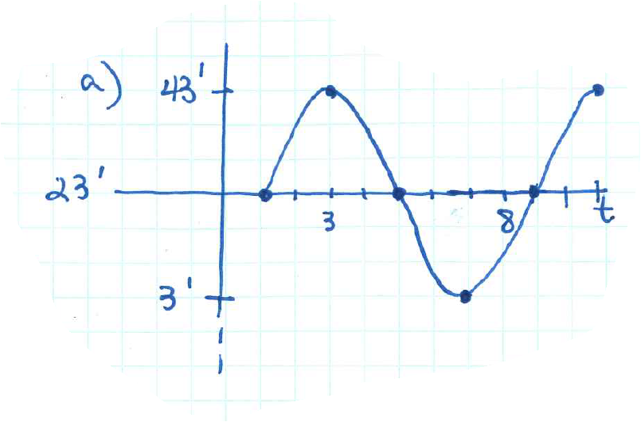
Ex. 4 You have probably noticed that as you ride a Ferris wheel, your distance from the ground varies sinusoidally with time. When the last seat is filled and the Ferris wheel starts, your seat is at the position shown in the figure at the right. Let tbe the number of seconds that have elapsed since the Ferris wheel started. You find that it takes you 3 quiddles (a new measure of time) to reach the top,
43 ft above the ground, and that the wheel makes a revolution once every 8 quiddles. The diameter of the wheel is 40 ft. Your mission, should you
choose to accept it, is to
do the following:
a) Sketch a graph of this sinusoid.

Slide 16
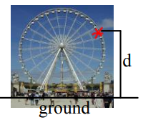
Ex. 4 You have probably noticed that as you ride a Ferris wheel, your distance from the ground varies sinusoidally with time. When the last seat is filled and the Ferris wheel starts, your seat is at the position shown in the figure at the right. Let t be the number of seconds that have elapsed since the Ferris
wheel started. You find that it takes you 3 quiddles (a new measure of time) to reach the top, 43 ft above the ground, and that the wheel makes a revolution once every 8 quiddles. The diameter of the wheel is 40 ft. Your mission, should you
choose to accept it, is to do the following:
b) What is the lowest you go as the Ferris wheel turns?
Why is this number greater than 0?
Lowest height = 3 ft
Must be greater than 0 in order for Ferris wheel to turn. Can’t hit the ground.

Slide 17
Ex. 4 You have probably noticed that as you ride a Ferris wheel, your distance from the ground varies sinusoidally with time. When the last seat is filled and the Ferris wheel starts, your seat is at the position shown in the figure at the right. Let t be the number of seconds that have elapsed since the Ferris
wheel started. You find that it takes you 3 quiddles (a new measure of time) to reach the top, 43 above the ground, and that the wheel makes a revolution once every 8 quiddles. The diameter of the wheel is 40 ft. Your mission, should you
choose to accept it, is to do the following:
c) Write a function that models this sinusoid.

Slide 18
Ex. 4 You have probably noticed that as you ride a Ferris wheel, your distance from the ground varies sinusoidally with time. When the last seat is filled and the Ferris wheel starts, your seat is at the position shown in the figure at the right. Let t be the number of seconds that have elapsed since the Ferris
wheel started. You find that it takes you 3 quiddles (a new measure of time) to reach the top, 43 above the ground, and that the wheel makes a revolution once every 8 quiddles.The diameter of the wheel is 40 ft. Your mission, should you
choose to accept it, is to do the following:
d) Predict your height above ground qt 6 quiddles, 4.3 quiddles, 9 quiddles, and 0 quiddles.

Slide 19
Ex. 4 You have probably noticed that as you ride a Ferris wheel, your distance from the ground varies sinusoidally with time. When the last seat is filled and the Ferris wheel starts, your seat is at the position shown in the figure at the right. Let t be the number of seconds that have elapsed since the Ferris
wheel started. You find that it takes you 3 quiddles (a new measure of time) to reach the top, 43 above the ground, and that the wheel makes a revolution once every 8 quiddles.The diameter of the wheel is 40 ft. Your mission, should you
choose to accept it, is to do the following:
e) How far from the ground were you when the last seat was filled?

Slide 20
ASSIGNMENT:
Worksheet: Harmonic Motion
REMINDER: Submit by 11:00 pm
Sunday, April 19, 2020
DG25
Q12
Unit 5 Test (optional)

