Slide 1
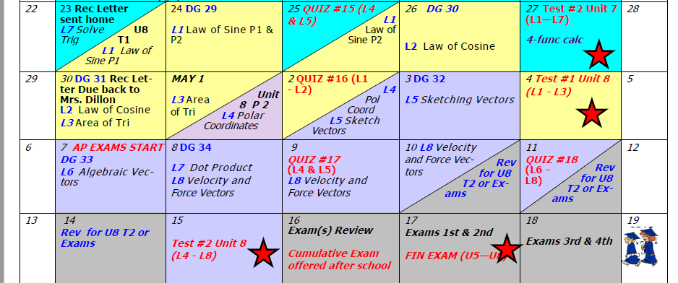
Day 69 Agenda:
DG 29 ---moved to Tues

Slide 2
Accel Precalc
Unit #7: Trig Identities
Lesson 7: Solve Trig Equations Using Factoring
EQ: What are the different methods of factoring and how can I use them to solve trig equations?

Slide 3
Recall:
List four different methods of factoring. When is each method appropriate?
GCF
Difference of 2 Squares
X Factor aka Trial and Error
Factor by Grouping

Slide 4
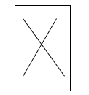
Solve. 2x² + 3x + 1 = 0
2x² + 2x + 1x + 1 = 0
2
(2x² + 2x) + (1x + 1) = 0
2 1
3
2x(x + 1) + 1(x + 1) = 0
(2x + 1)(x + 1) = 0
2x + 1 = 0 x + 1 = 0
x = -½ x = -1

Slide 5
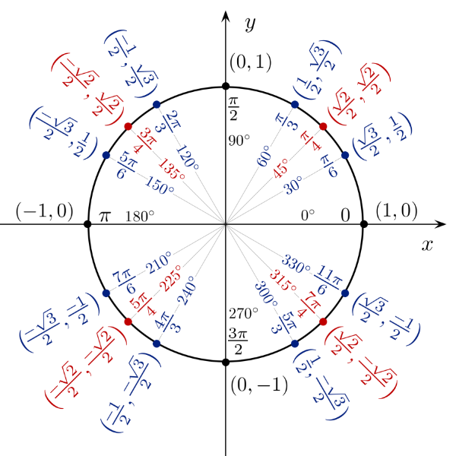
(2sinθ + 1)(sinθ + 1) = 0
2sinθ + 1 = 0 sinθ + 1 = 0
sinθ = -½ sinθ = -1
sin⁻¹ (-½) = θ sin⁻¹ (-1) = θ
210⁰, 330⁰, 270⁰

Slide 6
Solve these trig equations.
Factoring Technique?
3sinθsecθ - secθ = 0
GCF
secθ(3sinθ - 1) = 0
secθ = 0 3sinθ - 1 = 0
sinθ = 1/3
Not on Unit Circle. What do you do?
MEANS: cosθ = Ø
This is never true.

Slide 7
MEANS: cosθ = Ø
This is never true.
sinθ = 1/3
Not on Unit Circle. What do you do? Use calculator.
sin⁻¹(1/3) = θ
19.5⁰ = θ
180⁰ - 19.5⁰ = 160.5⁰
θ
θ
19.5⁰
, 160.5⁰

Slide 8
3cosθ + 3 - 2sin²θ = 0
3cosθ + 3 – 2(1 - cos²θ) = 0
3cosθ + 3 – 2 + 2cos²θ = 0
Factoring Technique?
2cos²θ + 3cosθ + 1 = 0
(2cosθ + 1)(cosθ + 1) = 0
2cosθ + 1 = 0 cosθ + 1 = 0
cosθ = -½ cosθ = -1
120⁰, 240⁰, 180⁰

