Slide 1
Accel Precalc
Unit #6: Graphs and Inverses of Trig Functions
Lesson 7: Sinusoidal Graphs and Equations
EQ: What are sinusoidal graphs and how are their equations written?

Slide 2
Recall:
Linear Combination in Algebra
--- a linear combination of x and y would result in an expression of the form
ax + by
Think about combining like terms in algebra expressions:

Slide 3
---of sin(cx) and
cos(d x) is the sum in the form
asin(cx) + bcos(dx)
--- a waveform with deviations that
can be graphically expressed as the sine curve
Look Familiar ?

Slide 4
A --- amplitude
B --- calculates new period
t --- time; notice this is now your DOMAIN
h --- horizontal phase shift from the origin
D --- vertical displacement

Slide 5
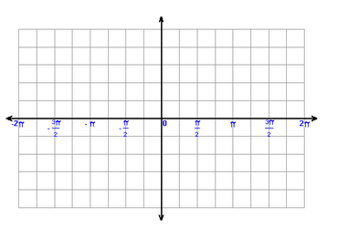
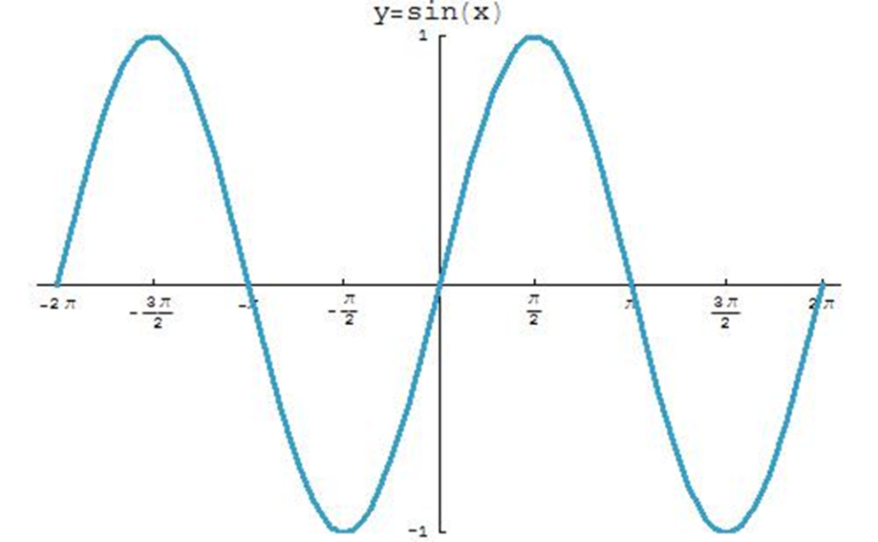
Recall: Sketch parent function for sine:

Slide 6
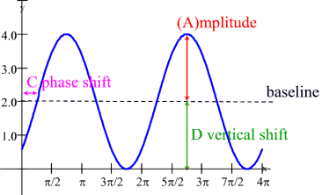
Recall: Terms for Transformations
Amplitude
New Period
Phase Shift
Vertical Displacement

Slide 7
Determine if a given linear combination
is sinusoidal.
Part I:
What would you expect the graph to look like?

Slide 8
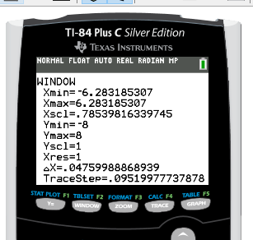

Slide 9
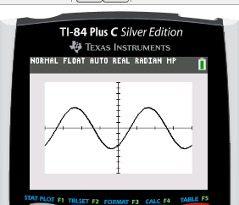
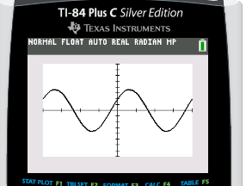
2. y = 2sinx – 3cosx

Slide 10
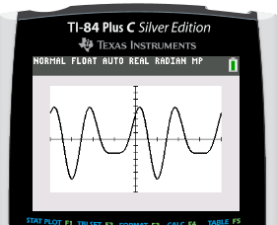
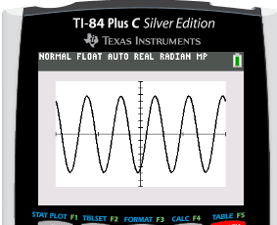
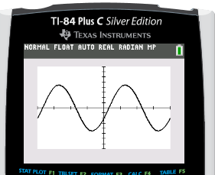
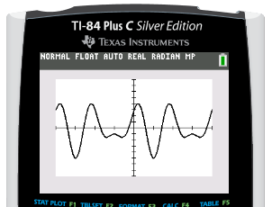
3. y = 2sin3x + 4cos2x
4. y = 3sin5x – 5cos5x
5. y = 4sinx – 2cosx
6. y = 2sin3x + 3cos2x

Slide 11
Which, if any, appear to be sinusoidal?
Not all of these equations are sinusoids.
#1, 2, 4, and 5 appear to be sinusoidal.
What do the sinusoidal equations have in common?
Given asin(cx) + bcos(dx) or asin(cx) - bcos(dx)
The two trig functions must have the same period.
c = d

Slide 12
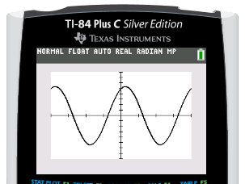
How do you write the equation of a sinusoid in the form y = Asin[B(x - C)] + D?

Slide 13
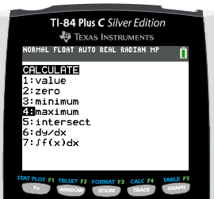
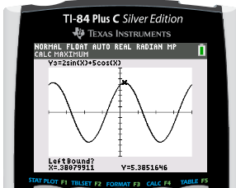
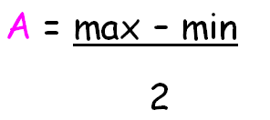
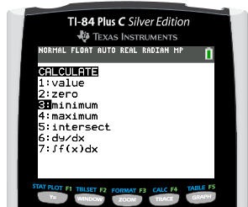
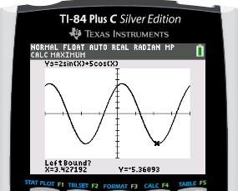

Slide 14
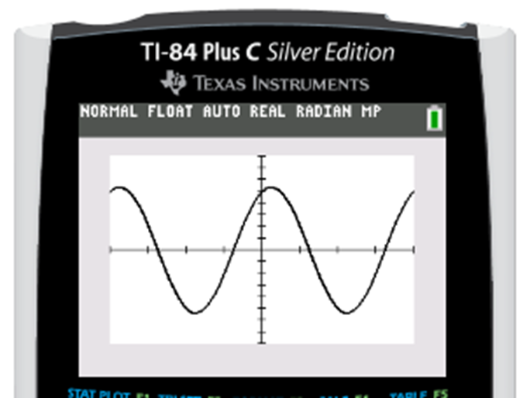
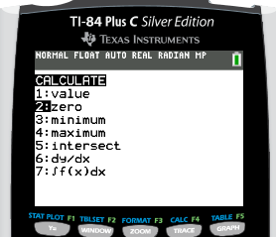
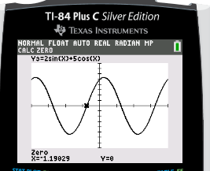
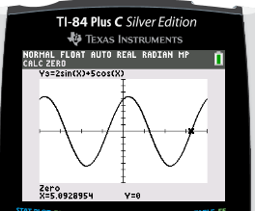
-1.19
5.09
NP = 5.09 – (-1.19) = 6.28
WHAT DOES THAT MEAN?
NO PERIOD CHANGE.

Slide 15
NO PERIOD CHANGE? PROVE IT.

Slide 16
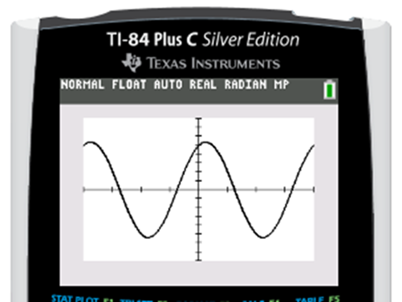
-1.19
RECALL: This point is at
x = -1.19.
*** PAY ATTENTION: Does the graph rise or fall at this
zero? That will determine if you need A or -A .

Slide 17
Therefore there has been NO vertical displacement (shift).
State your equation in the form f(x) = Asin[B(x - C)] + D
5.385sin(x + 1.190)
f(x) = ___________________________

Slide 18
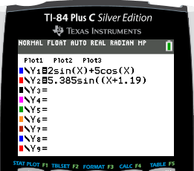
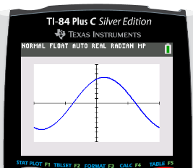
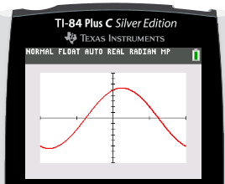

Slide 19
Complete these examples on your own. Show your work for determining each value of the equation
f(x) = Asin[B(x – C)] + D.
REMEMBER: There are many correct answers. Make sure your answer MATCHES the
original equation.
Ex 2. y = 4sinx + 3cosx
f(x) = 5sin(x + 0.64)
f(x) = 4.47sin[3.01(x – 0.369)] or
f(x) =4.47sin(3.01x – 1.11)
Ex 3. y = 2sin3x – 4cos3x
Ex 4. y = 3sin(2x – 1) + 4cos(2x + 3)
f(x) = 6.57sin[2(x – 0.7)]
or
f(x) = 6.57sin(2x – 1.4)

Slide 20
Assignment:
Practice Worksheet #1
“Exploring Sinusoidal Graphs”
You must show all steps for the work that justifies each value in the equation.

