Slide 1
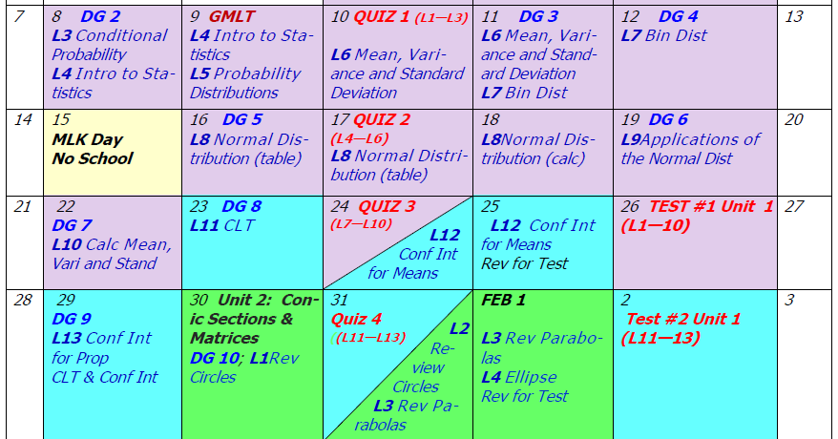
DAY 8 AGENDA
DG4 --- 10 minutes
Begin U1 L7

Slide 2
Accel Precalc
Unit #1: Data Analysis
Lesson #7: Binomial Distribution
EQ: What are the characteristics of a
binomial distribution and how do you calculate the probability of a specific event in this type of distribution?

Slide 4
2
Success
Failure

Slide 5
fixed number of observations n = ___
only 2 outcomes --- a success and a failure
each outcome independent of next outcome
probability stays the same for each trial

Slide 6
results
binomial distribution
outcomes
binomial experiment
probabilities

Slide 7
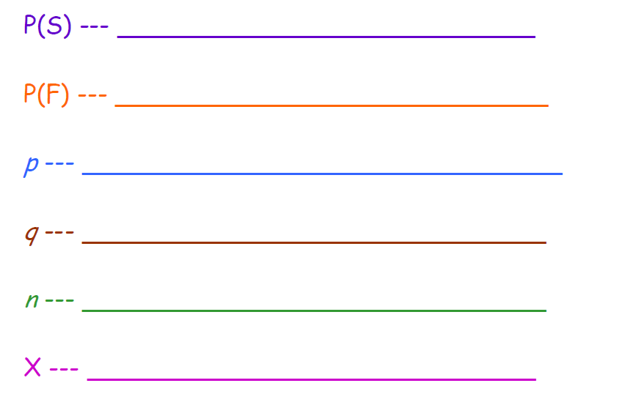
probability of success
probability of failure
numerical value of probability of success
numerical value of probability of failure
# of observations
# of successes in n observations

Slide 8
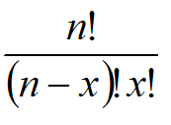

Slide 9
where x is the number of successes desired.

Slide 10
{HHH, TTT, HHT, TTH, THT, HTH,HTT, THH}
S = ________________________________
# of heads on 3 tosses of a coin
X= ________________________________
P(exactly two heads on 3 coins) =
P(X = 2) =

Slide 11
fixed # of observations n = 3
Success – Heads Failure - Tails
each toss independent of other tosses
p = ½ remains the same from trial to trial

Slide 12
3
2
1/2
1/2

Slide 13
Ex 2. A survey found that one out of five Americans say he or she has visited a doctor in any given month. If 10 people are selected at random, find the probability that exactly 3 will have visited a doctor last month.
fixed # of observations n = 10
Success – visit dr Failure – not visit dr
each visit independent of other visits
p = 1/5 remains the same from trial to trial

Slide 14
Ex 2. A survey found that one out of five Americans say he or she has visited a doctor in any given month. If 10 people are selected at random, find the probability that exactly 3 will have visited a doctor last month.

Slide 15
Ex 3. A survey from Teenage Research Unlimited found that 30% of teenage consumers receive their spending money from part-time jobs. If 5 teenagers are selected at random, find the probability that at
least 3 of them will have part-time jobs.
fixed # of observations n = 5
Success – part-time job Failure – not part time job
each employment status independent of other employment status
p = 0.30 remains the same from trial to trial

Slide 16
Ex 3. A survey from Teenage Research Unlimited found that 30% of teenage consumers receive their spending money from part-time jobs. If 5 teenagers are selected at random, find the probability that at
least 3 of them will have part-time jobs.

Slide 17
Ex 4. It has been reported that 5% of Americans are afraid of being alone in a house at night. If a random sample of 20 Americans are selected, find the following probabilities:
a) exactly 5 people in the sample are afraid of being alone at night
fixed # of observations n = 20
Success – afraid Failure – not afraid
each person’s fear independent of other person’s fear
p = 0.05 remains the same from trial to trial

Slide 18
Ex 4. It has been reported that 5% of Americans are afraid of being alone in a house at night. If a random sample of 20 Americans are selected, find the following probabilities:
a) exactly 5 people in the sample are afraid of being alone at night

Slide 19
Ex 4. It has been reported that 5% of Americans are afraid of being alone in a house at night. If a random sample of 20 Americans are selected, find the following probabilities:
b) at most 3 people in the sample are afraid of being alone at night

Slide 20
Ex 4. It has been reported that 5% of Americans are afraid of being alone in a house at night. If a random sample of 20 Americans are selected, find the following probabilities:
c) at least 3 people in the sample are afraid of being alone at night
OR

Slide 21
Try This One on Your Own
Ex 5. A report from the Secretary of Health and Human Services stated that 70% of single-vehicle traffic fatalities that occur at night on weekends involve an intoxicated driver. If a sample of 15 single-vehicle traffic fatalities that occur at night on weekends is selected, find the probability that exactly 12 involve a driver who is intoxicated.

Slide 22
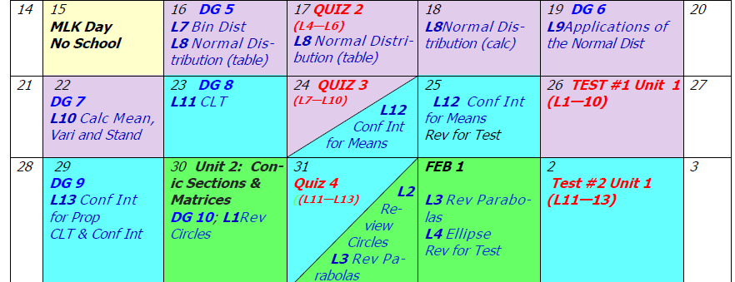
ASSIGNMENT: PW Binomial Distributions
#1, #2, #4a, #4b

Slide 23
Day 9 Agenda:
DG5 --- 20 minutes

Slide 24
Two Commands On the Graphing Calculator
1. binomialpdf --- for particular values of X; equals
Arguments: binomialpdf(n, p, x)
2. binomialcdf --- range of values of X; inequality
Arguments: binomialcdf(n, p, x)
includes that value

Slide 25
BINOMIALCDF FUNCTION WORKS FOR LESS THAN (LESS THAN or EQUAL TO)
GREATER THAN (GREATER THAN or EQUAL TO) USE:
1 – function
PAY ATTENTION TO WHICH VALUES SHOULD BE INCLUDED IN THE PROBABILITY!!

Slide 26
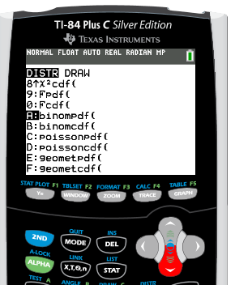
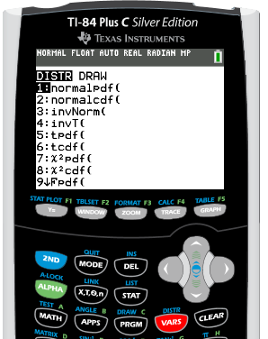
Use your graphing calculator and rework Ex #1 – 5. Write the commands you used below.
1. _______________________________________
STEP 1: 2nd VARS
STEP 2: scroll down to
A:binomialpdf

Slide 27
Use your graphing calculator and rework Ex #1 – 5. Write the commands you used below.
1. _______________________________________
0.5
binomialpdf(___, ___, ___)
3
2
CALCULATOR JARGON IS
NOT CONSIDERED WORK!!
THIS IS STILL THE WORK FOR THE PROBLEM!

Slide 28
Use your graphing calculator and rework Ex #1 – 5. Write the commands you used below.
2. _______________________________________
10
0.2
3
binomialpdf(___, ___, ___)
CALCULATOR JARGON IS
NOT CONSIDERED WORK!!
THIS IS STILL THE WORK FOR THE PROBLEM!

Slide 29
Use your graphing calculator and rework Ex #1 – 5. Write the commands you used below.
3. _______________________________________
0 1 2 3 4 5

Slide 30
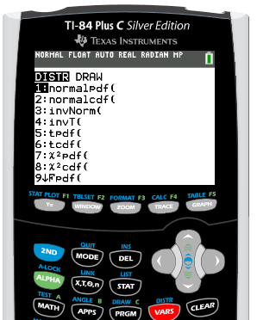
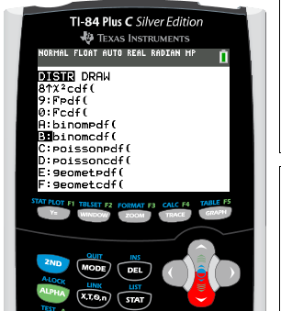
STEP 1: 2nd VARS
STEP 2: scroll down to
B:binomialcdf

Slide 31
Use your graphing calculator and rework Ex #1 – 5. Write the commands you used below.
3. _______________________________________
0 1 2 3 4 5
1 - binomialcdf(___, ___, ___)
5
0.3
2

Slide 32
Use your graphing calculator and rework Ex #1 – 5. Write the commands you used below.
4a. ________________________________________
20
0.05
5
4a) binomialpdf(___, ___, ___)

Slide 33
Use your graphing calculator and rework Ex #1 – 5. Write the commands you used below.
4b. ________________________________________
3
4b) binomialcdf(___, ___,___)
20
0.05

Slide 34
Use your graphing calculator and rework Ex #1 – 5. Write the commands you used below.
4c. ________________________________________
0 1 2 3 4 5 6 7 8 9 10 11 12 13 14 15 16 17 18 19 20
20
0.05
2
4c) 1 - binomialcdf(___, ___, ___)

Slide 35
Use your graphing calculator and rework Ex #1 – 5. Write the commands you used below.
5. _________________________________________
12
binomialpdf(___, ___, ___)
15
0.7

Slide 36
Rework #2, #3, #4 using the binomial distribution function on your graphing calculator.

