Slide 1
Accel Precalc
Unit #7: Trig Identities & Equations
Lesson 6: Solving BasicTrig Equations
EQ: How do you determine the solutions to trig equations?

Slide 2
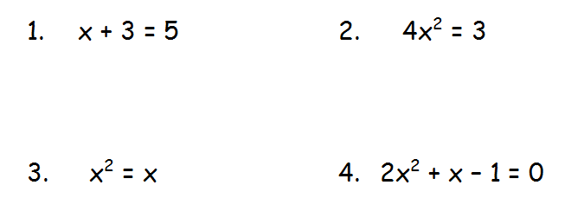
Recall
Solve These Algebra Equations
x = 2
-2
2 -1
1
x = 0 x = 1

Slide 3
FINITE
Algebraic equations have a _________ number of solutions.
Trig functions are “periodic”, therefore they will have an _____________ number of solutions.
INFINITE
NO
YES
Are there other angles on the Unit Circle that are solutions to this equation?

Slide 4
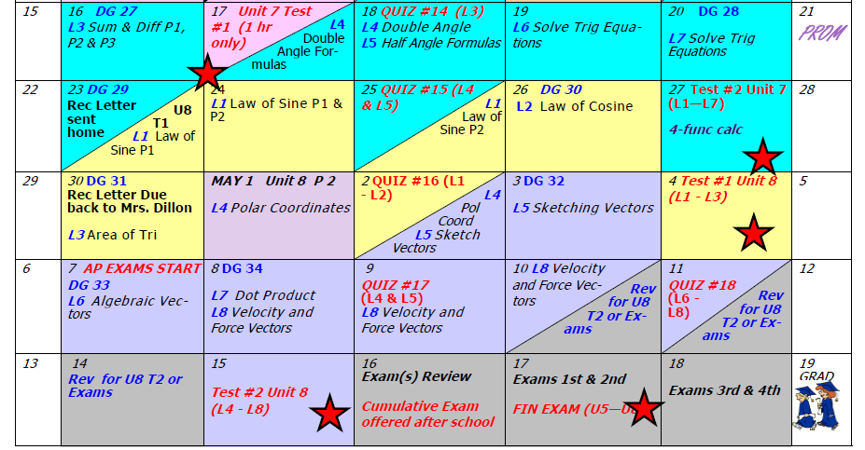
DAY 68AGENDA:
DG28 --- 12 minutes

Slide 5
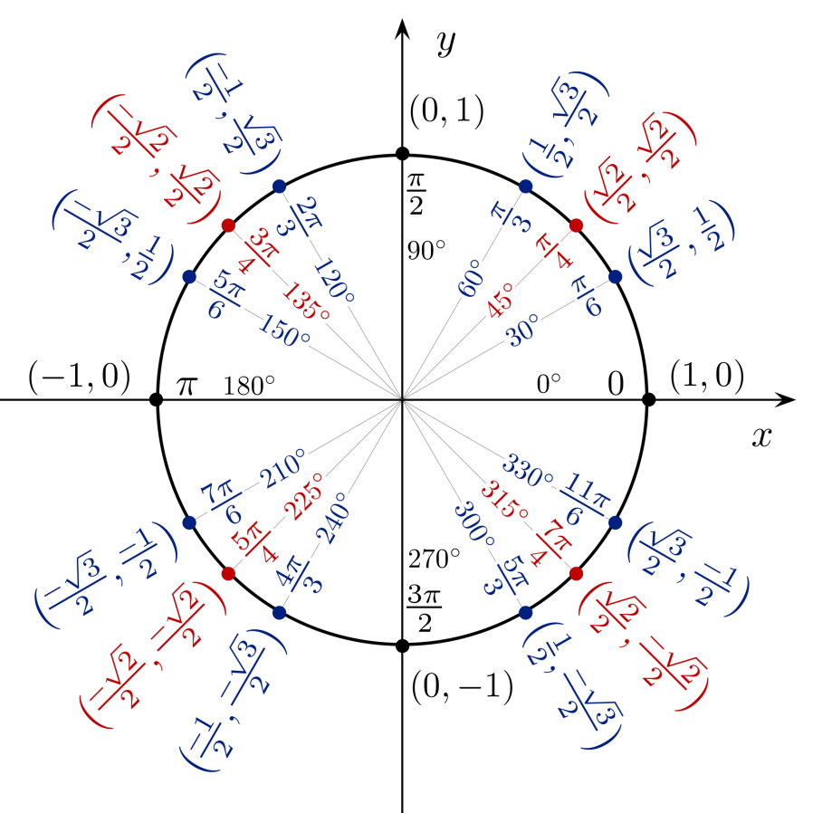
1 rotation
Infinite Solutions
Can go anywhere on unit circle.
Where k is an integer representing the number of rotations beyond the initial angle.

Slide 7
*** 1 is its own RECIPROCAL!!
Where k is an integer representing the number of rotations beyond the initial angle.

Slide 9
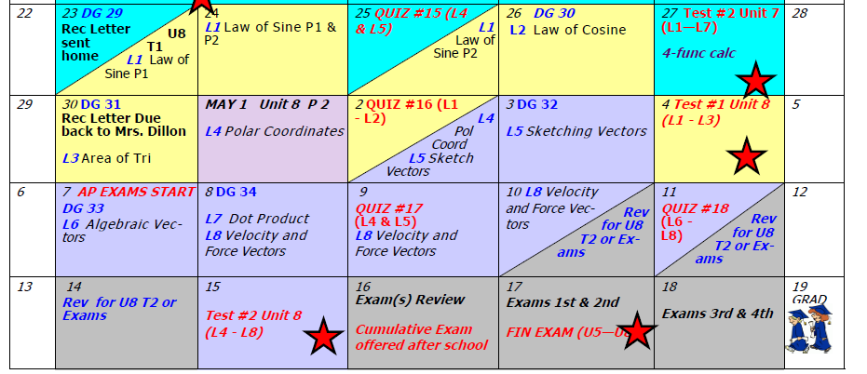
Assignment: PW #1 Solving Trig Equations
#1 – 14
Assignment: PW #2 Solving Trig Equations
#1 – 9

Slide 10
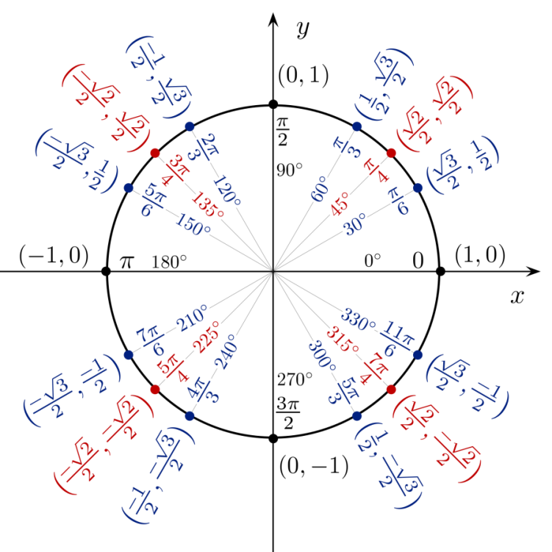
What is the question?
What angle(s), when doubled, will give a ratio of ½ for sine?
0
15°
1
195°
2
375°
0
75°
1
255°
2
435°
X
X

Slide 11
What is the question?
What angle(s), when halved, will give a ratio of ½ for cosine?
0
120°
1
840°
0
600°
X
X

Slide 12
What is the question?
What angle(s), when decreased by 90°, will give a ratio of 1 for tangent?
These are the same as just saying
Θ = 135º + 180kº. WHY?

Slide 13
0
135°
1
495°
0
315°
1
675°
X
X
Or just creating a table for Θ = 135º + 180kº.
0
135°
1
315°
2
495°
X

Slide 15
Place calculator in DEGREE MODE first.
Where else would sine return a positive ratio?
162.5°
Now change your calculator MODE to RADIANS and recalculate the angle.
2.84 rad
NOTE: It is a coincidence that the angle measure is the same as the ratio of the sides.
17.5°
0.3 rad
0.3 rad
17.5°
HOW?
3.14 rad – 0.3 rad = 2.84 rad

Slide 16
Place calculator in DEGREE MODE first.
Where else would sine return a negative ratio?
Now change your calculator MODE to RADIANS and recalculate the angle.
55.1°
55.1°
0.96 rad
0.96 rad

Slide 17
Place calculator in DEGREE MODE first.
Where else would cosine return a negative ratio?
Ref ∠ = 1.4 rad
Now change your calculator MODE to RADIANS and recalculate the angle.
Ref ∠ = 80.4°
99.6°
1.74 rad
Ref ∠ = 80.4°
Ref ∠ = 1.4 rad

