Slide 1
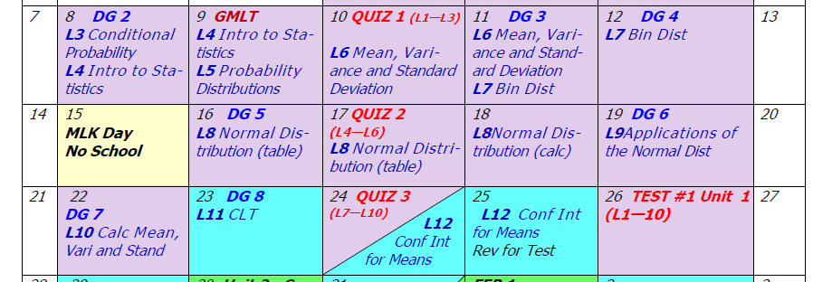
Day 6 Agenda:
Quiz 1 --- 30 minutes
For today’s lesson, U1 L6, you will need a graphing calculator.

Slide 2
Accel Math III
Unit #1: Data Analysis
Lesson #6: Mean, Variance, and Standard Deviation
EQ: How do you calculate mean, standard deviation, and variance for probability distributions?

Slide 3
Terms to Recall:
Measures of Center: Mean
Median Mode
Measures of Spread: Range
Quartiles
IQR
MAD
Standard Deviation
Variance

Slide 4
Find the mean, variance, and standard deviation of the data set
2, 3, 3, 4, 5, 6, 8, 8.
Recall: State what each of the following represent.
n = ________________________
X_{i} = _______________________
∑ = _______________________
# of elements in data set
specific element in data set
Summation of data set
_____________________

Slide 5
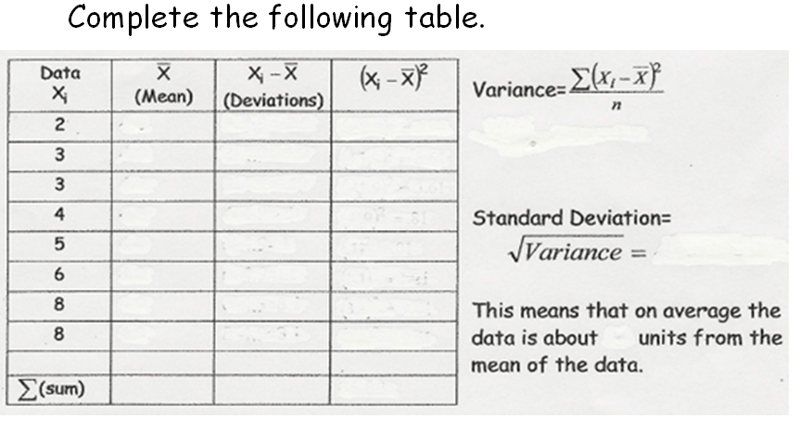
I will show you how to set up your graphing calculator and let it do the arithmetic work for you!

Slide 6
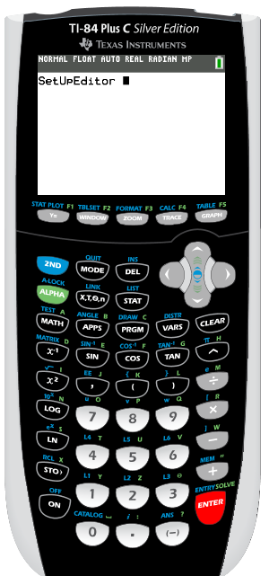
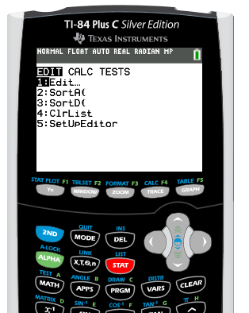
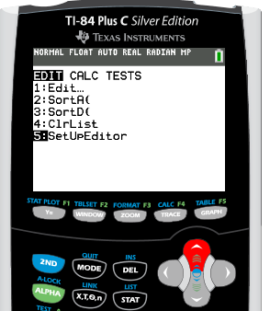

Slide 7
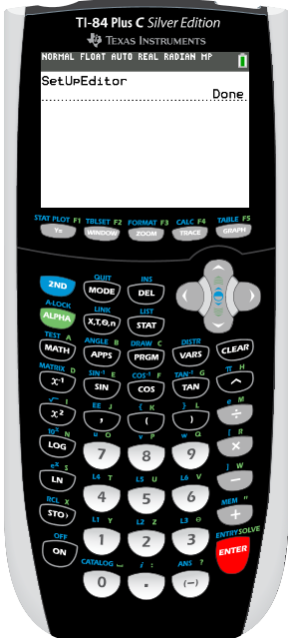
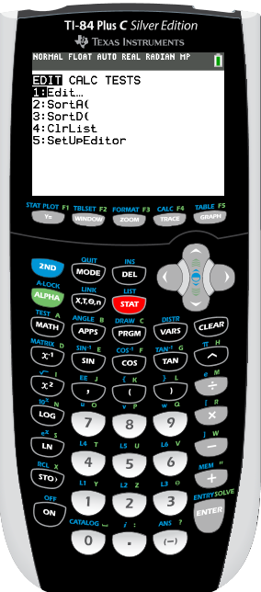
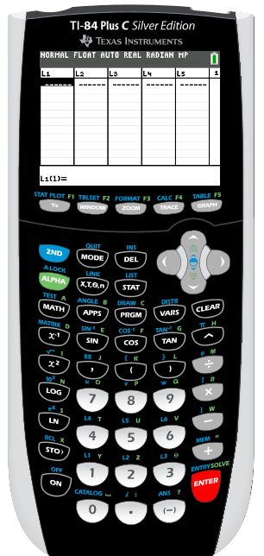
We will set up LISTS in our graphing calculator and let it do the work for us!

Slide 8
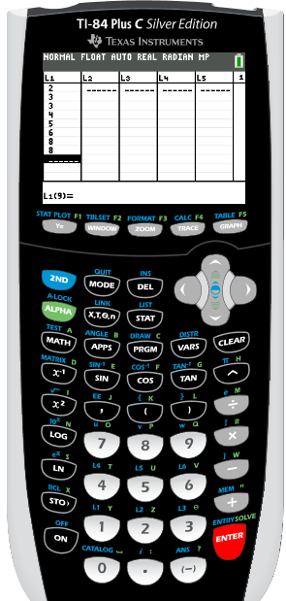
Step 1: Input the data set into
List 1 (L1)

Slide 9
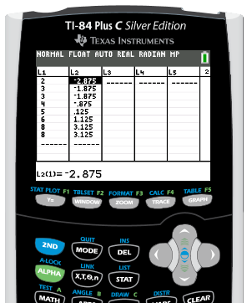
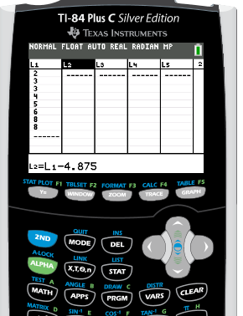
Step 2: Calculate the deviation of L1 and the mean and place it in L2.

Slide 10
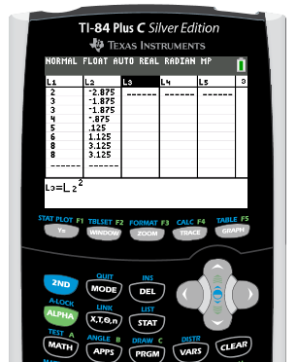
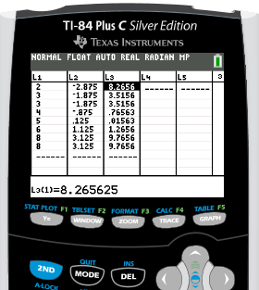
Step 3: Square L2 and place it in L3.

Slide 11
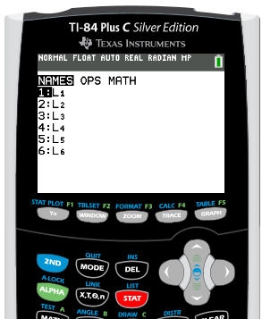
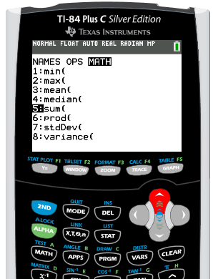
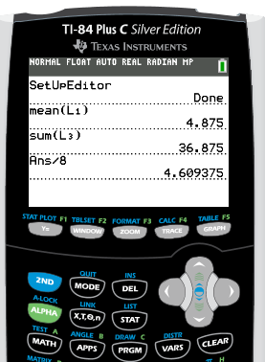
Step 4: Find the sum of L3 and divide by n.

Slide 12
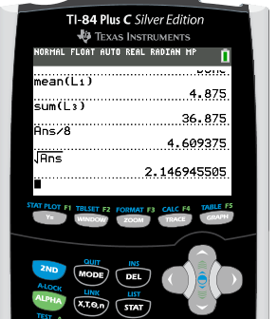
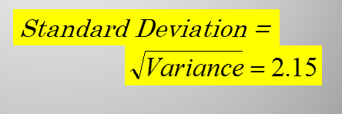
Step 5: Take the square root of this value.
This means on average, each data value is approximately 2.15 units from the mean of the data.

Slide 13

What About Calculating the Mean for Probability Distributions?
New Notation:

Slide 14
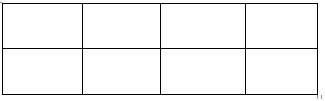
Recall: Sample Space for tossing two coins:
S = {HH, HT, TH, TT}
__________________________
Recall: Create the probability distribution for the number of heads when tossing two coins.
X 0 1 2
P(X) 1/4 1/2 1/4

Slide 15
Recall: What is expected value?
E(X) = ________________________
_____________________________
the mean value expected to occur over a LONG period of time
Recall: What is the formula for expected value?
E(X) = _______________________

Slide 16
Find the expected value for this sample space:
1
E(X) = ______________________
ROUNDING RULE: one more decimal place than the outcome X.
The example for tossing two coins should be rounded to the _______ place.
tenths

Slide 17
2. The probability distribution shown represents the number of trips of five nights or more that American adults take per year. (That is, 6% do not take any trips
lasting five nights or more, 70% take one trip lasting five nights or more per year, etc.) Find the mean (also known as ?).
X = number of trips of 5 nights or more that American
adults take per year

Slide 18
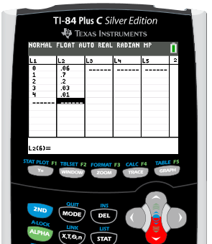
Let’s work SMARTER, not HARDER!
Step 1: Input the data set into L1 and the corresponding probability in L2

Slide 19
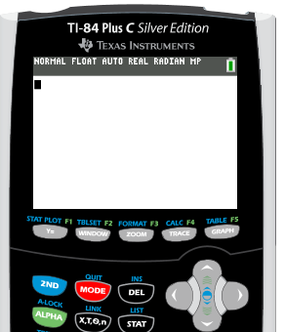
Step 2: Go back the home screen (2nd MODE).

Slide 20
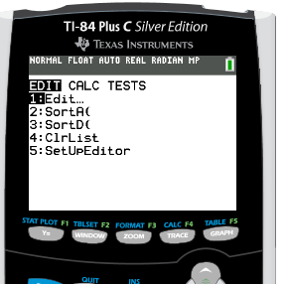
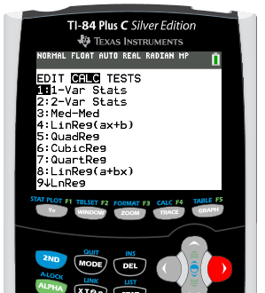
Step 3: Go to list EDIT.
Step 4: Arrow over to CALC.

Slide 21
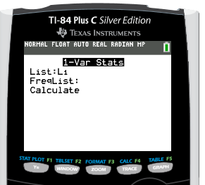
Step 5: ENTER.

Slide 22
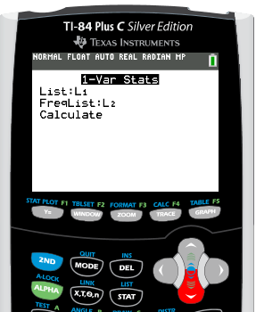
Step 6: Paste L1 (2nd 1) as List arrow down then paste L2 (2nd 2) as FreqList. ENTER on Calculate
NOTE: If you have an older TI-83, your home screen should look like:
1-Var Stats L1, L2
The COMMA is its own key, above the 7.

Slide 23
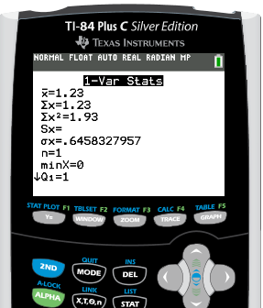
Step 6: Locate the Expected Value in the output.
You may use the 1st-Var Stats function to calculate the Expected Value in this class.
However you are required to show the formula with the values for the particular problem inserted into the formula correctly to receive full credit for your answer.

Slide 24

For examples #3 - 5, define the random variable X, create a probability distribution. Then answer the question.
3. Find the mean number of spots that appear when a single die is tossed.
X = ___________________________
number of spots appearing on a single toss of a die
X 1 2 3 4 5 6
P(X) 1/6 1/6 1/6 1/6 1/6 1/6
E(X) = _______________________

Slide 25
DAY 7 AGENDA
DG3 --- 10 minutes
Finish notes on U1 L6
Begin U1 L7

Slide 26
4. In a family with two children, find the mean of the number of children who are girls.
X = ___________________________
number of girls in a family of 2 children
X 0 1 2
P(X) 1/4 1/2 1/4
E(X) = _______________________

Slide 27
5. If three coins are tossed, find the mean of the number of heads that occur.
X = ___________________________
number of heads appearing on a toss of 3 coins
X 0 1 2 3
P(X) 1/8 3/8 3/8 1/8
E(X) = _______________________

Slide 28
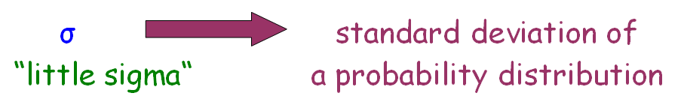
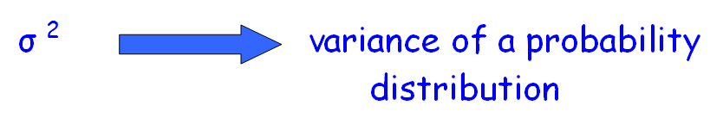
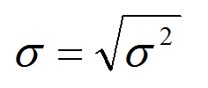

More New Notations:
Formulas:

Slide 29
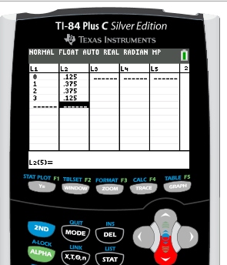
6. Calculate the variance and standard deviation for #5.
Again let’s work SMARTER, not HARDER!
Step 1: Input the data set into L1 and the corresponding probability in L2

Slide 30
Step 2: Go back the home screen (2nd MODE).

Slide 31
Step 3: Go to list EDIT.
Step 4: Arrow over to CALC.

Slide 32
Step 5: ENTER.

Slide 33
Step 6: Paste L1 (2nd 1) as List arrow down then paste L2 (2nd 2) as FreqList. ENTER on Calculate
NOTE: If you have an older TI-83, your home screen should look like:
1-Var Stats L1, L2
The COMMA is its own key, above the 7.

Slide 34
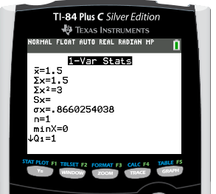
Step 6: Locate the Expected Value and the Standard Deviation in the output.
You may use the 1st-Var Stats function to calculate the Standard Deviation and Variance in this class.
However you are required to show the formula with the values for the particular problem inserted into the formula correctly to receive full credit for your answer.

Slide 35
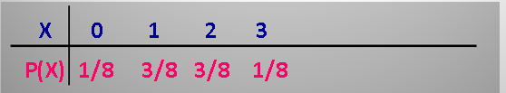
6. Calculate the variance and standard deviation for #5.
Show how the variance is obtained by inserting the correct values into the given formulas:

Slide 36

6. Calculate the variance and standard deviation for #5.
Show how the standard deviation is obtained by inserting the correct values into the given formulas:

Slide 37
REMEMBER: You may use your calculator functions to crunch the numbers, but you must show the correct formulas with values included to receive credit for answers.

Slide 38
Five balls numbered 0, 2, 4, 6, and 8 are placed in a bag. After the balls are mixed, one is selected, its number is noted, and then it is replaced. If this is repeated many times, find the variance and standard deviation of the numbers on the balls.
X = ___________________________
number on ball selected from a bag
X 0 2 4 6 8
P(X) 1/5 1/5 1/5 1/5 1/5
Use 1st Var Stat to first find the expected value. Then plug correct values into formulas to justify answers.

Slide 39
Five balls numbered 0, 2, 4, 6, and 8 are placed in a bag. After the balls are mixed, one is selected, its number is noted, and then it is replaced. If this is repeated many times, find the variance and standard deviation of the numbers on the balls.
X = ___________________________
number on ball selected from a bag
X 0 2 4 6 8
P(X) 1/5 1/5 1/5 1/5 1/5

Slide 40
For examples #8, define the random variable X then answer the question.
8. A talk radio station has four telephone lines. If the host is unable to talk (during a commercial) or is talking to a person, the other callers are placed on hold. When all lines are in use, others who are trying to call in get a busy signal. The probability that at most 4 people will get through is shown in the distribution. Find the variance and standard deviation for the distribution. Should the station have considered getting more phone lines installed?
# of callers who get through to radio talk show host out of 4 callers
X = ___________________________

Slide 41
For examples #8, define the random variable X then answer the question.
8. A talk radio station has four telephone lines. If the host is unable to talk (during a commercial) or is talking to a person, the other callers are placed on hold. When all lines are in use, others who are trying to call in get a busy signal. The probability that at most 4 people will get through is shown in the distribution. Find the variance and standard deviation for the distribution. Should the station have considered getting more phone lines installed?

Slide 42
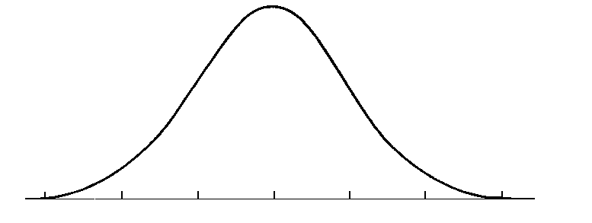
What is the expected number of calls received through these 4 phone lines?
E(X) = 1.6 calls
What is the standard deviation of calls received?
Are MOST callers accommodated by the number of phone lines at the radio station? WHY?
2.7
2.7 + 1.1
1.6
1.6 + 1.1
3.8

Slide 43
Are MOST callers accommodated by the number of phone lines at the radio station? WHY?
1.6
2.7
3.8
3.8 callers will get through majority of the time, so the station DOES NOT need to add more phone lines.

Slide 44
Assignment:
Practice Worksheet:
Mean, Variance, and Standard Deviation of Probability Distributions

