Slide 1
Accel Precalc
Unit #6: Graphs and Inverses of Trig Functions
Lesson 6: Graphs of Tangent and Cotangent
EQ: How do you use the values from the unit circle to create the graphs of tangent and cotangent?

Slide 2
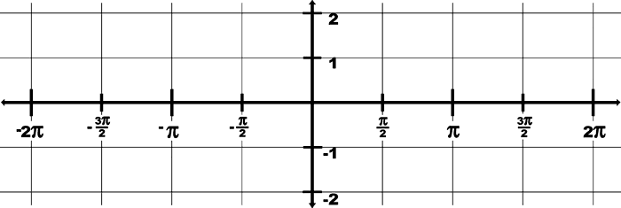
In Class Activity: Handout: Graphing Tangent and
Cotangent
Graphing f(x)=tan(x)
x | y = tan(x) | (x,y)
-2π | 0 | (-2π, 0)
-7π/4 | 1
-3π/2 | undefined | VA
-5π/4
-π
-3π/4
-π/2
-π/4
0
π/4
π/2
3π/4
π
5π/4
3π/2
7π/4
2π
(-7π/4, 1 )
-1
(-5π/4, -1 )
0
(-π, 0 )
1
(-3π/4, 1 )
Undefined
Vert Asymp
-1
(-π/4, -1 )
0
(0, 0 )
1
(π/4, 1 )
Undefined
Vert Asymp
-1
(3π/4, -1 )
0
(π, 0 )
1
(5π/4, 1 )
Undefined
Vert Asymp
-1
(7π/4, -1 )
0
(2π, 0 )

Slide 3
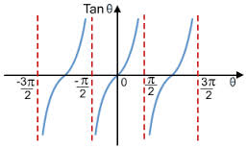
Facts to know about the tangent function:
The domain is _______________
(-∞, ∞)
2. The range is __________
3. Tangent is symmetric to the _______, therefore it is an ____ function.
origin
odd
π
180°
4. Tangent cycles every ____ or ___˚.

Slide 4
The x-intercepts are _____________ (List 4)
0
6. The y-intercept is ______
7. The asymptotes occur at ______________ (list 4)

Slide 5
Graphing f(x) = cot (x)
x | y = cot(x) | (x,y)
-2π | undefined | VA
-7π/4 | 1 | (-7π/4 , 1)
-3π/2 | 0
-5π/4
-π
-3π/4
-π/2
-π/4
0
π/4
π/2
3π/4
π
5π/4
3π/2
7π/4
2π
(-3π/2, 0 )
-1
(-5π/4,-1 )
Undefined
Vert Asymp
1
(-3π/4, 1 )
0
(-π/2, 0 )
-1
(-π/4,-1 )
Undefined
Vert Asymp
1
(π/4, 1 )
0
(π/2, 0 )
-1
(3π/4,-1 )
Undefined
Vert Asymp
1
(5π/4, 1 )
0
(3π/2, 0 )
-1
(7π/4,-1 )
Undefined
Vert Asymp

Slide 6
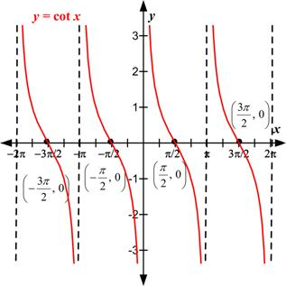
Facts to know about the cotangent function:
The domain is _______________
(-∞, ∞)
2. The range is __________
3. Cotangent is symmetric to the _______, therefore it is an ____ function.
origin
odd
π
180°
4. Cotangent cycles every ____ or ___˚.

Slide 7
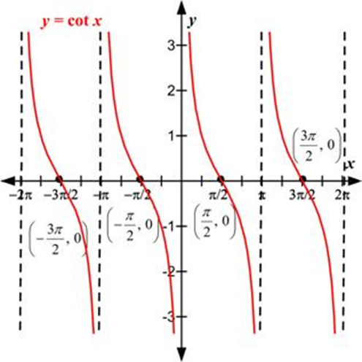
The x-intercepts are _____________ (List 4)
none
6. The y-intercept is ______
7. The asymptotes occur at ______________ (list 4)

Slide 8
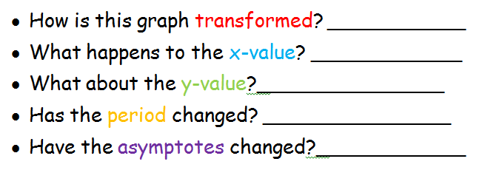
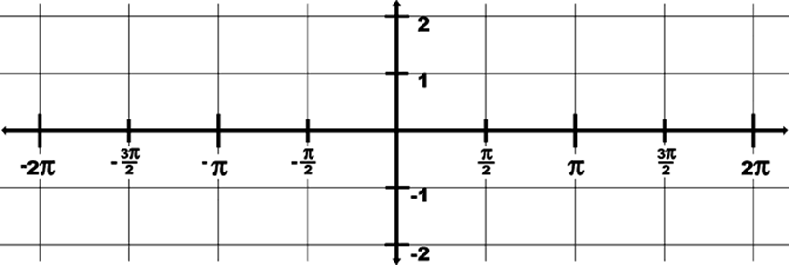
Transformations of the Tangent
and Cotangent Functions
1. y = tan(x - π/2)
Horizontal Shift Right
Add π/2
No change
No change
Move right π/2

Slide 9
2. y = -2tan(x)
Reflect and Vertical Stretch
nothing
Negate and double
No change
No change

Slide 10
3. y = cot(x) + 1
Vertical Shift up
nothing
Add 1
No change
No change

Slide 11
4. y = cot(2x)
Horizontal Shrink
Divide by 2
No change
Divide by 2
Divide by 2

Slide 12
Assignment:
PW #1 Graphing Tangent and Cotangent
PW #2 Graphs of Tangent, Cotangent, Secant, and
Cosecant
Pre-calculus Worksheet Tangent and Cotangent

