Slide 1
Accel Precalc
Unit 8: Extended Trigonometry
Lesson 6: Algebraic Vectors
EQ: How can you represent vectors algebraically and how do you perform algebraic operations on vectors?

Slide 2
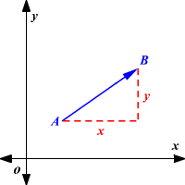
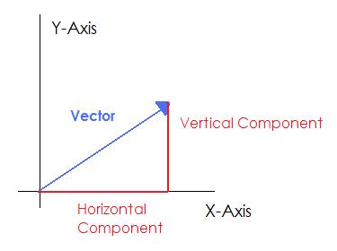
PART II:
Algebraic Vectors
Terms & Symbols to Know:
Vectors in the Plane ---
Vertical Component
x-component and y–component
Horizontal Component

Slide 3
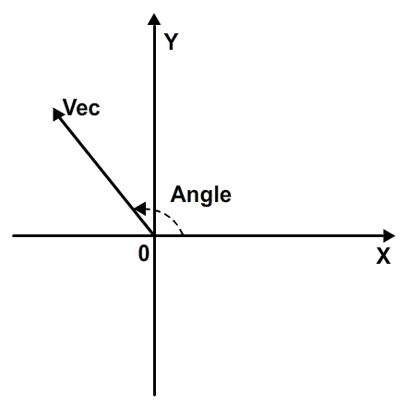
Angle of a Vector --- the angle between the x-axis and the vector's direction line.

Slide 4
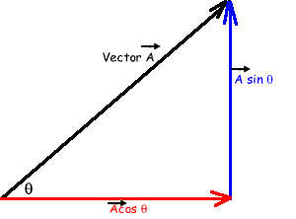
Recall:
Polar to Rectangular
x =
Y =
The radius in the polar plane would equal the magnitude of a vector.
Magnitude of a Vector
--- length of vector
Horizontal Component =
Vertical Component =

Slide 5
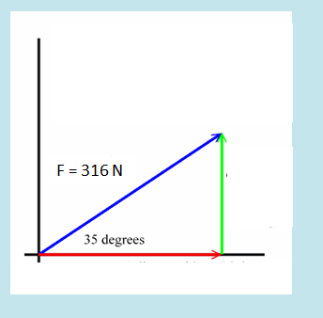
Ex. Find the horizontal and vertical components of the given vector.

Slide 6
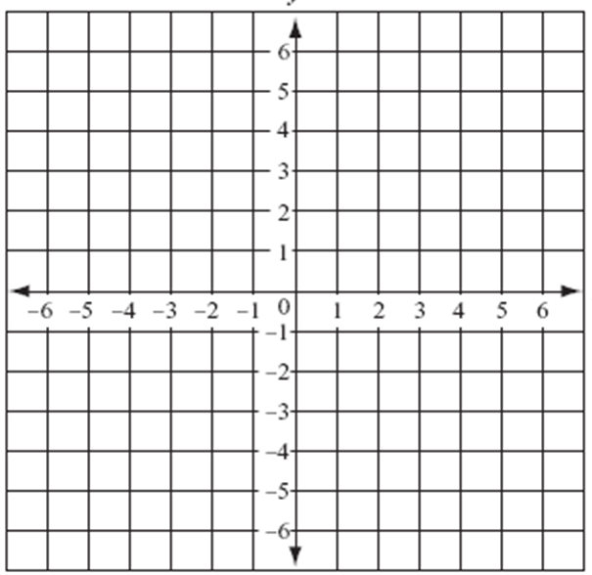
RECALL: How do you calculate the distance between two stationary points?

Slide 7
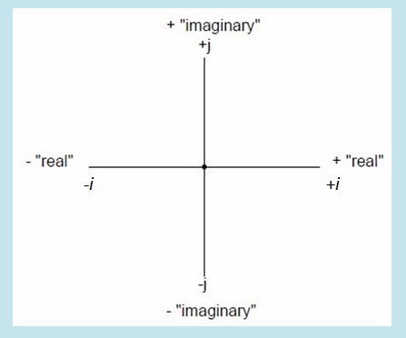
Component form of a vector ---

Slide 8
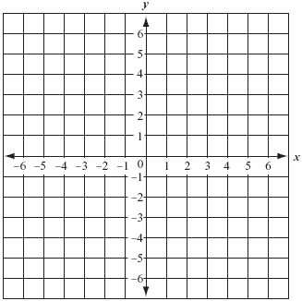
Ex Graph the following vectors.

Slide 9
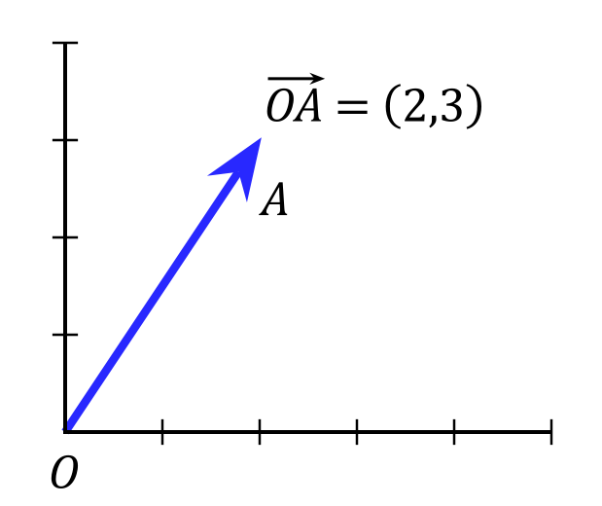
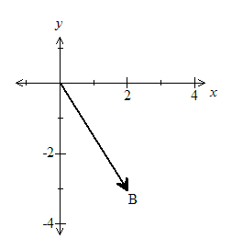
These are all examples of Position Vectors.
---vector whose initial point is at
the pole
Position Vector

Slide 11
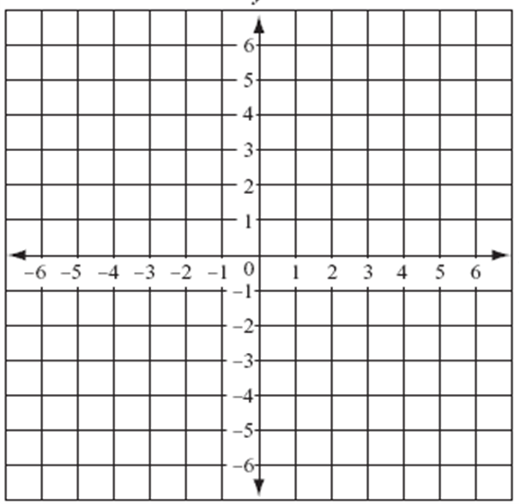
Unit Vector --- a vector of length one
Components of a Unit Vector
Ex. Find a unit vector in the direction of v = -2i + 5j. Verify that this vector has length 1.

Slide 12
Ex. Find a unit vector in the direction of v = -2i + 5j. Verify that this vector has length 1.

Slide 13
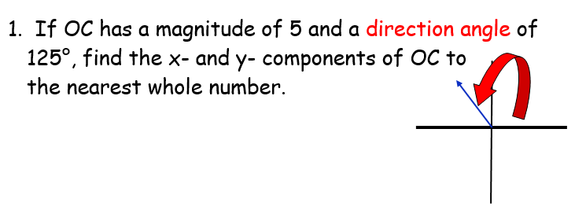
In class practice:
$$x=5cos125°$$
$$y=5\sin{125}°$$
$$x=−3$$
$$y=4$$

Slide 14
In class practice:
$$\left||w|\right|=\sqrt{{\left(3\right)}^{2}+{\left(−2\right)}^{2}}$$

Slide 15
In class practice:
$${\left|x\right|}^{2}={\left(200\right)}^{2}+{\left(26\right)}^{2}−2\left(200\right)\left(26\right)\cos{58}°$$
200
$$\left|x\right|= 187.5mph$$
58 $°$
26
58 $°$
Z
x
$${26}^{2}={187.5}^{2}+{200}^{2}−2(187.5)(200)\cos{Z}$$
$$∠Z≈8.75°$$
Alt Int Angles are Congruent
Bearing of 58° + 6.75°= 64.75°

Slide 17
Assignment: Practice Worksheet #2
Algebraic Vectors

