Slide 1
Day 79 AGENDA:
DG33 --- 10 minutes

Slide 2
Accel Precalc
Unit 8: Extended Trigonometry
Lesson 6: Algebraic Vectors
EQ: How can you represent vectors algebraically and how do you perform algebraic operations on vectors?

Slide 3
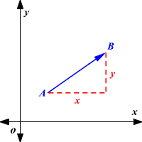
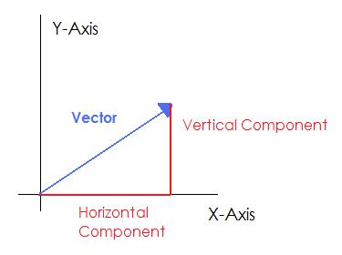
PART II:
Algebraic Vectors
Terms & Symbols to Know:
Vectors in the Plane ---
Vertical Component
x-component and y–component
Horizontal Component

Slide 4
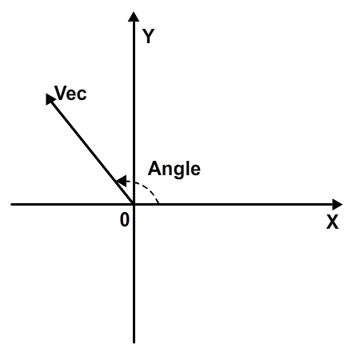
Angle of a Vector --- the angle between the x-axis and the vector's direction line.

Slide 5
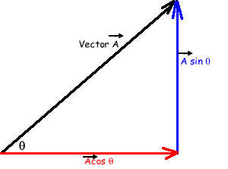
Recall:
Polar to Rectangular
x =
Y =
The radius in the polar plane would equal the magnitude of a vector.
Magnitude of a Vector
--- length of vector
Horizontal Component =
Vertical Component =

Slide 6
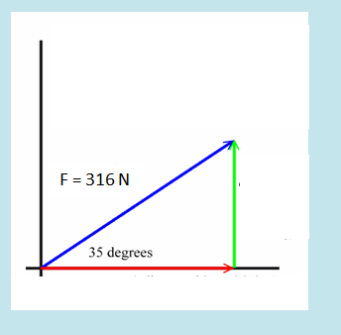
Ex. Find the horizontal and vertical components of the given vector.

Slide 7
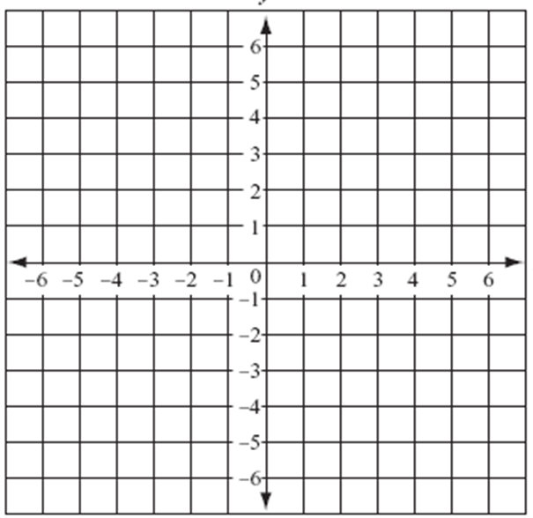
RECALL: How do you calculate the distance between two stationary points?

Slide 8
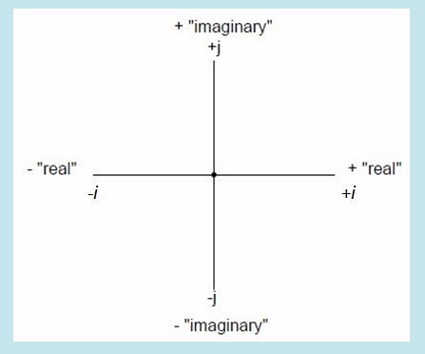
Component form of a vector ---

Slide 9
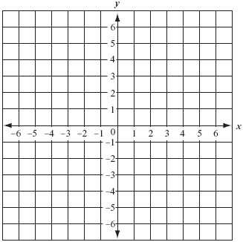
Ex Graph the following vectors.

Slide 10
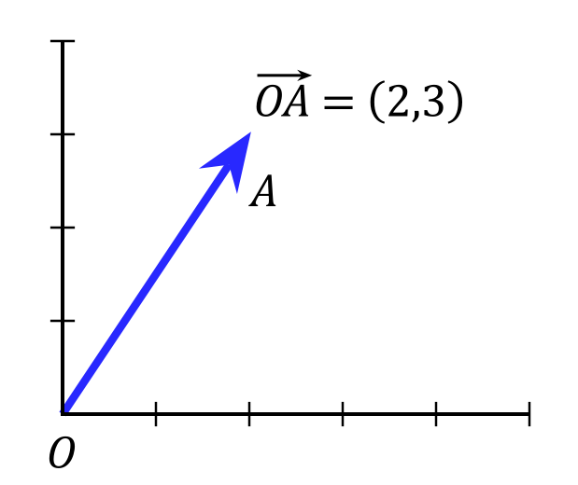
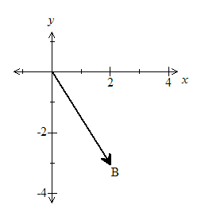
These are all examples of Position Vectors.
---vector whose initial point is at
the pole
Position Vector

Slide 12
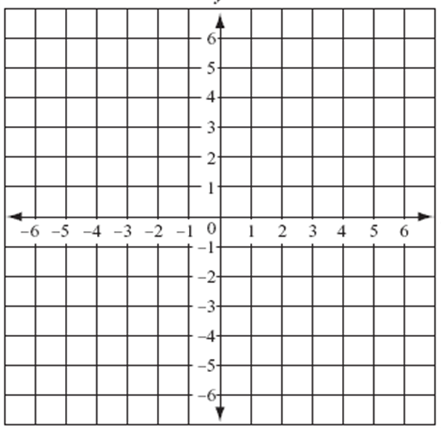
Unit Vector --- a vector of length one
Components of a Unit Vector
Ex. Find a unit vector in the direction of v = -2i + 5j. Verify that this vector has length 1.

Slide 13
Ex. Find a unit vector in the direction of v = -2i + 5j. Verify that this vector has length 1.

Slide 14
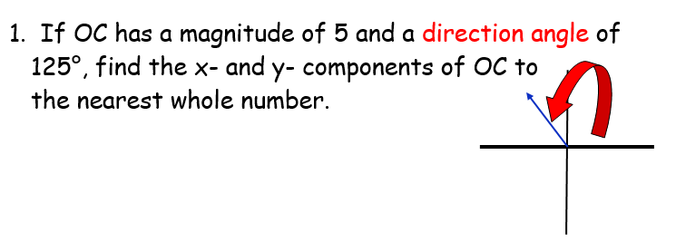
In class practice:

Slide 16
Assignment: Practice Worksheet #2
Algebraic Vectors

