Slide 1
Accel Precalc
Unit #7: Trig Identities
Lesson 5: Half-Angle Formulas
EQ: How can you use half- angle formulas to evaluate angles NOT on the unit circle?

Slide 2
Half-Angle Formulas (will not derive)
***Sign of radical based on location of half-angle

Slide 3
Ex. Find the exact value of each using a half-angle formula.
Where is the half angle located?
1. sin 15°

Slide 4
Where is the half angle located?
2. cos 22.5°

Slide 5
13
5
-12
Where is the half angle located?

Slide 6
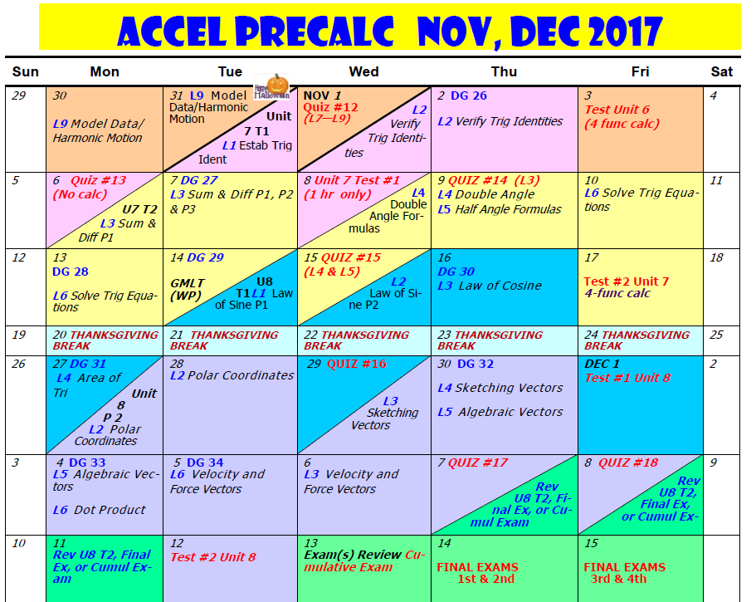

Slide 7
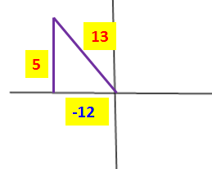

Slide 8
Don’t have to worry about location of half angle. WHY?
What about…

Slide 9
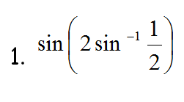
*** Treat this as a DOUBLE ANGLE problem.
2
1
Or recognize this RATIO is on your UNIT CIRCLE!!

Slide 10
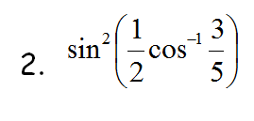
*** Treat this as a HALF ANGLE problem.
5
4
3

Slide 11
