Slide 1
Accel Precalc
Unit #6: Graphs and Inverses of Trig Functions
Lesson 5: Graphs of Secant and Cosecant
EQ: How do you use the values from the unit circle to create the graphs of secant and cosecant?

Slide 2
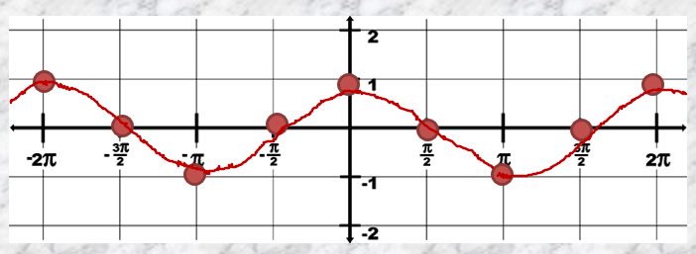
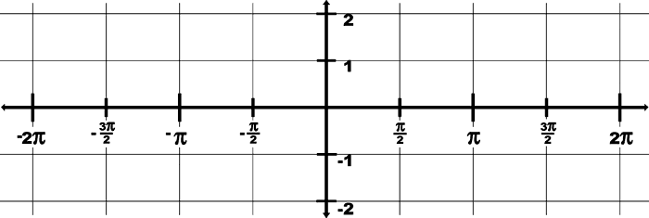
In class Activity: Graphing Secant & Cosecant
Graphing f(x)=sec(θ)
[Hint: Since sec is the reciprocal of cos, graph cos first.]
x | y=sec(x) | (x,y)
-2π | 1
-7π/4 | √2 | (-7π/4 , 1.4)
-3π/2 | Undefined | Vertical asymptote
-5π/4
-π
-3π/4
-π/2
-π/4
0
π/4
π/2
3π/4
π
5π/4
3π/2
7π/4
2π
(-2π, 1)
-1.4
(-5π/4, -1.4 )
-1
(-π, -1 )
-1.4
(-3π/4, -1.4 )
Undefined
Vert Asymp
1.4
(-π/4, 1.4 )
1
(0, 1 )
1.4
(π/4, 1.4 )
Undefined
Vert Asymp
-1.4
(3π/4, -1.4 )
-1
(π, -1 )
-1.4
(5π/4, -1.4 )
Undefined
Vert Asymp
1.4
(7π/4, 1.4 )
1
(2π, 1 )

Slide 3
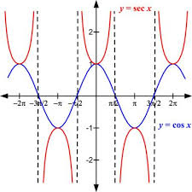
Graph of sec θ = y.
This is the parent function for secant that you must learn in order to do transformations.

Slide 4
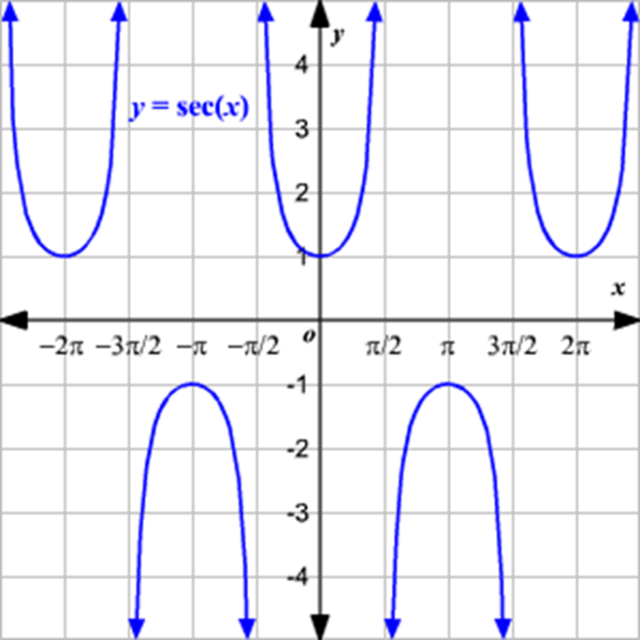
Facts to know about the graph of sec(θ):
The domain is ___________.
Therefore you will have _______ ___________.
Vertical Asymptotes
List at least 4 asymptotes ____________. They will occur every ___.
(-∞, -1] ∪ [1, ∞)
2. The range is _________.

Slide 5
3. Secant is symmetric to the ________. Therefore secant is an ______ function.
y- axis
EVEN
4. The secant function is periodic.
It cycles every ______ or ___.
2π
None
5. Are there any x-intercepts? _______
1
6. Is there a y-intercept?_____

Slide 6
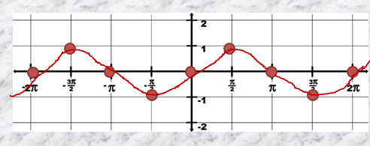
In class Activity: Graphing Secant & Cosecant
Graphing f(x)=csc(θ)
[Hint: Since csc is the reciprocal of sin, graph sin first.]
x | y=csc(x) | (x,y)
-2π | undefined | Vertical asymptote
-7π/4 | √2 | (-7π/4 , 1.4)
-3π/2 | 1
-5π/4
-π
-3π/4
-π/2
-π/4
0
π/4
π/2
3π/4
π
5π/4
3π/2
7π/4
2π
(-3π/2, 1 )
1.4
(-5π/4, 1.4 )
Undefined
Vert Asymp
-1.4
(-3π/4, -1.4 )
-1
(-π/2, -1 )
-1.4
(-π/4, -1.4 )
Undefined
Vert Asymp
1.4
(π/4, 1.4 )
1
(π/2, 1 )
1.4
(3π/4, 1.4 )
Undefined
Vert Asymp
-1.4
(5π/4, -1.4 )
-1
(3π/2, -1 )
-1.4
(7π/4, -1.4 )
Undefined
Vert Asymp

Slide 7
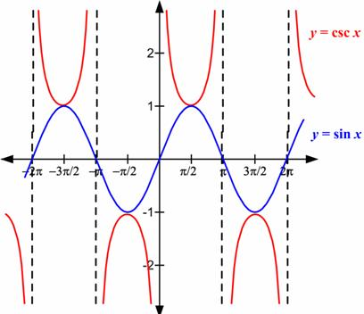
Graph of csc θ = y.
This is the parent function for secant that you must learn in order to do transformations.

Slide 8
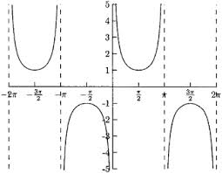
Facts to know about the graph of csc(θ):
The domain is ___________.
Therefore you will have _______ ___________.
Vertical Asymptotes
List at least 4 asymptotes ____________. They will occur every ___.
(-∞, -1] ∪ [1, ∞)
2. The range is _________.

Slide 9
3. Cosecant is symmetric to the ________. Therefore cosecant is an ______ function.
origin
ODD
4. The cosecant function is periodic.
It cycles every ______ or ___.
2π
None
5. Are there any x-intercepts? _______
NO
6. Is there a y-intercept?_____

Slide 10
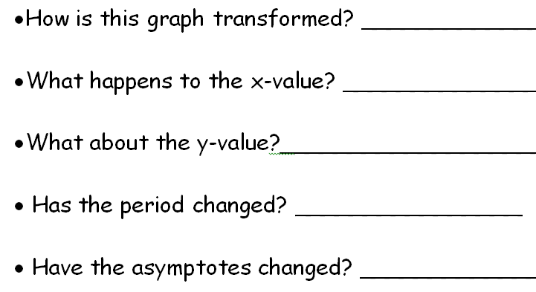
Transformations of the Secant and Cosecant Functions
1. y = sec(x + π/4)
Horizontal shift left
Subtract π/4
No change
No change
Shift left π/4

Slide 11
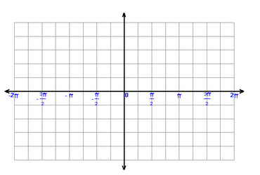
RECALL:
PARENT FUNCTION

Slide 12
2. y = sec(2x)
Horizontal shrink
Divide by 2
No change
yes
yes

Slide 13
RECALL:
PARENT FUNCTION

Slide 14
3. y = -csc(x) + 1
Reflect across x-axis;
vertical shift up
No change
Negate then add 1
No change
No change

Slide 16
4. y = ½csc(x - π/2) + 2
vert shrink, shift right, vert shift up
add π/2
add 2, divide by 2
Yes, shifted right π/2

Slide 17
4. y = ½csc(x - π/2) + 2

Slide 18
Assignment:
PW #1 Graphing Secant and Cosecant
Precalc Worksheet Cosecant and Secant

