Slide 1
Day 77 AGENDA:
DG32-- 15 minutes

Slide 2
Accel Precalculus
Unit #8: Extended Trigonometry
Lesson 5: Sketching Vectors and
Operations on Vectors
EQ: What are vectors and how are they represented in the real world?

Slide 3
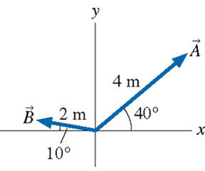
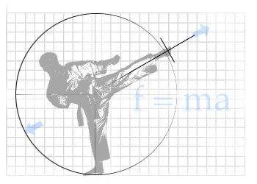
PART I: Geometric Vectors
Scalar
--- quantity that describes magnitude
or size only (with or without units). It does not
include direction.
Ex. temperature, area, distance, speed, mass
--- a directed line segment with an arrow head at the end indicating a direction
Vector
Ex. Displacement, Force, Velocity

Slide 4
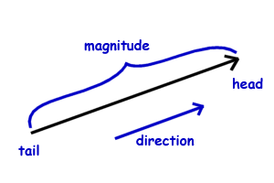
Magnitude of a Vector
--- length; notation | v |
Equivalent Vectors
--- same magnitude and direction

Slide 5
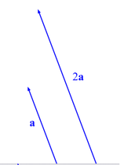
Opposite Vectors
--- same magnitude,
opposite direction
from initial point
Scalar Multiplication
--- alters the magnitude and (possibly) direction

Slide 6
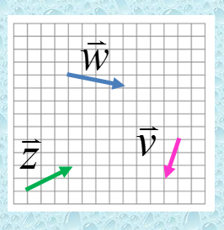
Ex. Using the diagram to the right
to create

Slide 7
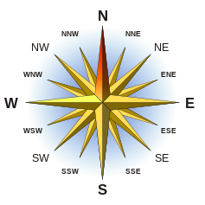
--- angle measures
east or west of the
north-south line.
Compass Bearing of a Vector

Slide 8
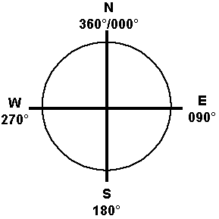
--- angle
measured clockwise from due north
True Bearing or Heading of a Vector

Slide 9
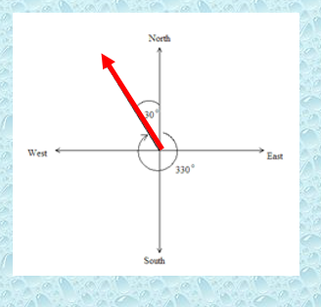
The compass bearing would be given as N30°W.
The true bearing would be given as 330°.

Slide 10
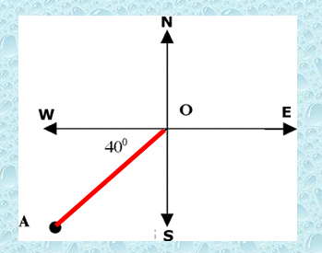
Ex. Write down the bearing notations for the given vector in the diagram.
The compass bearing would
be given as S50°W.
?
The true bearing would be given as 230°.

Slide 11
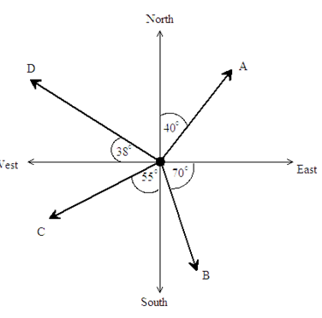
Ex. Write down the compass bearings of the points A, B, C and D in the diagram, using:
N40°E
S20°E
S55°W
N52°W

Slide 12
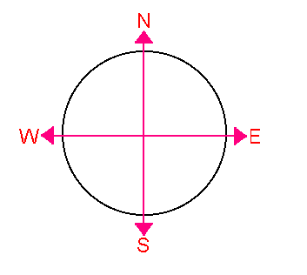
Ex. Sketch a vector having
45°
a) bearing S20°E
300°
b) heading 300°
20°
c) wind from 45°

Slide 13
Ex. A ship leaves port on a bearing of 28° and travels
8.2 mi. The ship then turns due east and travels
4.3 mi. How far is the ship from port? What is its bearing from port?
Now use Law of Cosines to solve for distance.
48.4°
Z
Now use Law of Sines to solve for bearing.
Bearing of 28° + 20.4°=
48.4°

Slide 14
--- speed relative to the air
Airspeed of a Plane
Groundspeed of a Plane
--- speed relative to the ground;
a result of wind direction and wind speed acting on plane

Slide 15
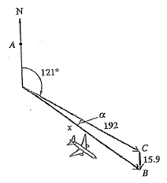
Ex. An airplane with an air speed of 192 mph is flying on a heading of 121°. A north wind is blowing at 15.9 mph. Find the groundspeed and the actual bearing of the plane.
124.89°
Bearing of 121° + 3.89°=
124.89°
WHY?
Alt Interior Angles are Congruent

Slide 16
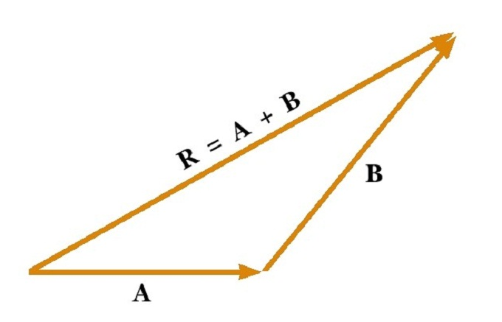
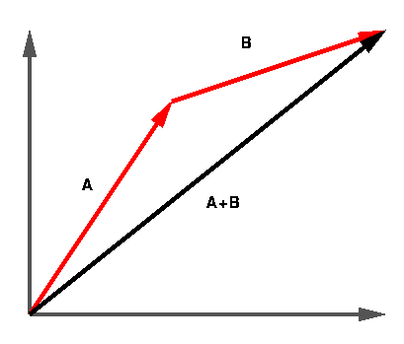
Resultant (sum) of Two Vectors --
--- drawn from initial point of first vector to terminal point of second vector

Slide 17
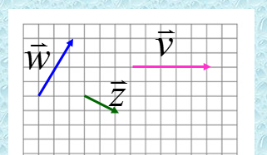
Use the vectors at the right to draw
the resultant vectors.
What do you notice about these vectors?

Slide 18
Use the vectors at the right to draw
the resultant vectors.

Slide 19
Use the vectors at the right to draw
the resultant vectors.

Slide 20
Use the vectors at the right to draw
the resultant vectors.

Slide 21
Assignment:
Practice Worksheet #1: Sketching Vectors

