Slide 1
Day 53 Mar 25 Agenda:
DG 23 --- 10 minutes
Complete notes on U6 L4

Slide 2
Accel Precalc
Unit #6: Graphs and Inverses of Trig Functions
Lesson 4: Transformations of Sine and Cosine Graphs
EQ: How do transformations change the graphs of sine
and cosine ?

Slide 3
Recall:
Transformations of Graphs of Functions
Given y = f(x) transformed function
y = af[b(x - h)] + k
Where:
a → vertical stretch/shrink
b → horizontal stretch/shrink
h → horizontal shift
k → vertical shift

Slide 4
Standard Form: Transformations of Sine and Cosine Graphs:
y = Asin[B(x – C)] + D
y = Acos[B(x – C)] + D
Amplitude
--- represented by A; notation | A |;
measured from the horizontal line of
symmetry
Graphically --- distance from horizontal line
of symmetry to max or min

Slide 5
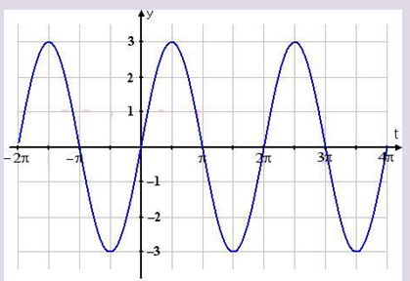
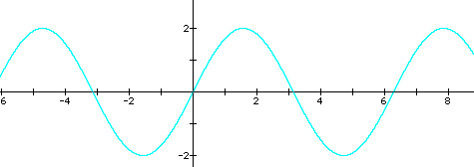
Find the amplitude both graphically and algebraically. Then write the function represented by the graph.
Would you consider this a sine or cosine graph? WHY?
|A|= 3
graphically
algebraically
y = ___sin ( x)
3
|A| = 2
graphically
algebraically
2
y = __ sin ( x)

Slide 6
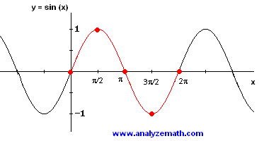
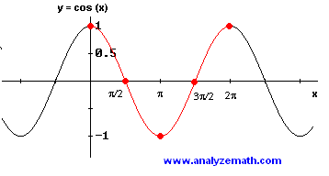
New Period
--- complete cycle on graph or calculate using
B from equation
Sine and Cosine cycle every 360° or 2π radians.
“Ride” the wave until you have completed an entire cycle.

Slide 7
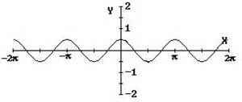
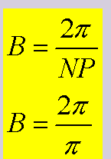
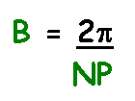
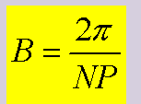
Ex 3. What is the amplitude and new period for graph below?
Would you consider this a sine or cosine graph? WHY?
A = 0.5
Use graph to determine B.
Identify consecutive
critical points, then determine
the period of the graph.
NP = π
y = ___ cos ( __ x)
0.5
2

Slide 8
Use amplitude and new period to graph the equation.
Ex 4. y = 3cos (½x) A = ____ B = ____
3
1/2
-4π -3π -2π -π π 2π 3π 4π
4 critical points are at:
π, 2π , 3π , 4π
4 critical points are at:
__________________
This graph should go HALF AS FAST as the parent graph.

Slide 9
4
π radians
Ex 5. y = -4cos (πx) |A| = ____ B = ______
Reflect across x-axis
What intervals should you use on the x-axis?
Decimal Radians
4
-3 -2 -1 1 2 3
-4

Slide 10
4
π radians
Ex 5. y = -4cos (πx) |A| = ____ B = ______
What intervals should you use on the x-axis?
Decimal Radians
4
-3 -2 -1 1 2 3
-4

Slide 11
y = Asin [B(x – C)] + D y = Acos [B(x – C)] + D
Phase Shift (horizontal)
--- represented by C
Vertical Shift
--- represented by D
Based on your knowledge of transformations, answer these questions about each of the following equations. Then graph.

Slide 12
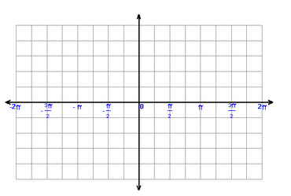
3
2
1
-1
-2
-3
How is this graph transformed?
Shift right
What happens to the x-value?
Add π/4
Why here?
What about the y-value ?
No change
Has the period changed?
No change
Has the maximum value changed ?
No
Has the minimum value changed?
No

Slide 13
3
2
1
-1
-2
-3
Why decrease?
How is this graph transformed?
Reflected and shifted up
What happens to the x-value?
No change
What about the y-value ?
Negated then add 2
Has the period changed?
No change
Has the maximum value changed ?
yes
Has the minimum value changed?
yes

Slide 14
3
2
1
-1
-2
-3
How is this graph transformed?
Vert Stretch, shift left, shift down
What happens to the x-value?
Decrease by π/2
What about the y-value ?
Doubled, decreased by 1
Has the period changed?
No change
Has the maximum value changed ?
yes
Has the minimum value changed?
yes

Slide 15
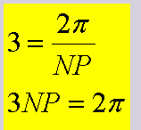
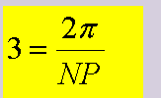
Going 3 times as fast as Parent Function.
-180°-150° -120°-90°-60°-30°
30° 60° 90° 120° 150° 180°
critical points are at:
0°, 30°, 60°, 90°, 120°
How is this graph transformed?
Horizontal Shrink
What happens to the x-value?
Multiplied by 1/3
What about the y-value ?
No change
Has the maximum value changed ?
no
Has the minimum value changed?
no

Slide 16
Rewrite in the form :
|A| = ____ B = ____ C = _____ D = ____
2
2
1
2
Yes
π
Amplitude = ___ Reflect across x-axis = ____ NP = _____
Critical Pts = ________________
Phase Shift = ______
Vertical Shift = _______
occur every π/4
π/2 right
1 unit up

Slide 17
Why go below x-axis?
After the shift right 90°, the first critical points are:
135 °, 180°, 225°, 270°

Slide 18
Assignment:
PW #1 Graphing Sine and Cosine
PW #2 Writing Equations of Sine and Cosine
PW #3 Graphing Sine and Cosine

