Slide 1
Accel Precalc
Unit 8: Extended Trigonometry
Lesson 3: Area of Triangles
EQ: How do you find the area of non-right triangles ?

Slide 2
Recall:
How do you find the area of right triangles?

Slide 3
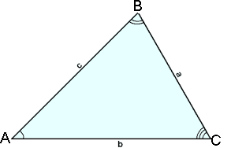
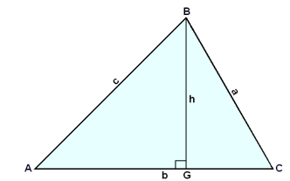
What if h is not known?
Can it be expressed using right triangle trig?
Recall how we solved for height when we derived the Law of Sines.
h = _______

Slide 4
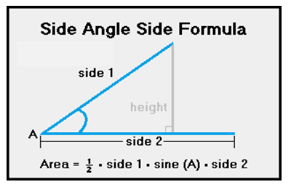
Now Substitute for h in the Area Formula:
Used when you know a pair of sides and the included angle --- SAS.

Slide 5
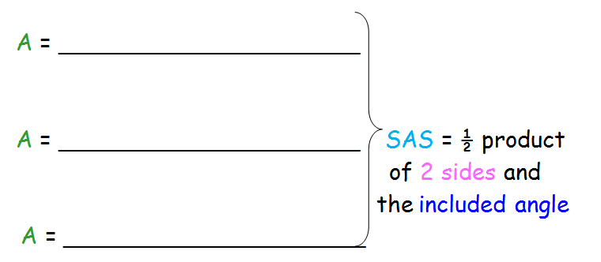
Formula for Area of SAS Triangles:

Slide 6
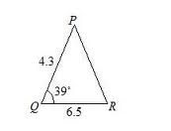
Ex. 1 Determine the area of the given triangle.
SAS

Slide 7
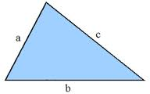
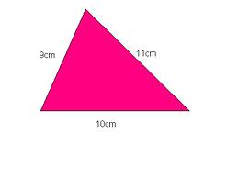
Formula for Area of SSS Triangles:
“Heron’s Formula”
Area = __________________________
where s =
“semi-perimeter”
Ex. 2 Determine the area of the given triangle.
SSS

Slide 8
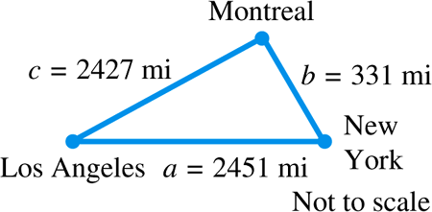
Example 1
USING HERON’S FORMULA TO FIND AN AREA (SSS)
The distance “as the crow flies” from Los Angeles to New York is 2451 miles, from New York to Montreal is 331 miles, and from Montreal to Los Angeles is 2427 miles. What is the area of the triangular region having these three cities as vertices? (Ignore the curvature of Earth.)

Slide 9
The semi-perimeter s is
Using Heron’s formula, the area  is

Slide 10
Examples. Find the area for each triangle.
1. a = 8, b = 6, γ = 30°
2. b = 5, c = 8, α = 115°
3. A triangular lot has street frontage of 50’, 60’,
and 80’. Find the area of the lot.
4. A triangular garden has sides of length 20 m, 30 m, and 30 m. Find the area of the garden.

Slide 11
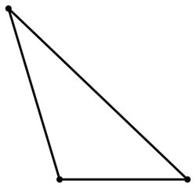
Special Case:
15°
5. β = 100°, γ= 65°, a = 2.2
7.704
100°
65°
*** Must work with smaller angles first.***
2.2

Slide 12
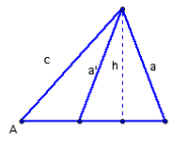
What about the ambiguous case
SSA ?
2 areas
7. a = 22, c = 30, and α = 30°
107°
30
22
30°
43°
At least 1 Triangle
TRUE: Therefore 2 Triangles
TRI 1:

Slide 13
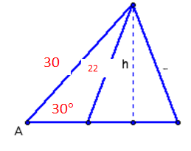
What about the ambiguous case
SSA ?
2 areas
13°
7. a = 22, c = 30, and α = 30°
TRI 2:
137°
REMEMBER:
OBTUSE ANGLE IS SUPPLEMENT

Slide 14
ASSIGNMENT:
PW #1 Area of Triangles
PW #2 Area of Triangles

