Slide 1
Day 74Agenda:
Turn in Recommendation Letter
DG31 --- 15 minutes
Workday on Law of Sines and Law of Cosines
Complete U8 L3

Slide 2
Accel Precalc
Unit 8: Extended Trigonometry
Lesson 3: Area of Triangles
EQ: How do you find the area of non-right triangles ?

Slide 3
Recall:
How do you find the area of right triangles?

Slide 4
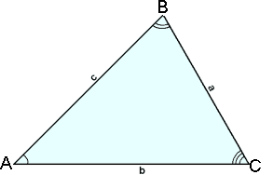
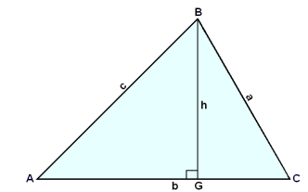
What if h is not known?
Can it be expressed using right triangle trig?
Recall how we solved for height when we derived the Law of Sines.
h = _______

Slide 5
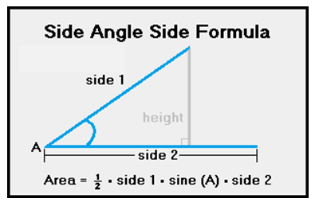
Now Substitute for h in the Area Formula:
Used when you know a pair of sides and the included angle --- SAS.

Slide 6
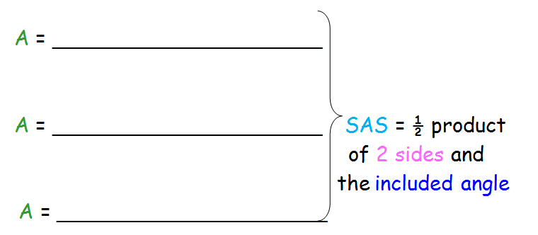
Formula for Area of SAS Triangles:

Slide 7
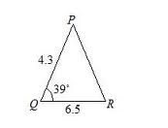
Ex. 1 Determine the area of the given triangle.
SAS

Slide 8
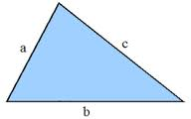
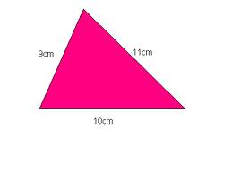
Formula for Area of SSS Triangles:
“Heron’s Formula”
Area = __________________________
where s =
“semi-perimeter”
Ex. 2 Determine the area of the given triangle.
SSS

Slide 9
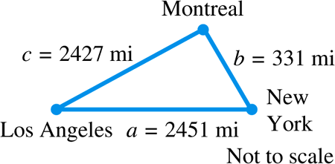
Example 1
USING HERON’S FORMULA TO FIND AN AREA (SSS)
The distance “as the crow flies” from Los Angeles to New York is 2451 miles, from New York to Montreal is 331 miles, and from Montreal to Los Angeles is 2427 miles. What is the area of the triangular region having these three cities as vertices? (Ignore the curvature of Earth.)

Slide 10
The semi-perimeter s is
Using Heron’s formula, the area  is

Slide 11
Examples. Find the area for each triangle.
1. a = 8, b = 6, γ = 30°
2. b = 5, c = 8, α = 115°
3. A triangular lot has street frontage of 50’, 60’,
and 80’. Find the area of the lot.
4. A triangular garden has sides of length 20 m, 30 m, and 30 m. Find the area of the garden.

Slide 12
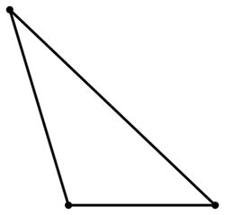
Special Case:
15°
5. β = 100°, γ= 65°, a = 2.2
7.704
100°
65°
*** Must work with smaller angles first.***
2.2

Slide 13
Day 75 Agenda:
Turn in Recommendation Letter
Complete U8 L3
Short Workday on Area of Triangles and Application Problems
Begin U8 (Part 2) L4

Slide 14
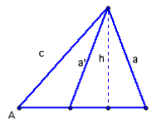
What about the ambiguous case
SSA ?
2 areas
7. a = 22, c = 30, and α = 30°
107°
30
22
30°
43°
At least 1 Triangle
TRUE: Therefore 2 Triangles
TRI 1:

Slide 15
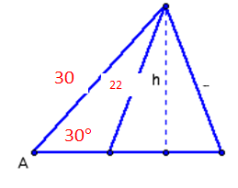
What about the ambiguous case
SSA ?
2 areas
13°
7. a = 22, c = 30, and α = 30°
TRI 2:
137°
REMEMBER:
OBTUSE ANGLE IS SUPPLEMENT

Slide 16
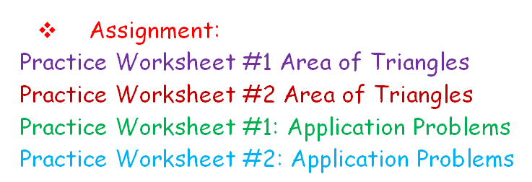
Come in the mornings or afternoons, if you would like to use your test folders to begin studying for final and cumulative exams.

