Slide 1
DAY 52 Mar 24 AGENDA:
DG 22 --- 10 minutes
Complete notes on U6 L3
Memorize the parent graphs of Sine and Cosine
DG23 Wed

Slide 2
Accel Precalc
Unit #5: Graphs and Inverses of Trig Functions
Lesson 3: Graphs of Sine and Cosine
EQ: How do you use the values from the unit circle to create the graphs of sine and cosine?

Slide 3
Use your UNIT CIRCLE to complete each table then create the graphs.
We are going to graph the function f(x) = sin(θ).
The ordered pairs will be (___, ____).
The domain, θ, will represent ________measures.
angle
ratio
The range, sin(θ), will represent the _______ for
sine at ________ .
angle θ

Slide 4
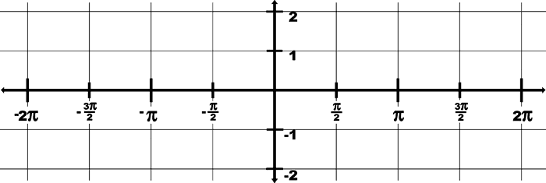
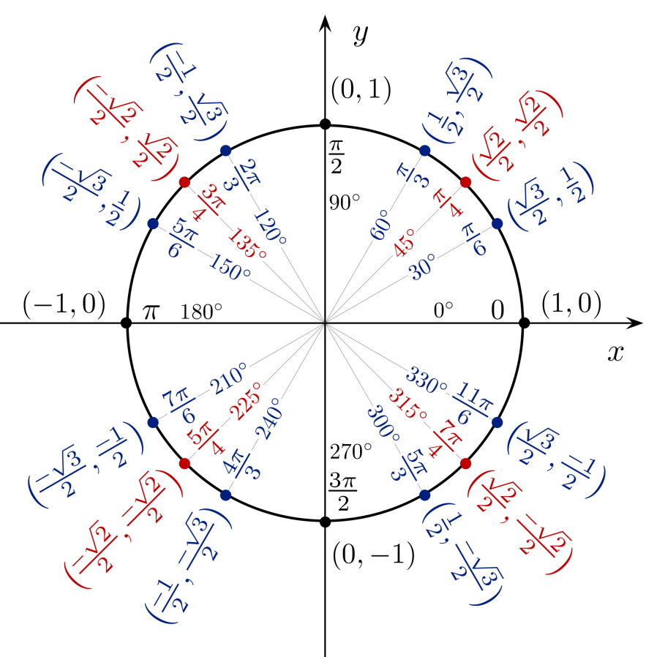
Use your UNIT CIRCLE to complete each table then create the graphs.
x | y = sin(x) | Ordered pair (x,y)
0 | 0 | (0,0)
π/6 | 0.5 | (π/6, 0.5)
π/4
π/3
π/2
2π/3
3π/4
5π/6
π
7π/6
5π/4
4π/3
3π/2 | -1 | (3π/2, -1)
5π/3
7π/4
11π/6
2π
9π/4
5π/2
-π/4
-π/2
REMEMBER: On the UNIT CIRCLE, sin θ corresponds to the y value in the ordered pair (x, y).
0.7071
(π/4, 0.7071)
0.866
(π/3, 0.866)
1
(π/2, 1)
0.866
(2π/3, 0.866)
Complete the graph by plotting points from 0 to -2π
0.7071
(3π/4, 0.7071)
0.5
(5π/6, 0.5)
0
(π, 0)
-0.5
(7π/6, -0.5)
-0.7071
(5π/4, -0.7071)
-0.866
(4π/3,- 0.866)
-0.866
(5π/3,- 0.866)
-0.7071
(7π/4, -0.7071)
-0.5
(11π/6, -0.5)
0
(2π, 0)

Slide 5
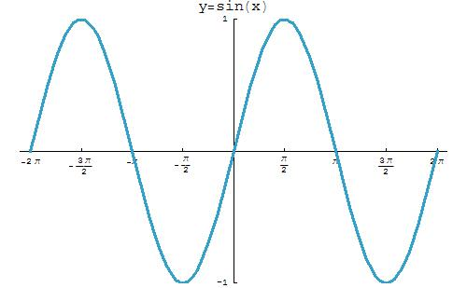
Graph of sin θ = y from -2π to 2π.
This is the parent function for sine that you must learn in order to do transformations.

Slide 6
Facts to know about the graph of sin(θ):
(-∞, ∞)
The domain is from ________. You can put in any________ measure and find sin(θ).
angle
[-1, 1]
2. The range is from [__, __].
origin
3. Sine is symmetric to the _________. Therefore sine is an ________ function.
odd
4. The sine function is periodic. It cycles every ______ or _______.
2π
360°

Slide 7
Facts about the graph of sin(θ) from -2π to 2π :
5. List at least 3 x-intercepts. _______________
-2π, -π, 0, π, 2π
origin
6. The y-intercept is _______.
The maximum value is ____, it occurs when x = __________(list 2).
1
-1
8. The minimum value is ___, it occurs when
x =________(list 2).

Slide 8
Now we are going to graph the function f(x) = cos(θ).
The ordered pairs will be (___, ____).
The domain, θ, will represent ________measures.
angle
ratio
The range, cos(θ), will represent the _______ for
cosine at ________ .
angle θ

Slide 9
Now graph the function f(x) = cos(θ), Repeat the steps you performed to graph f(x) = sin(θ).
x | y=cos(x) | Ordered pair (x,y)
0 | 1 | (0,1)
π/6
π/4
π/3 | 1/2 | (π/3, 1/2)
π/2
2π/3
3π/4
5π/6
π
7π/6
5π/4
4π/3
3π/2 | 0 | (3π/2, 0)
5π/3
7π/4
11π/6
2π
9π/4
5π/2
-π/4
-π/2
REMEMBER: On the UNIT CIRCLE, cos θ corresponds to the x value in the ordered pair (x, y).
0.866
(π/6, 0.866)
0.7071
(π/4, 0.7071)
0
(π/2, 0)
Complete the graph by plotting points from 0 to -2π
-0.5
(2π/3, -0.5)
-0.7071
(3π/4, -0.7071)
-0.866
(5π/6,- 0.866)
-1
(π, -1)
-0.866
(7π/6,- 0.866)
-0.7071
(5π/4, -0.7071)
-0.5
(4π/3, -0.5)
0.5
(5π/3, 0.5)
0.7071
(7π/4, 0.7071)
0.866
(11π/6, 0.866)
1
(2π, 1)

Slide 10
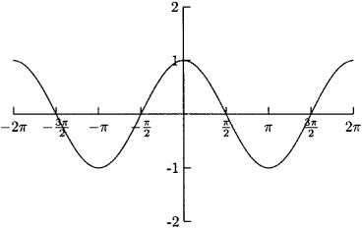
Graph of cos θ = y from -2π to 2π.
.
This is the parent function for cosine that you must learn in order to do transformations.

Slide 11
Facts about the graph of cos(θ) from -2π to 2π :
(-∞, ∞)
The domain is from ________. You can put in any________ measure and find cos(θ).
angle
[-1, 1]
2. The range is from [__, __].
y-axis
3. Cosine is symmetric to the _________. Therefore cosine is an ________ function.
even
4. The cosine function is periodic. It cycles every ______ or _______.
2π
360°

Slide 12
Facts to know about the graph of cos(θ):
5. List at least 3 x-intercepts. _______________
1
6. The y-intercept is ____.
The maximum value is ____, it occurs when x = __________(list 2).
1
-2π, 0, 2π
-1
8. The minimum value is ___, it occurs when
x =_______(list 2).
-π, π

Slide 13
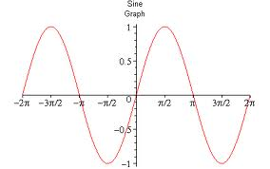
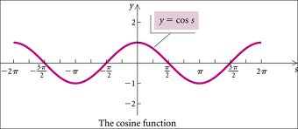
Memorize: Parent Graphs of Sine and Cosine.
Learn graphs based on “critical points”.
Must be able to graph 2 FULL CYCLES, from -2π to 2π.

