Slide 1
Accel Precalc
Unit 7:Trig Identities
Lesson 1: Establishing Trig Identities
EQ: What are the trig identities and how are they used to simplify trigonometric expressions and solve trigonometric equations?

Slide 2
RECALL:
Complete these Fundamental Identities
Reciprocal Identities

Slide 3
Therefore:

Slide 4
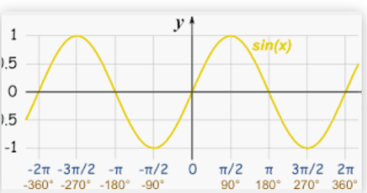
Ratio Identities (in terms of sine and cosine)
Even/Odd Identities (think about the graphs)
ODD

Slide 5
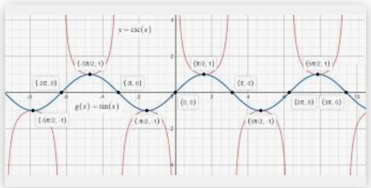
Even/Odd Identities (think about the graphs)
ODD

Slide 6
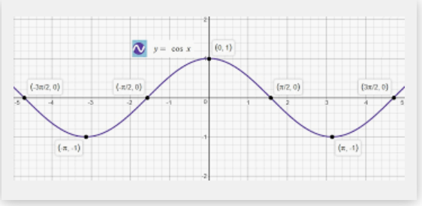
Even/Odd Identities (think about the graphs)
EVEN

Slide 7
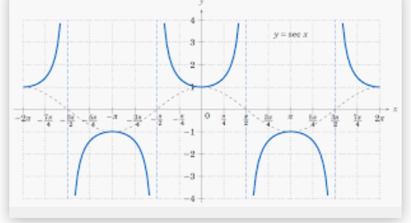
Even/Odd Identities (think about the graphs)
EVEN

Slide 8
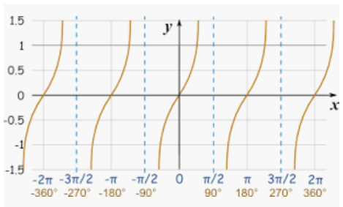
Even/Odd Identities (think about the graphs)
ODD

Slide 9
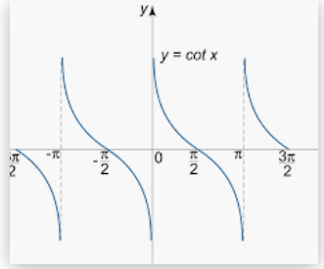
Even/Odd Identities (think about the graphs)
ODD

Slide 10
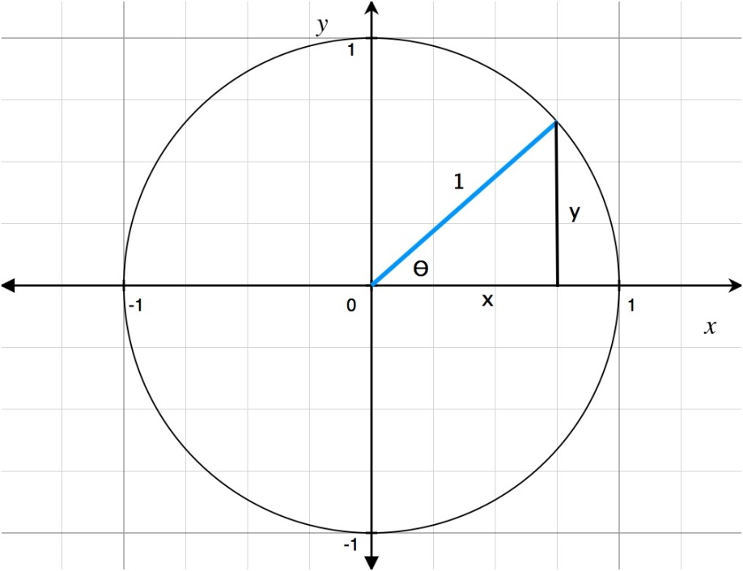
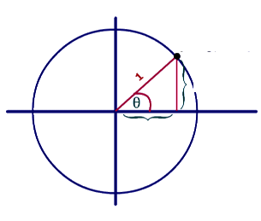
Pythagorean Identities
RECALL: Unit Circle
(x, y)
(cos θ, sin θ)
sin θ
cos θ
RECALL: Pythagorean Theorem

Slide 11
I. “Grandmama” or “Madea”
Derivations:
Solve for sin² θ:
Solve for cos² θ:

Slide 12
II. Divide Grandmama by sin² θ
Derivations:
Solve for cot² θ:
Solve for 1:

Slide 13
III. Divide Grandmama by cos² θ
Derivations:
Solve for tan² θ:
Solve for 1:

Slide 14
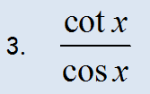
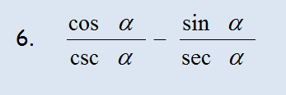
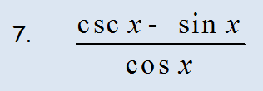
Ex. Simplify using trig identities. I will work these out on another video showing you all steps necessary.
Assignment: p. 381 #19 – 44
Practice Worksheet #1: Simplify Trig Identities
Practice Worksheet #2: Simplify Trig Identities
Practice Worksheet #3: Simplify Trig Identities
Practice Worksheet #4: Simplify Trig Identities

Slide 16
Assignment: p. 381 #19 – 44
Practice Worksheet #1: Simplify Trig Identities
Practice Worksheet #2: Simplify Trig Identities
Practice Worksheet #3: Simplify Trig Identities
Practice Worksheet #4: Simplify Trig Identities

