Slide 1
Accel Precalc
Unit 8: Extended Trigonometry
Lesson 1: Law of Sine (Part II)
EQ: What is the ambiguous case for Law of Sine? How do you determine if a triangle exists?

Slide 2
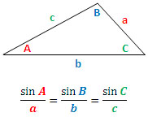

Slide 4
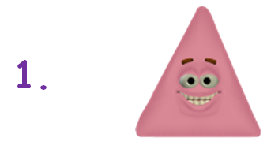
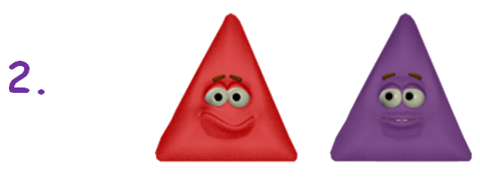
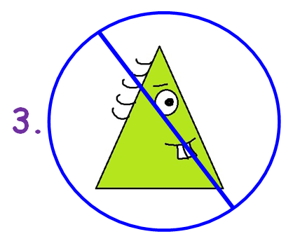

Slide 5
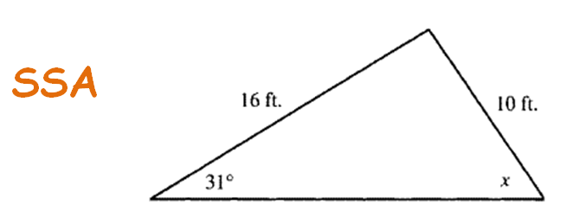

Slide 6
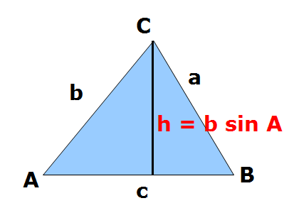
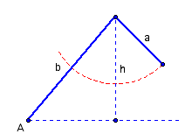
Scenario 1: ∠A is acute
opp < adj sin∠
NO SOLUTION

Slide 7
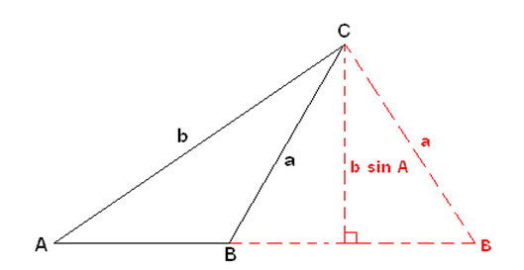
Scenario 2: ∠A is acute
If a > b sin A, at least 1 triangle can be formed.
adj sin∠ < opp < adj
∠B is θ
θ
∠B is 180° - θ
180°-θ

Slide 8
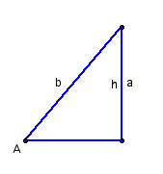
Scenario 3:
∠A is acute
If a = b sin A, a right triangle can be formed.
opp = adj sin∠
1 SOLUTION

Slide 9
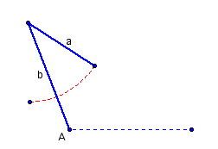
Scenario 4:
∠A is obtuse
If a < b or a = b , then NO triangle can be formed.
opp < adj or opp = adj
NO SOLUTION

Slide 10
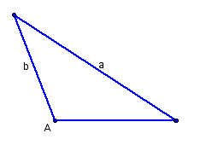
Scenario 5:
∠A is obtuse
If a > b , then one triangle can be formed.
opp > adj
1 SOLUTION

Slide 11
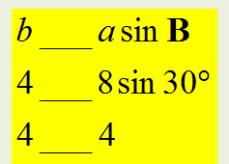
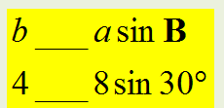
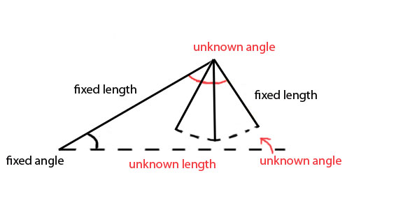
Ex 1. Sketch the information given on a triangle. Determine how many solutions exist for each triangle. Find all missing parts.
a) a = 8, b = 4, ∡B = 30º
∡B is ACUTE
8
4
30º
1 Right Triangle
Now Solve

Slide 12
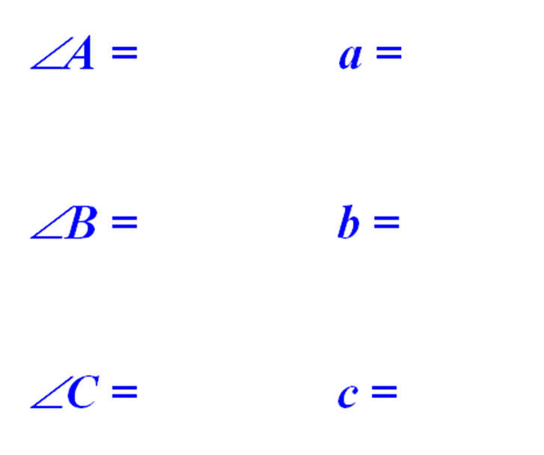
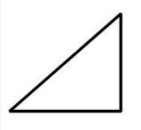
90˚
8
C
8
60˚
4
30˚
4
30˚
90˚
A
B
6.93
60˚
6.93

Slide 13
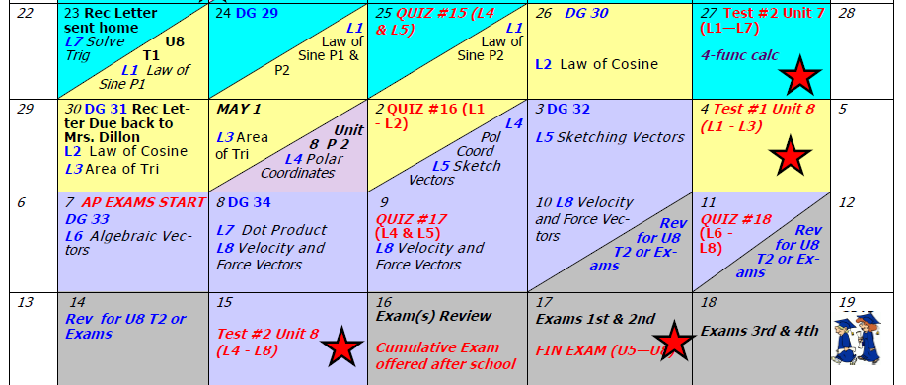
Day 71 Agenda:
Quiz 15 --- 30 minutes
Turn in Rec Letter --- due Monday

Slide 14
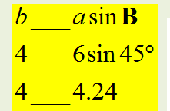
Ex 1. Sketch the information given on a triangle. Determine how many solutions exist for each triangle. Find all missing parts.
b) a = 6, b = 4, ∡ B = 45º
∡B is ACUTE
6
4
45º
NO Triangle

Slide 15
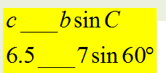
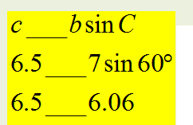
Ex 1. Sketch the information given on a triangle. Determine how many solutions exist for each triangle. Find all missing parts.
c) b = 7, c = 6.5, ∡ C = 60º
∡C is ACUTE
7
6.5
60º
A Least 1 Triangle
2 Triangles

Slide 16
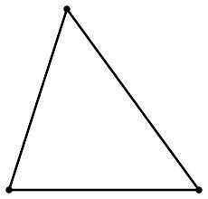
A
51˚
5.8
51˚
7
6.5
69˚
7
60˚
69˚
C
B
5.8
60˚
6.5
These values will be the SAME for both triangles.
Second Triangle : Use Supplement of ∡B

Slide 17
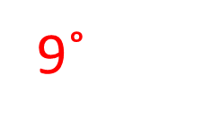
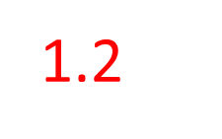
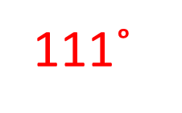
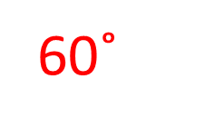
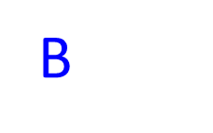
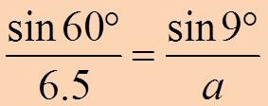
A
7
6.5
7
C
6.5

Slide 18
Ex 1. Sketch the information given on a triangle. Determine how many solutions exist for each triangle. Find all missing parts.
d) a = 5, c = 10, ∡ C = 70º
∡C is ACUTE
5
10
70º
At Least 1 Triangle
FALSE, Only 1 Triangle

Slide 19
A
28˚
5
28˚
10.5
10
82˚
10.5
70˚
82˚
C
B
5
70˚
10

Slide 20
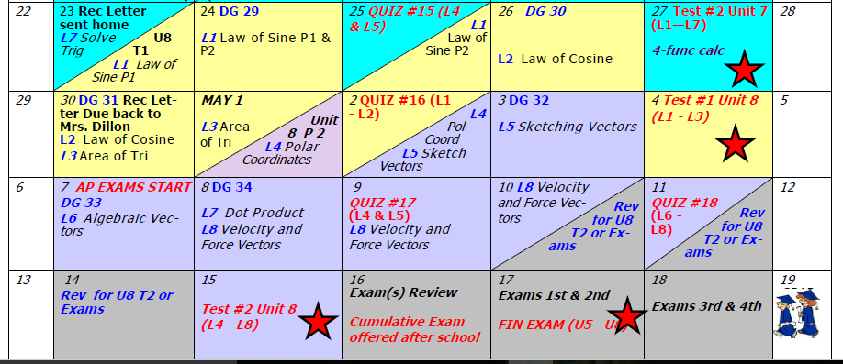
Assignment: Practice Worksheet #2

