Slide 1
Accel Precalc
Unit 8: Extended Trigonometry
Lesson 1: Law of Sines (Part I)
EQ: How do you solve for missing parts of triangles which are not “right”?

Slide 2
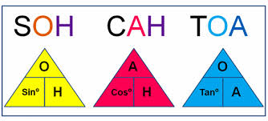
Recall:
What trig ratios are used to solve right triangles?
Two Methods to Solve “Non-Right Triangles”:
Let’s derive this one today!

Slide 3
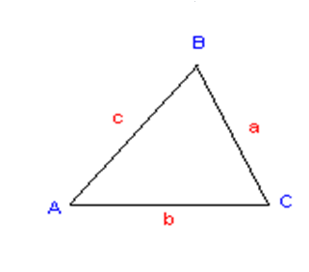
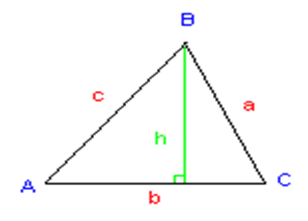

Slide 4
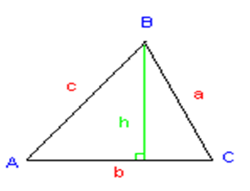

Slide 6
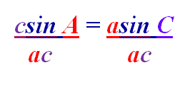
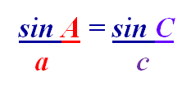
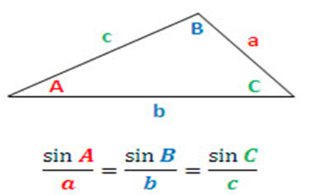
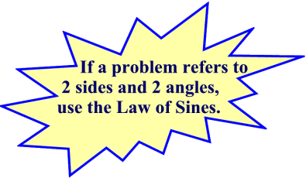

Slide 7
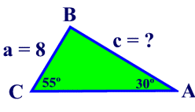
Ex. 1 Given ABC with side a = 8, ∠A = 30º, and ∠C = 55º. Find side c to the nearest tenth.
Check calculator MODE!!

Slide 8
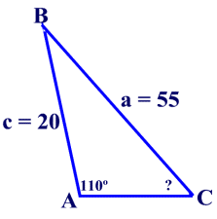
Ex. 2 Given ABC with side ∠A=110°, a = 55,
c =20, find the measure if ∠C to the nearest whole degree.
This will require WHAT TYPE of trig function?

Slide 9
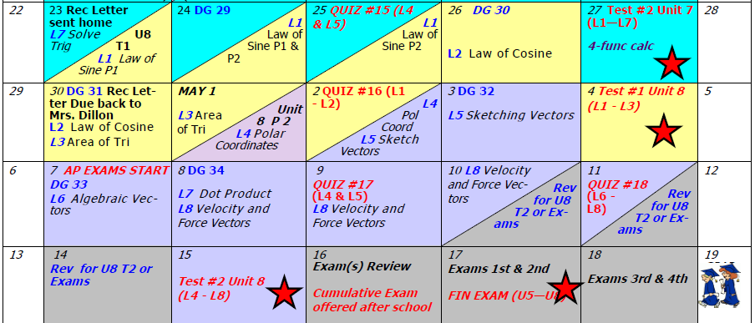
Day 70 Agenda:
DG 29 --- 20 minutes

Slide 10
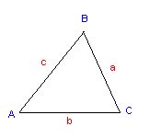
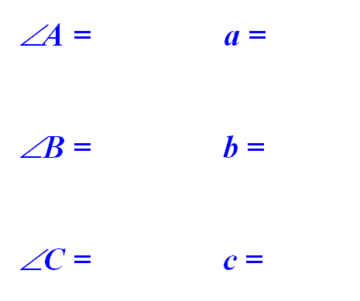
Ex. 3 Given ABC with ∠ A = 50º, ∠B = 70º and
a = 12. Solve the triangle.
70°
12
50°
60°

Slide 11
Ex. 4 Solve ABC if ∠ B = 30º, ∠C = 70º and b = 10.
80°
30°
80°
70°
10

Slide 12
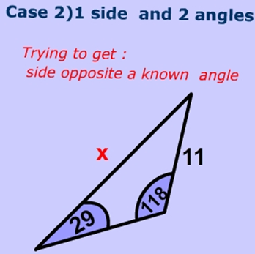
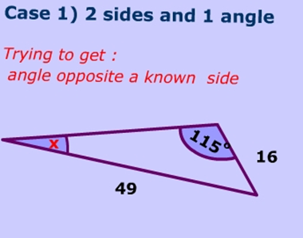

Slide 13
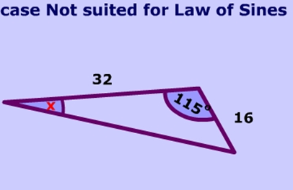
WHY??

