Slide 1
Mosaic Plots
Ruth.carver@germantownacademy.org

Slide 3
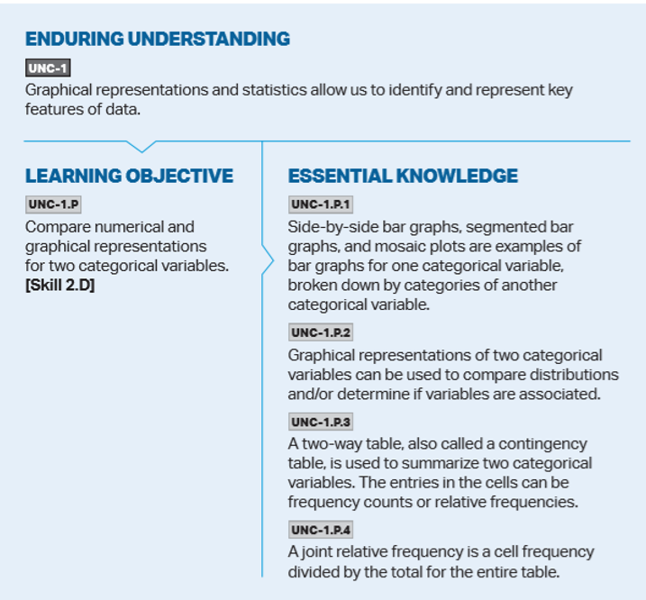
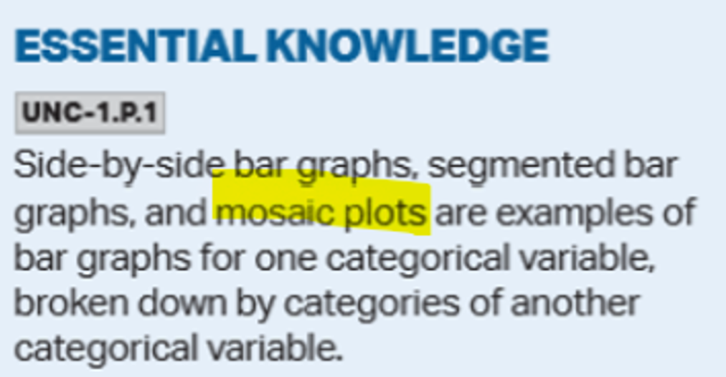

Slide 4
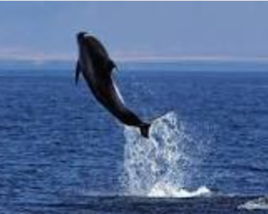
Example: Icelandic Dolphins
Professor Marianne Rasmussen of the University of Southern Denmark observed the behavior of dolphins off the coast of Iceland. Professor Rasmussen’s basic activity was to watch the behavior of dolphins at different times of day and to record their activities. She identified three basic activities:
traveling quickly,
feeding, or
socializing
Dolphins tend to engage in these activities in groups, so she also tallied how many dolphins engaged in each activity. She also noted the time of day
morning,
afternoon, or
evening

Slide 5
Two-Way Table
Are Icelandic dolphins’ behavioral activities related to a specific period of the day?

Slide 6
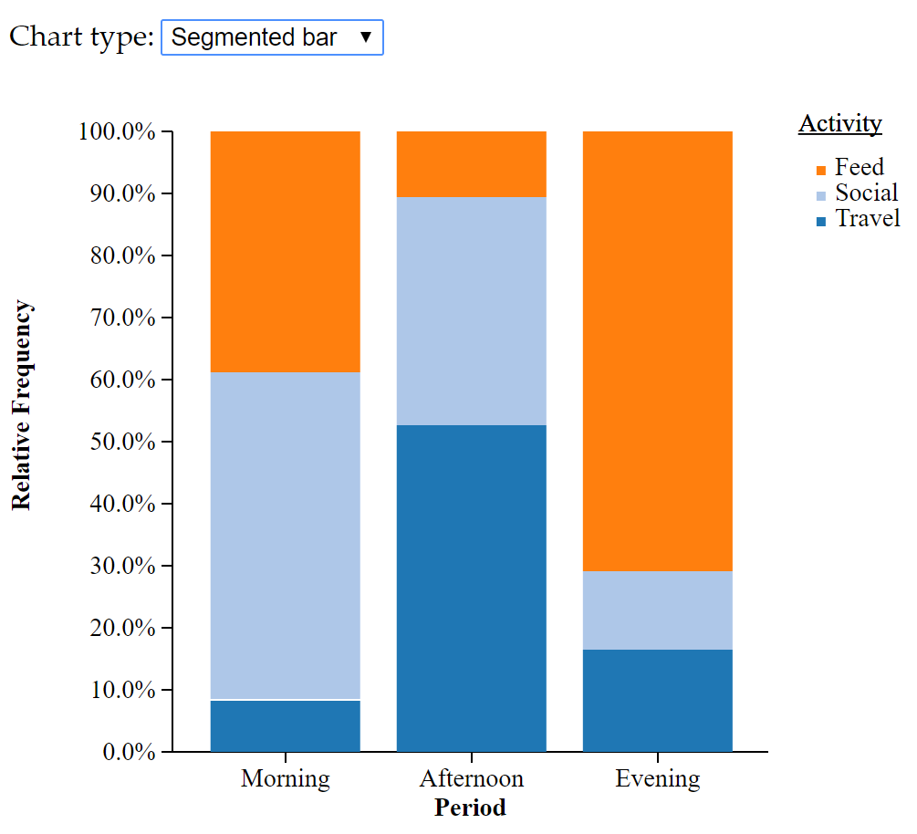
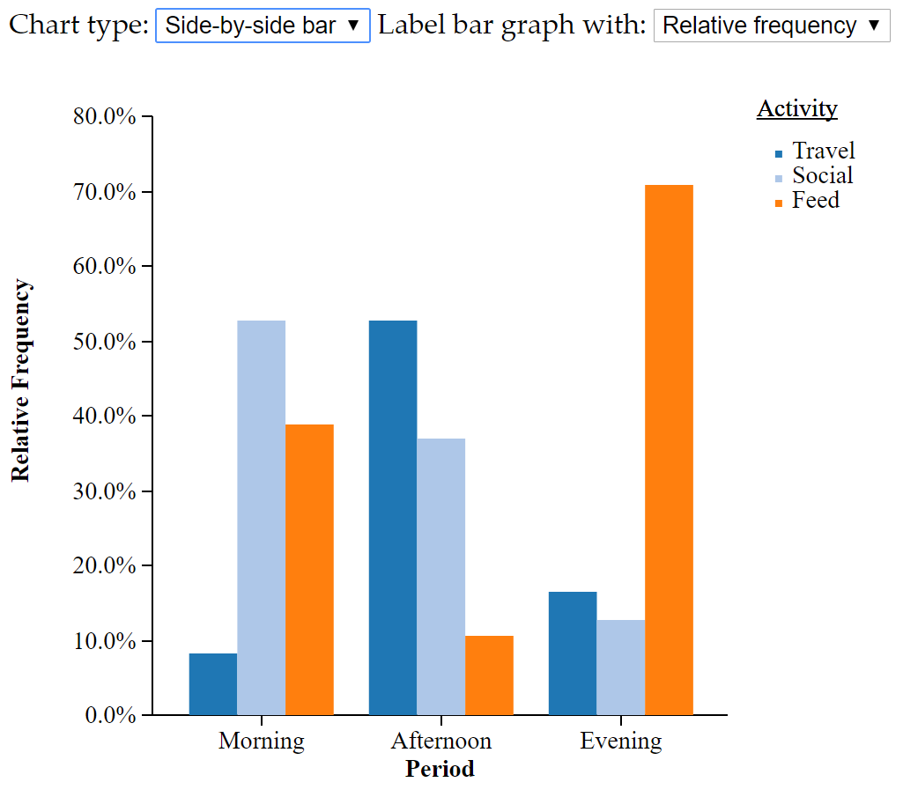
Segmented Bar Graph and Side-by Side Bar Graph

Slide 7
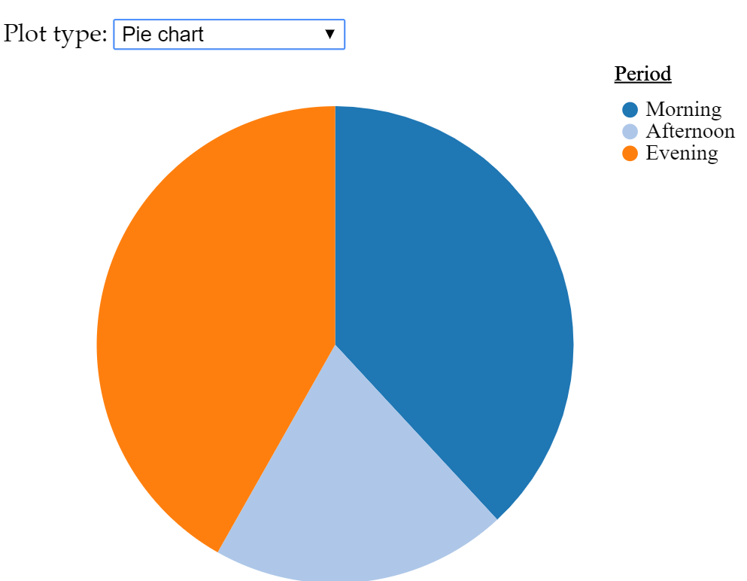
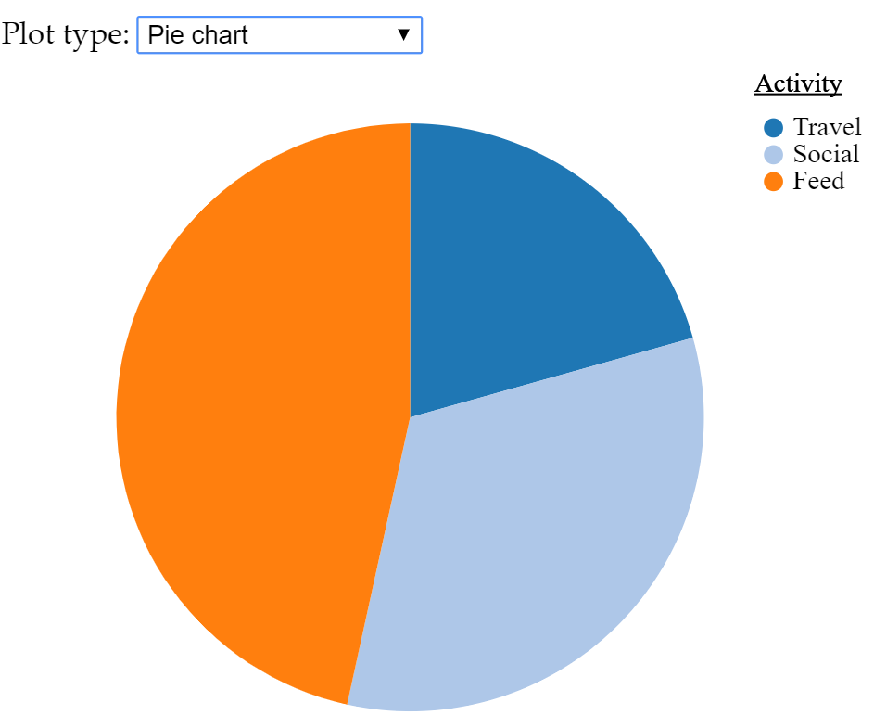
Pie Charts of Marginal Distributions
The best known graph featuring a part-to-whole relationship is a pie chart.

Slide 8
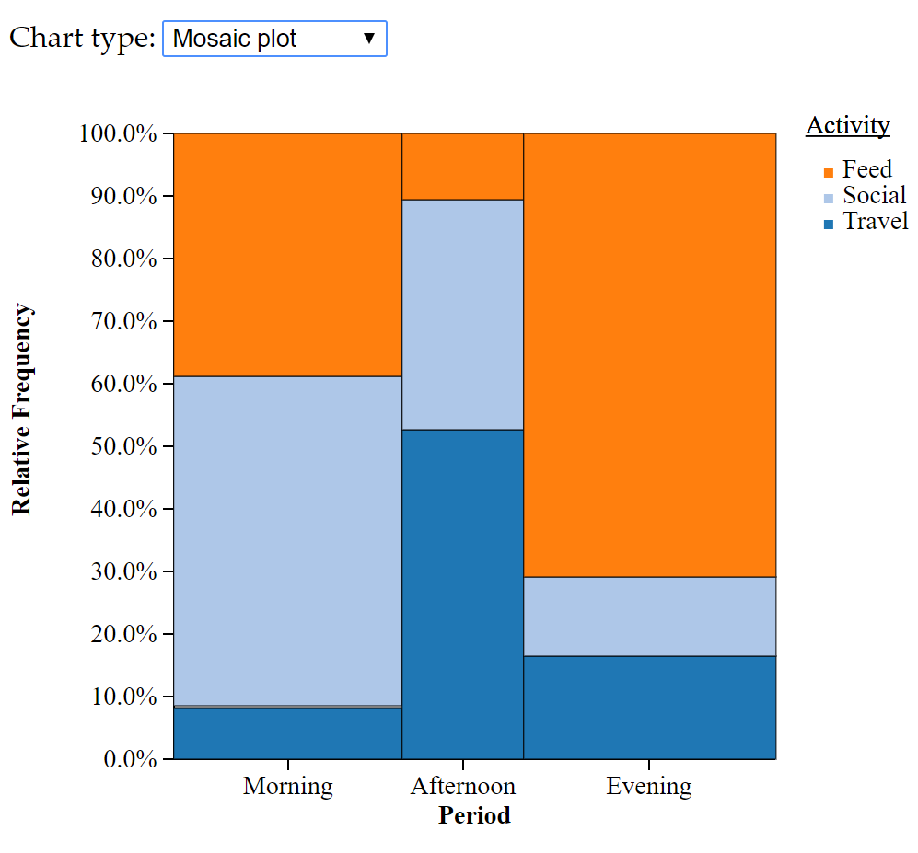
Mosaic Plots: Icelandic Dolphins
Mosaic plots allow us to visualize multivariate categorical data.
A mosaic plot, like a pie-chart, represents parts of a whole proportionately by means of a containment.
A pie chart is a circular container which is divided into slices.
A mosaic plot is a rectangular container which is divided into smaller rectangles.
When we compare proportions within each group, we study only height.
When we compare counts between groups, we study only width.

Slide 9
Creating Mosaic Plots
• In order to produce a mosaic plot it is necessary to have:
– A contingency table containing the data.
- A preferred ordering of the variables, with the “response” variable last.

Slide 10
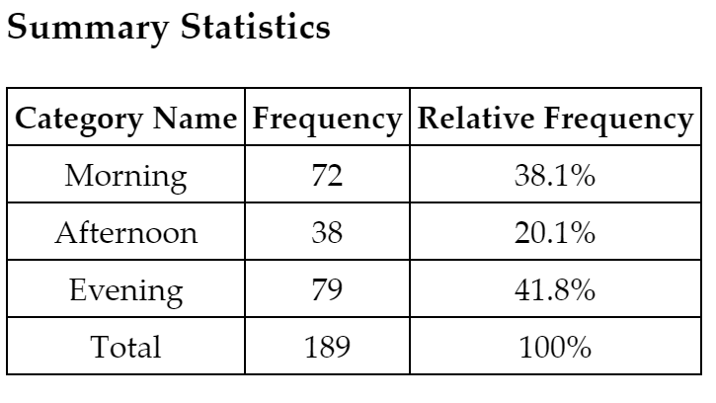
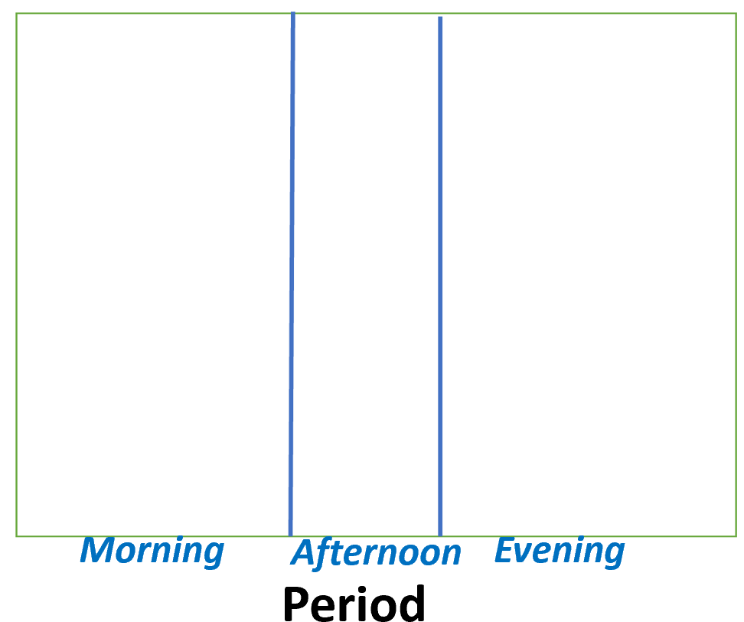
Period

Slide 11
The widths of the rectangles represent the proportion of dolphins in each period.
38.1%
20.1%
41.8%

Slide 12
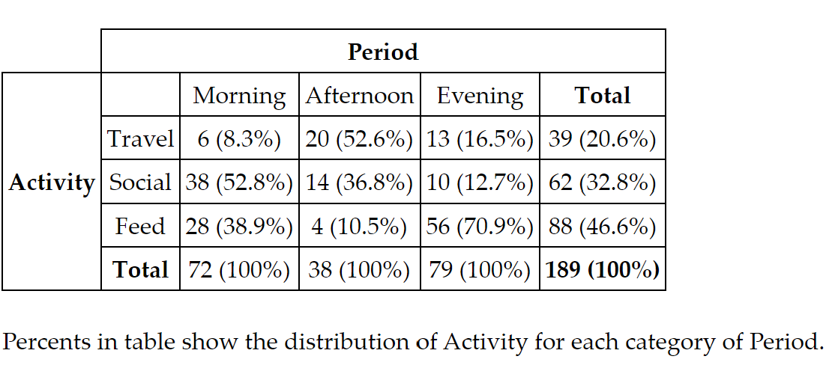
Creating Mosaic Plots
• You then divide it into horizontal sections based on the second variable, in this case, Activity

Slide 13
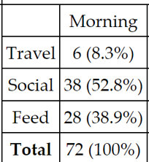
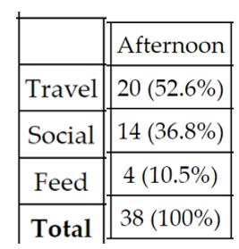
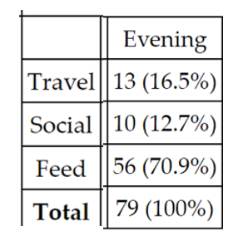
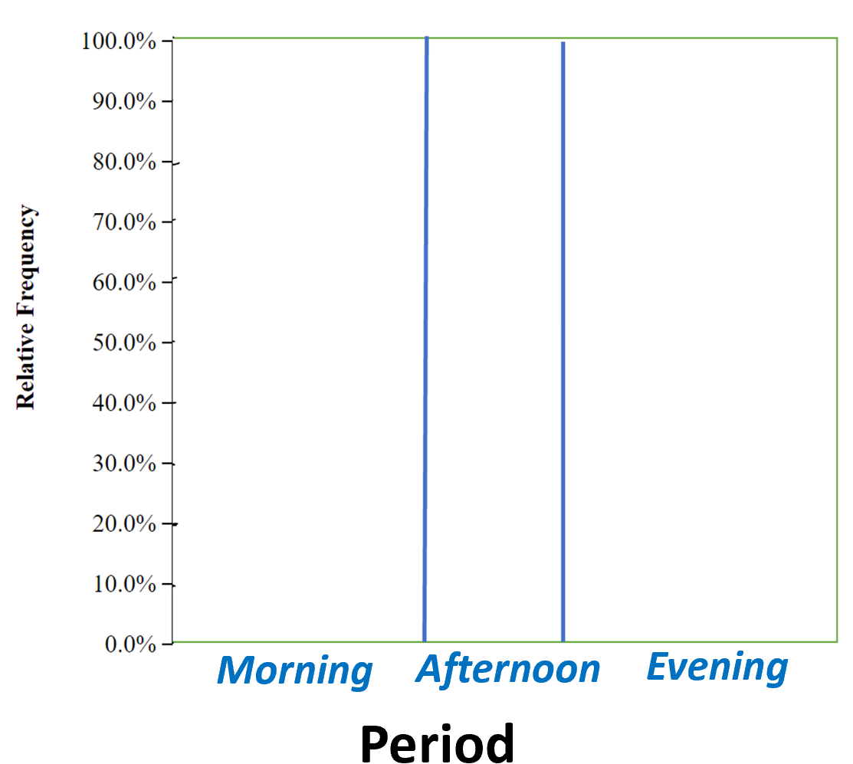

Slide 14
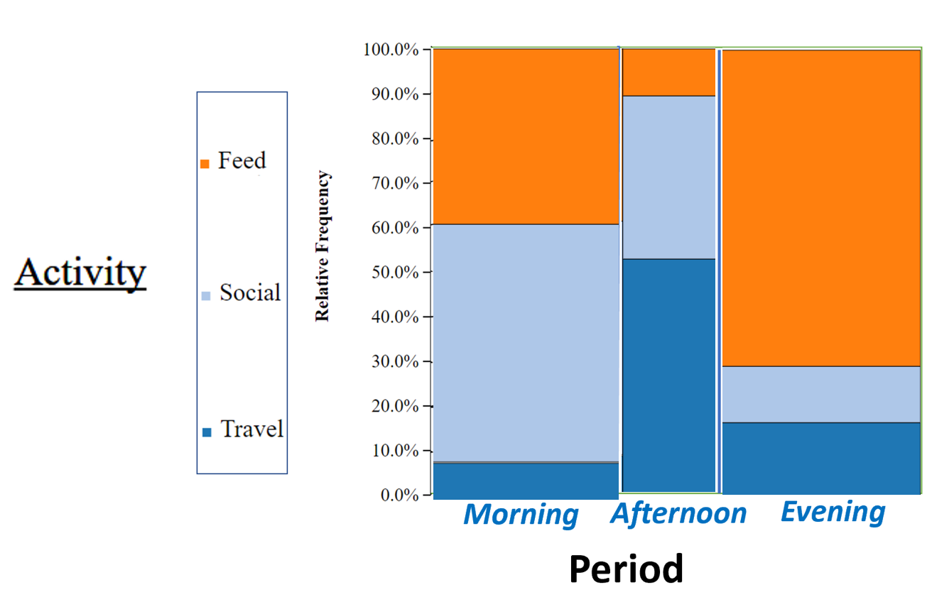
Note that the mosaic plot treats the row and column variables differently.
The column variable is treated as a conditioning variable, a "treatment", and
the row variable is treated as a "response".

Slide 15
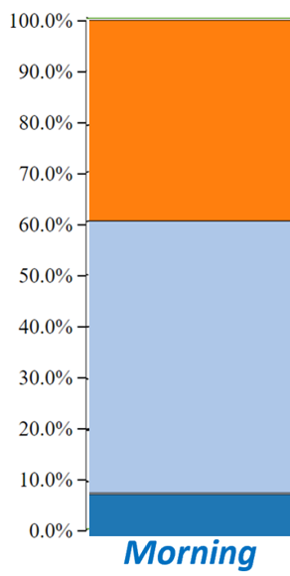
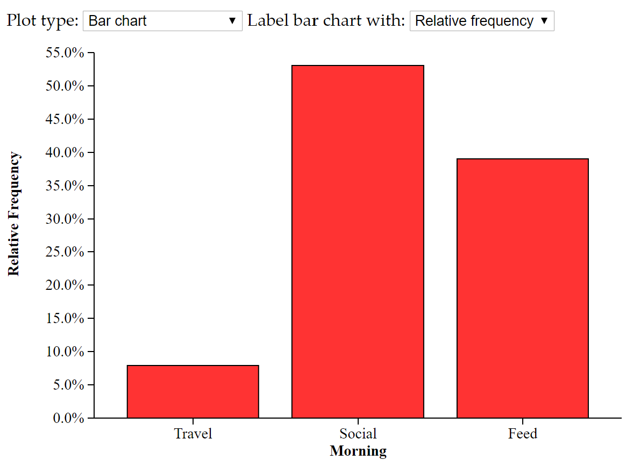
Each column is a bar chart, with bins stacked on top of each other instead of side by side.

Slide 16
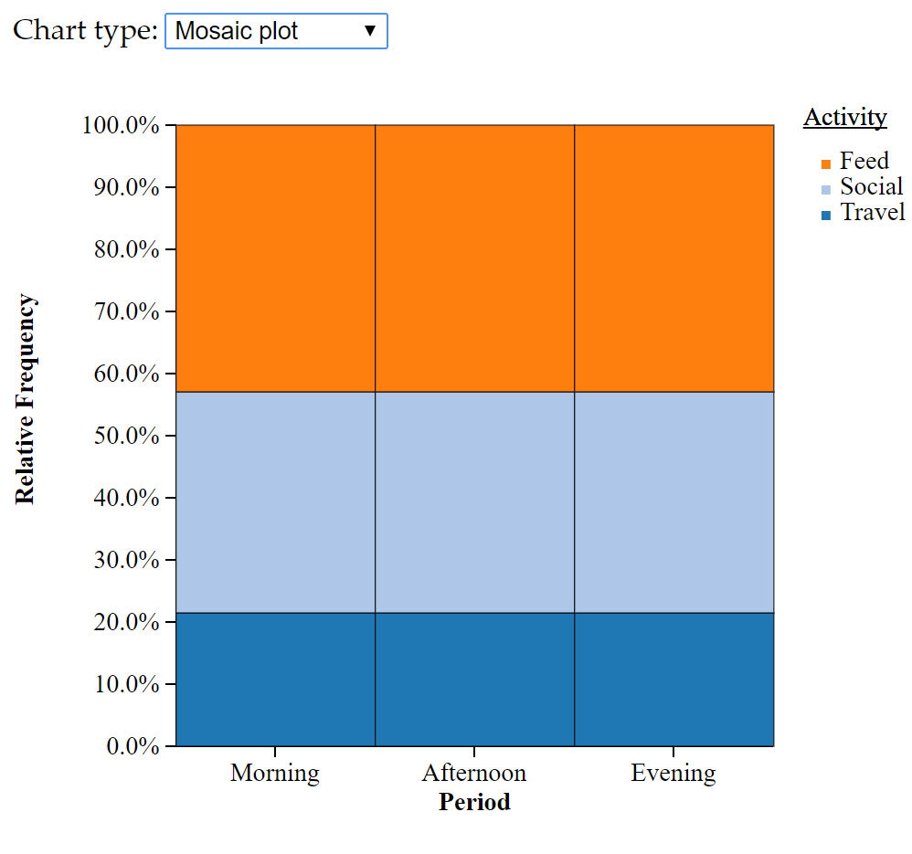
The strong disparity in the activity for the different times of the day is demonstrated by the lack of alignment of the three separating lines drawn on the vertical.

Slide 17
Possible Questions:
Based on the mosaic plot, is there a relationship between activity and period?
Notice the difference in the heights of the bars for the activity feeding for the different time periods.

Slide 18
Possible Questions:
Based on the mosaic plot, is there a relationship between activity and period?
Does knowing the period of the day give you information about the dolphins’ activity?

Slide 19
Possible Questions:
Based on the mosaic plot, is there a relationship between activity and period?
For example, If you know it is evening, what can you say about the activity they are engaged in?
Most likely to be engaged in feeding.
Least likely to be engaged in socializing.

Slide 20
Mosaic plots give both bivariate and univariate displays.
The bivariate display is the inside of the plot
Ex: The relationship between time period and dolphins’ feeding behavior
What information does this provide regarding the relationship between the period of the day and Icelandic dolphins’ feeding behavior?
The evening feed is a very large area
Versus the afternoon feeding which is a very small area.

Slide 21
Mosaic plots give both bivariate and univariate displays.
You can see the univariate displays if you look along the margins.
Example:
At what period were the Icelandic dolphins observed the least?

Slide 22
Possible Questions:
Based on the mosaic plot, approximately what percent of dolphins’ spent their mornings socializing?
(Given that it was the morning, what percent of the dolphins’ were socializing?)

Slide 23
Possible Questions:
Based on the mosaic plot, during what period of the day did most dolphins travel?

Slide 24
Possible Questions:
What information is available in the mosaic plot that is not evident in the segmented bar chart?
Both the mosaic plot and segmented bar graph provide information about the percent of observed dolphins within each of the activity groups for each of the time periods.
The mosaic plot also gives the group sizes for the period of the day by scaling the x-axis.

