Slide 1
Accel Precalculus
Unit #1: Data Analysis
Lesson #5: Probability Distributions
EQ: What is a probability distribution and what criteria must be met to have a valid distribution?

Slide 2
Terms to Recall:
Variable
Random Variable
Discrete Variables
Continuous Variables

Slide 3
New Terms:
Generally, statisticians use a capital letter to represent a random variable and a lower-case letter, to represent one of its values.
For example,

Slide 4
As an example, P(X = 1) refers to the probability that the random variable X is equal to 1.
Consider flipping 2 coins.
Possible outcomes __________________
{HH, TT, TH, HT}

Slide 5
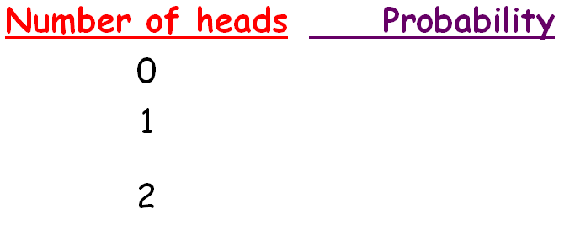
Using the previous sample space, complete the table below, which associates each outcome with its probability.

Slide 6
Probability Distribution --- a table or an equation that links each outcome of a statistical experiment with the probability of its occurrence.
Probability Distributions describe what will probably happen instead of what will actually happen.

Slide 7
Requirements for a Probability Distribution:

Slide 8
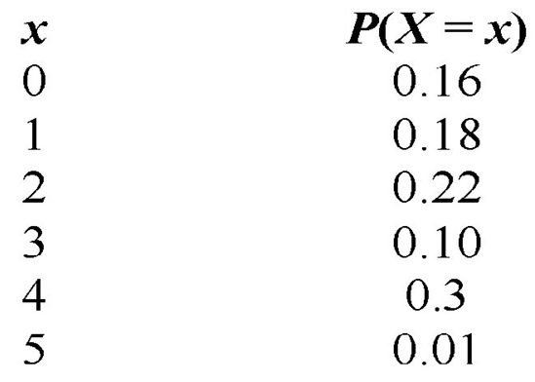
NO
NO; the sum is .97

Slide 9
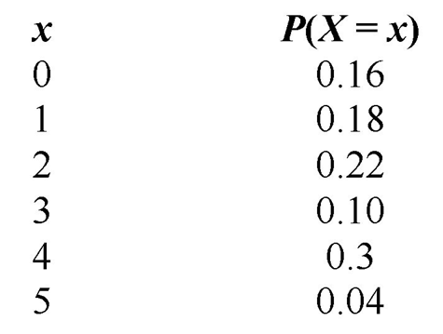
YES
YES; the sum is 1.00
YES; each value between or including 0 and 1.

Slide 10
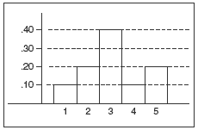
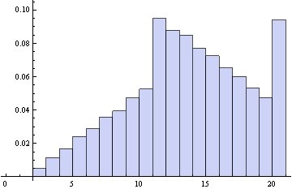
A probability histogram is a histogram in which the horizontal axis corresponds to the value of the random variable and the vertical axis represents the probability of that value of the random variable.

Slide 11
Complete In Class Practice Problems
You should define the random variable X for each problem.
X = the number of _______________________________

Slide 13
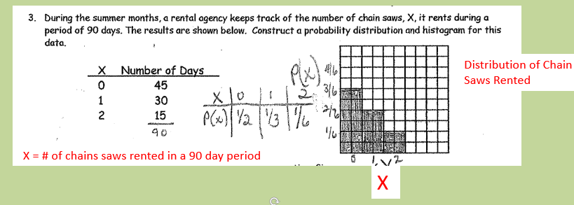

Slide 15
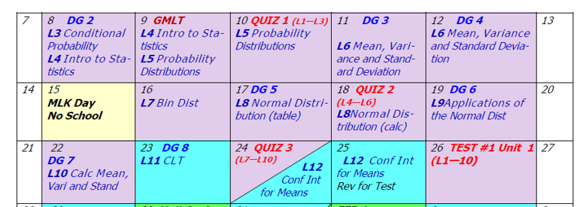
Assignment:
Practice Worksheet Probability Distributions

