Slide 1
Accel Precalculus
Unit #1: Data Analysis
Lesson #4: Introduction to
Statistics

Slide 2
Most people are familiar with probability
and statistics through radio, television,
internet, newspaper, and magazines.
How are statistics used in business?
Profession/Occupation Purpose
Marketing location of business
Medical clinical trials
Finance risk management of finds

Slide 3

Most people are familiar with probability
and statistics through radio, television,
internet, newspaper, and magazines.
science of conducting studies to collect, organize, summarize, analyze, and draw conclusions from data

Slide 4



consists of the
collection, organization, summarization, and presentation of data
consists of generalizations from samples to populations; perform estimations and hypothesis tests; determine relationships among variables; make predictions

Slide 5
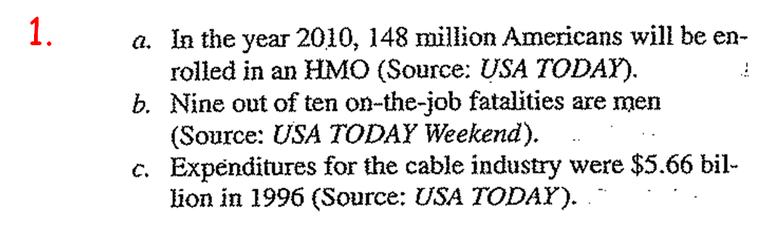
1. a) Infer
1. b) Descrip
1. c) Descrip

Slide 6
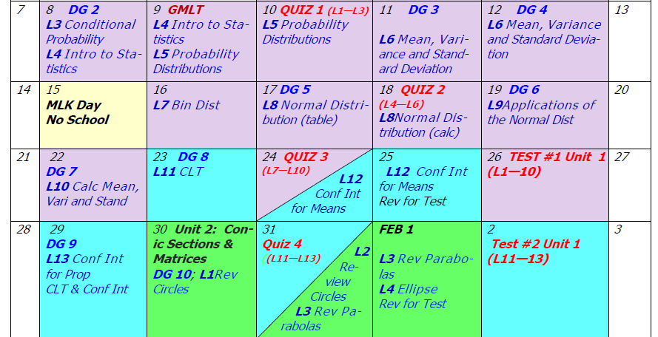
Day 5 Agenda:
GMLT today during WP
Missing Signature Page: RiC, ZS

Slide 7



What is Data?
characteristics or attributes that can assume different values
Think of this as the question being asked.
values that variables can assume
Think of this as the response to the question.
collection of data

Slide 8



variables whose values are determined by chance
Responses assume numerical values.
all subjects being studied
group of subjects selected from population

Slide 9

decision making process for evaluating claims about a population; based on data from samples
THIS IS A TOPIC THAT WE WILL SAVE FOR AP STATISTICS!!

Slide 10

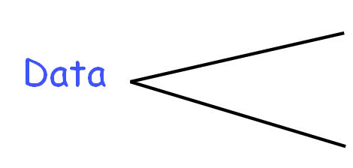






Slide 11
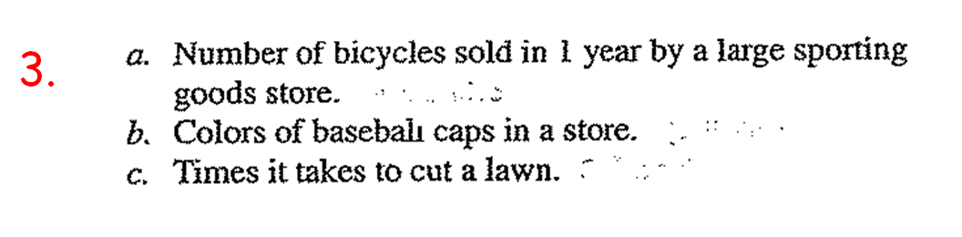
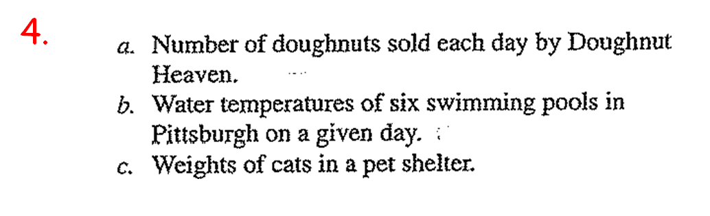
3. a) Quan
3. b) Qual
3. c) Quan
4. a) Discrete
4. b) Contin
4. c) Contin

Slide 12



chosen in such a way that every sample of size n has an equal chance to be selected
selected by using chance methods of random numbers

Slide 13
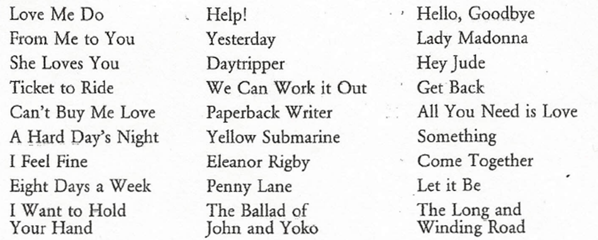
Mrs. Dillon has all 27 songs from The Beatles One CD stored on her IPhone and wants to play 4 randomly chosen songs to accompany her morning commute.

Slide 14
Assign a two-digit number to each song.
01
02
03
Etc.
27

Slide 15
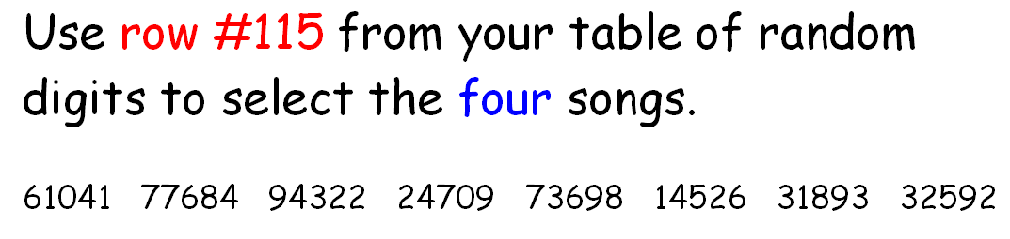


Etc. Until you have four unique songs
04
17
22
09
I Want to
Hold Your Hand
Ticket to Ride
Penny Lane
Get Back

Slide 16


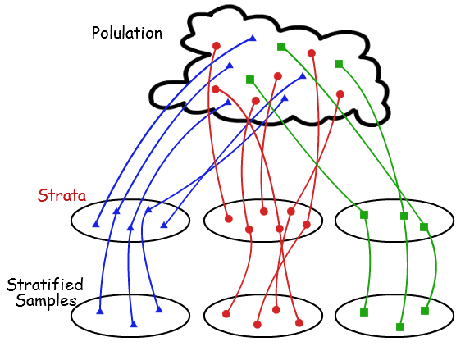
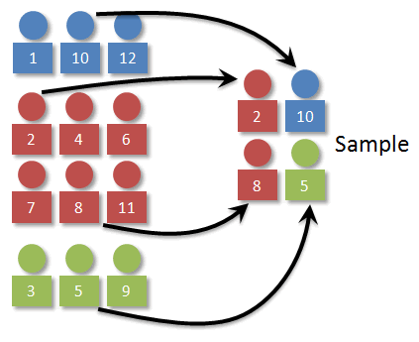
number subjects in population; select every n^{th} subject
divide population into groups according to a specific variable to the study; take a random sample from each group

Slide 17

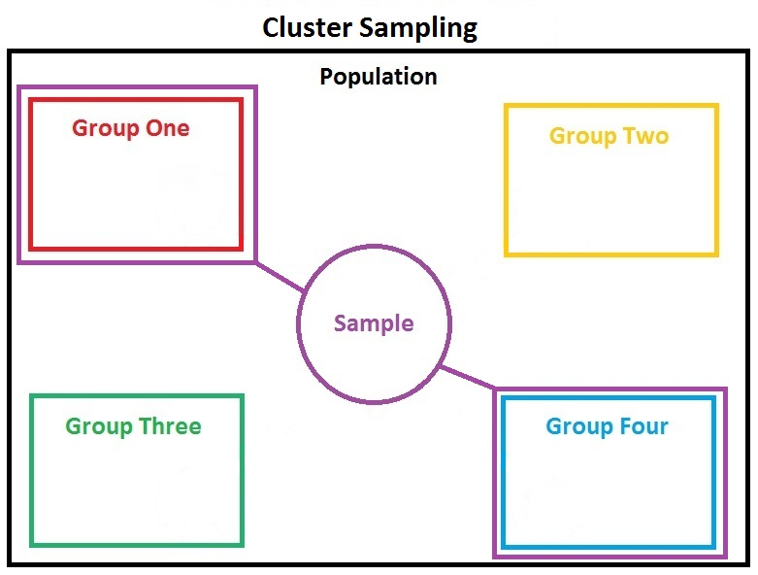
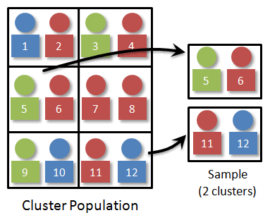

population divided into groups (clusters); randomly select an entire cluster

Slide 18

subjects
selected in a convenient manner (mall attendees, first to arrive) for the researcher

Slide 19

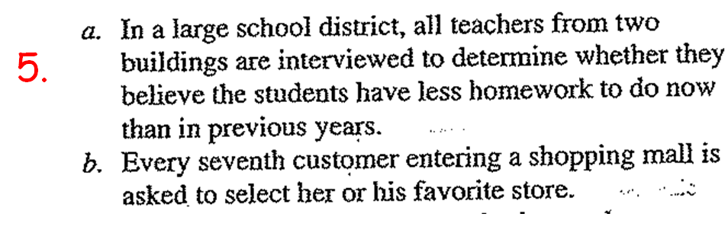
5. a) Cluster
5. b) Systematic

Slide 20


researchers observe subjects engaged in normal activity to draw conclusions
some treatment is imposed on the subjects by the researchers

Slide 21

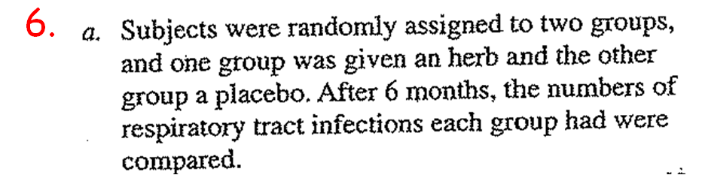
6. a) Experimental

Slide 22
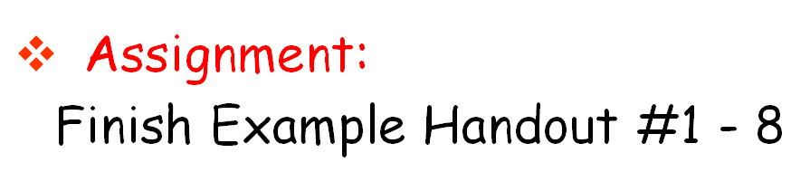
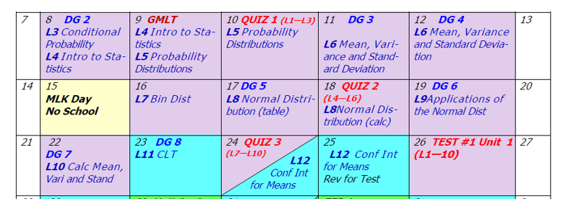
QUIZ 1 Wed
Probability (Lessons #1 – 3)

