Slide 1
Day 49 Mar 19 Agenda:
Complete DG 20 --- 12 minutes (yes 12!)
Study as much as you want to before you start, but once you begin, there should be no outside resources used.
Use today to catch up on past material. Study for Unit 5 Test or the Midterm Exam.
Memorize the ratios on the Unit Circle.

Slide 2
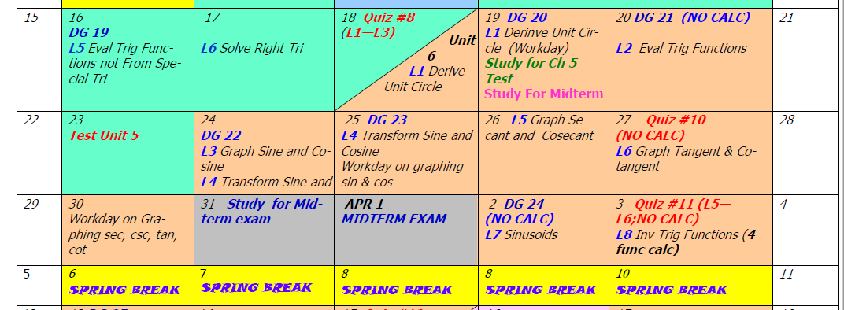
Quiz #9 has been eliminated. However you should still memorize the Unit Circle, especially of you plan to take calculus (at any level).

