Slide 1
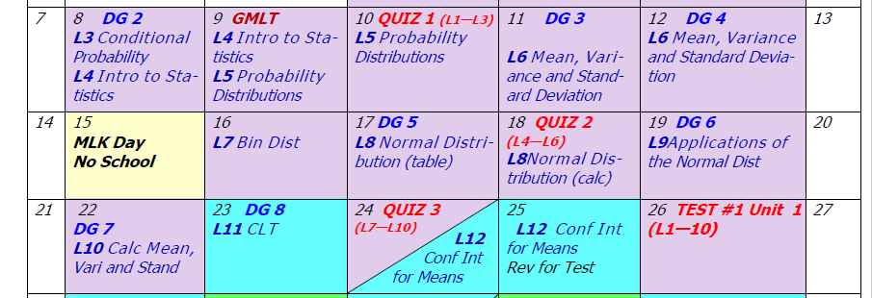
Day 4 AGENDA:
DG2 --- 15 min

Slide 2
Accel Precalc
Unit 1: Statistics & Probability
Lesson 3: Conditional Probability
EQ: What is conditional probability and how is it calculated?

Slide 3
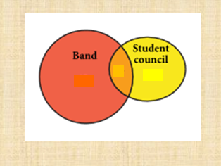
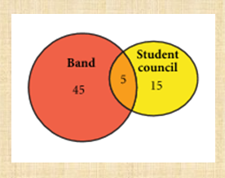
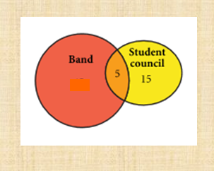
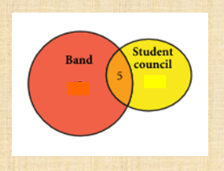
Sometimes knowing the outcome of one event can have an effect on the probability of another event.
Find the probability that the student is a member of the band if you know that he or she is on the student council.

Slide 4
Conditional Probability - probability that a second event will happen on the condition that a first event happened
Therefore

Slide 6
P(sophomore and girl) =
P(junior and girl) =
P(senior and girl) =

Slide 7
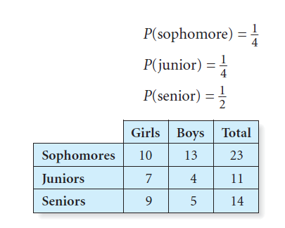
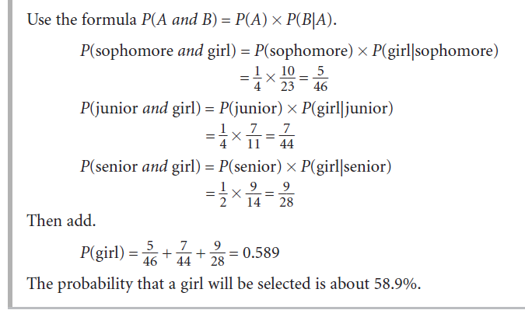

Slide 8
If and only if A and B are independent events.
WHY?
If P(B) is the same whether A happened or not, then A and B must be independent events.

Slide 9
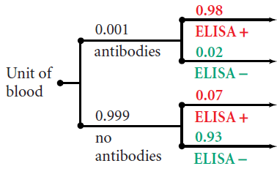
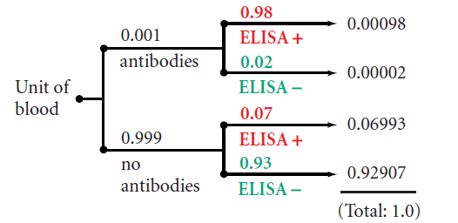
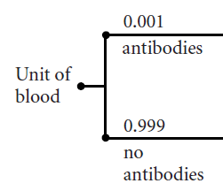
Ex. 4 The ELISA test is used to screen donated blood for the presence of HIV antibodies. When HIV antibodies are present in the blood tested, ELISA gives a positive result 98% of the time. When HIV antibodies are not present in the blood tested, ELISA gives a positive result 7% of the time, which is called a false positive. Suppose 1 out of every 1000 units of donated blood actually contains HIV antibodies.

Slide 10
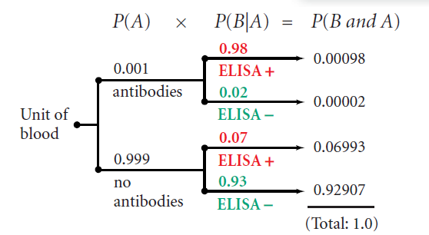
What is the probability the ELISA test is accurate?
P(test positive and antibodies or test negative and no antibodies)

Slide 11
What is the probability the antibodies were present, given the ELISA test was positive?
First find the P(positive).

Slide 12
What is the probability the antibodies were present, given the ELISA test was positive?

Slide 13
ASSIGNMENT:
Work on In Class Examples IN NOTES
Begin HW Assignment (WORKSHEET)
QUIZ #1 Wed
1. 60%
2. a) 23.7% b) 25.6%
3. 39.4%
4. a) 53.2% b) 93.375%

