Slide 1
Accel Precalculus
Unit 1: Probability and Statistics
Lesson 2: Probability
EQ: How do you find probability of mutually exclusive events, independent events, and complements of event?

Slide 2
How do some businesses, such as life insurance companies, and gambling establishments, make dependable profits on events that seem unpredictable?
Businesses have discovered that the overall likelihood, or probability, of an event can be discovered by observing the results of a large number of repetitions of the situation in which the event may occur.

Slide 3
New Terminology:
DEFINITION EXAMPLE
Trial: a systematic opportunity for an event to occur
rolling a die
Experiment: one or more trials
rolling a die 10 times
Sample Space: the set of all possible outcomes of an event
1, 2, 3, 4, 5, 6
Event: an individual outcome or any specified combination of outcomes
rolling a 3
rolling a 3 or rolling a 5
Outcomes are random if all possible outcomes are equally likely.

Slide 4
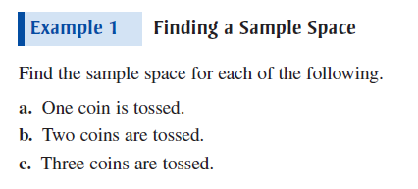
Now Try p. 682 #1

Slide 5
Determine the sample space for tossing a coin and rolling a die simultaneously.
S = _____________________________________
S = {H1, T1, H2, T2, H3, T3, H4, T4, H5, T5, H6, T6}

Slide 6
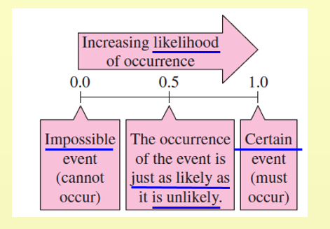

Slide 7
Expressing Probability:
1. must be a number from 0 to 1, inclusive
2. may be written as a fraction, decimal, or percent
3. an impossible event has a probability of 0
4. a certain event has a probability of 1
the sum of the probabilities of all outcomes in a
sample space is 1

Slide 8
Types of Probability:
Theoretical --- what we expect to happen for a given event
Experimental --- what actually happens when we perform a simulation
P(A) = # of outcomes in event A
# of outcomes in the sample space
Law of Large Numbers ---as the number of trials in an experiment increases, the approximation of the experimental probability approaches the theoretical probability.

Slide 9
S = {HH, HT, TH, TT}
E = {HH}

Slide 10
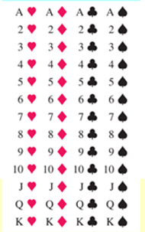

Slide 11
When tossing three coins, find the probability of getting exactly two heads.
S = { HHH, HHT, HTH, HTT, TTT, THT, TTH, THH}
E = { HTT, THT, TTH}

Slide 12
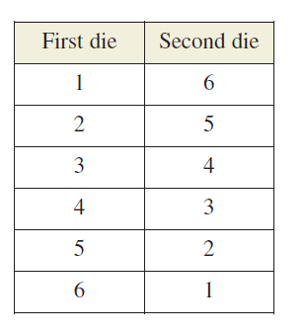

Slide 13
When tossing a six-sided die twice, find the
probability the sum is 5.
E = { (1, 4),(2, 3), (3, 2), (4, 1)}
**RECALL the FCP:

Slide 14
DAY 3 AGENDA:
DG1 --- 15 minutes
Finish U1 L2
Begin U1 L3

Slide 15
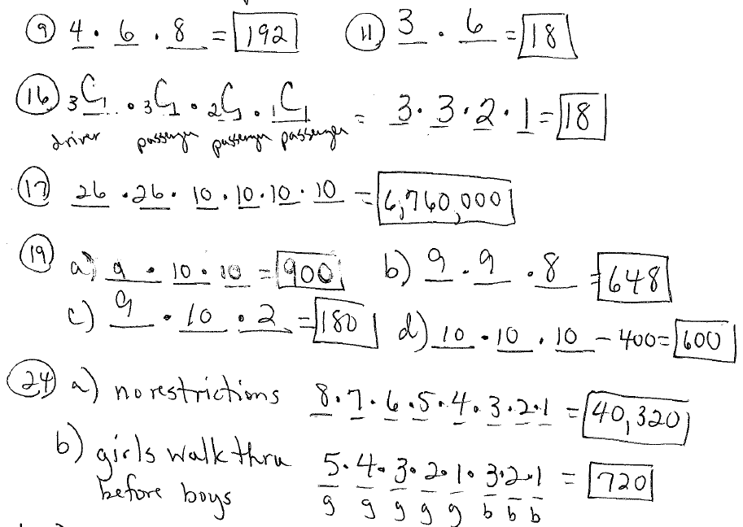

Slide 16
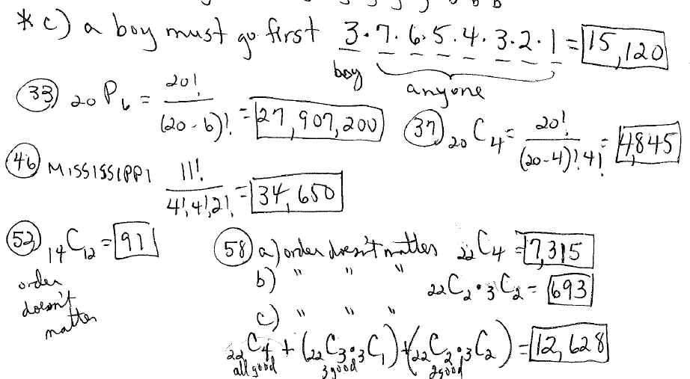

Slide 17
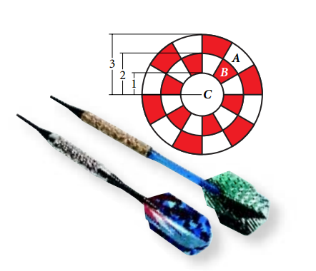
Ex. Assume that a dart will land on the dartboard at the right and that each point on the dartboard is equally likely to be hit.
Find the probability of a dart landing in region A, the outer ring.
πr²
RECALL: Area of a Circle = __________

Slide 19
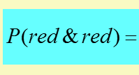
A bag contains one green two yellow, and three red marbles.
You draw two marbles (without replacement). Find the
probability of obtaining two red marbles.
NOTE: No Replacement!
or you can use combinations:

Slide 20
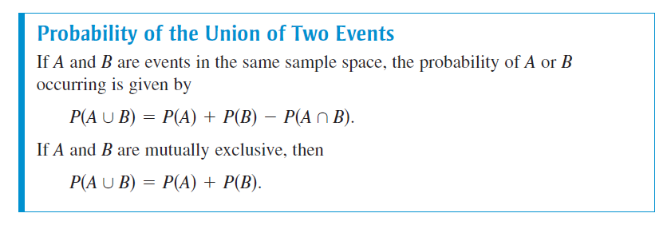
WHY?

Slide 21
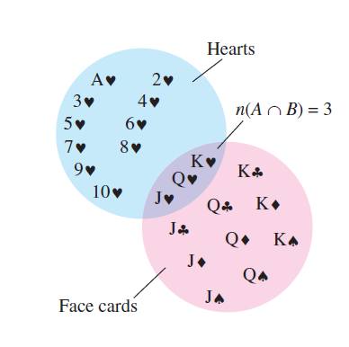

Slide 22
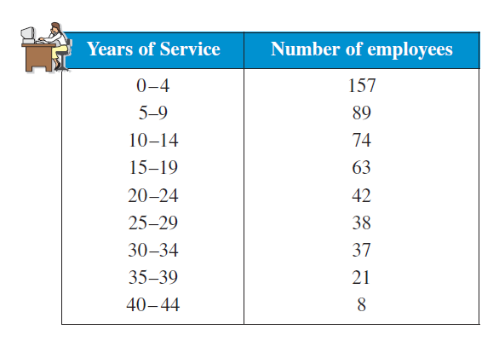
a) n(E) = 157 n(S) = 529

Slide 23
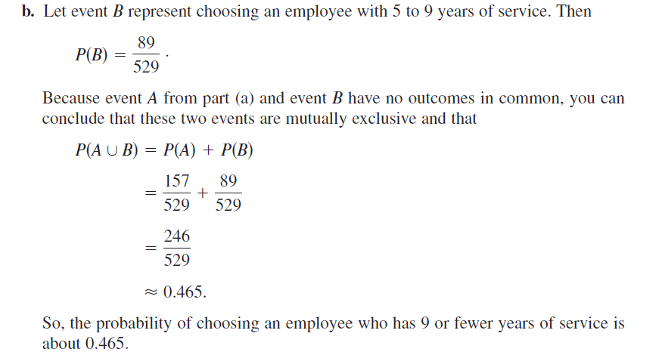

Slide 24
A shipment of 12 microwave ovens contains three defective ovens. A high school has ordered four of these ovens, and because each is identically packaged, the selection is random. What are the following probabilities?
a) probability all four microwaves are good
***Combination because ORDER doesn’t matter

Slide 25
A shipment of 12 microwave ovens contains three defective ovens. A high school has ordered four of these ovens, and because each is identically packaged, the selection is random. What are the following probabilities?
b) probability exactly 2 microwaves are good
***Combination because ORDER doesn’t matter

Slide 26
A shipment of 12 microwave ovens contains three defective ovens. A high school has ordered four of these ovens, and because each is identically packaged, the selection is random. What are the following probabilities?
c) probability at least 2 microwaves are good
***Combination because ORDER doesn’t matter
all 4 good
3 good
2 good

Slide 28
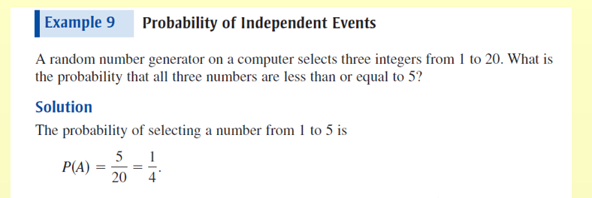

Slide 29
Two integers from 1 through 40 are chosen at random by a random number generator. Find the following probabilities.
a) probability that both numbers are even

Slide 30
Two integers from 1 through 40 are chosen at random by a random number generator. Find the following probabilities.
b) probability that one number is even or one number
is odd

Slide 31
Two integers from 1 through 40 are chosen at random by a random number generator. Find the following probabilities.
c) probability that both numbers are less than 30

Slide 32
Two integers from 1 through 40 are chosen at random by a random number generator. Find the following probabilities.
d) probability that the same number is chosen twice

Slide 34
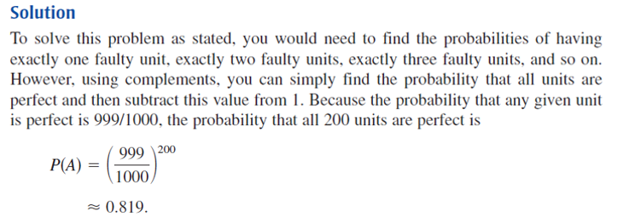
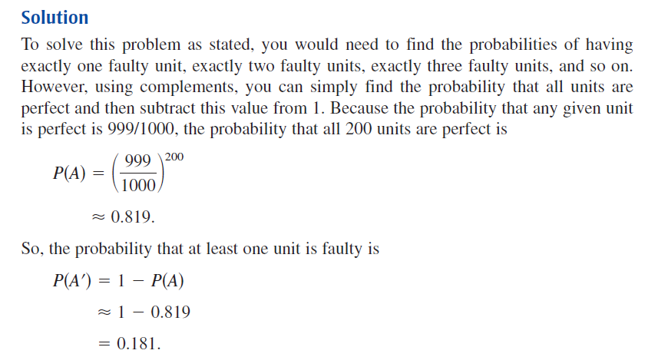

Slide 35
A fire company keeps two rescue vehicles to serve the community. Because the demand on the company’s time and the chance of mechanical failure, the probability that a specific vehicle is available when needed is 90%. If the availability of one vehicle is independent of the other, find the following probabilities.
both available
P(available) = 0.9 P(not available) = 0.1

Slide 36
A fire company keeps two rescue vehicles to serve the community. Because the demand on the company’s time and the chance of mechanical failure, the probability that a specific vehicle is available when needed is 90%. If the availability of one vehicle is independent of the other, find the following probabilities.
b) neither available
P(available) = 0.9 P(not available) = 0.1

Slide 37
A fire company keeps two rescue vehicles to serve the community. Because the demand on the company’s time and the chance of mechanical failure, the probability that a specific vehicle is available when needed is 90%. If the availability of one vehicle is independent of the other, find the following probabilities.
c) at least one available
means the same as the
complement of NONE AVAILABLE
P(available) = 0.9 P(not available) = 0.1

Slide 38
ASSIGNMENT:
p. 682 – 685
#6, 10, 18, 23, 24,
41, 50, 51, 55

