Slide 1
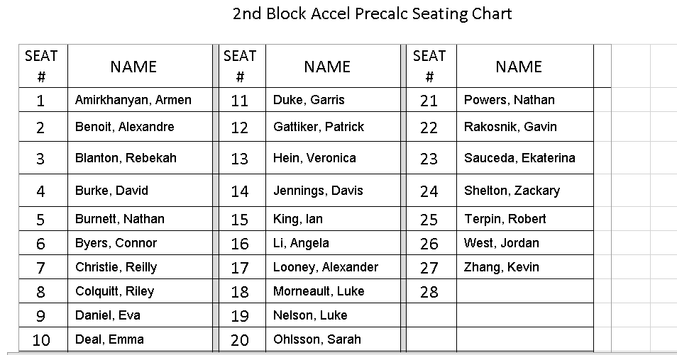
Welcome to Accel Precalculus!
Find your seat.
Each day you should POWER OFF your cell phone and place it in a slot in the holder at the front of the room.

Slide 2
All email communication with me should be conducted via your school email.
Day 1 Agenda:
Go over Syllabus
Begin the course
You should read the entire SYLLABUS. Return the signature page to me by Friday, Aug 5.

Slide 3
SYLLABUS
Does anyone want a calculator contract?

Slide 4
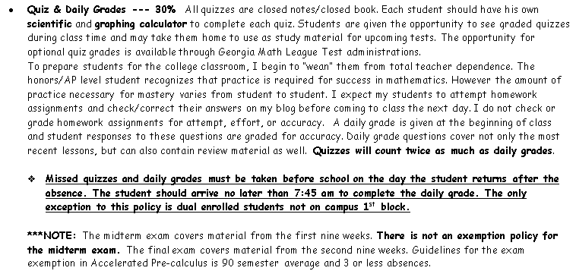

Slide 5
GMLT REMIND group
81010 text @gmlt17
Accel Precalc REMIND group
81010 text @apcsp18

Slide 6
www.mathwithdillon.weebly.com

Slide 9
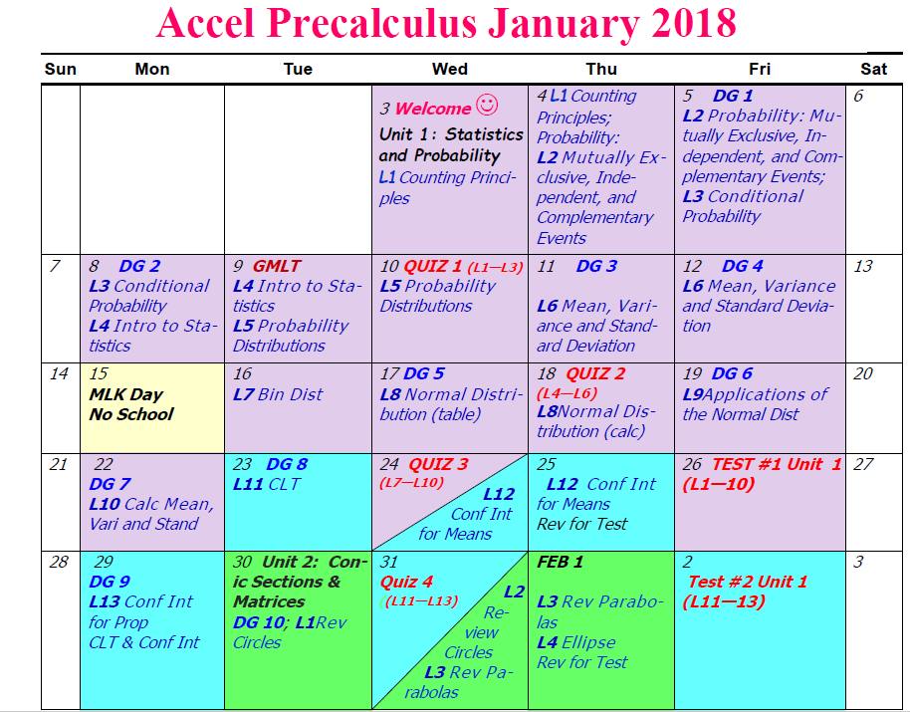

Slide 10
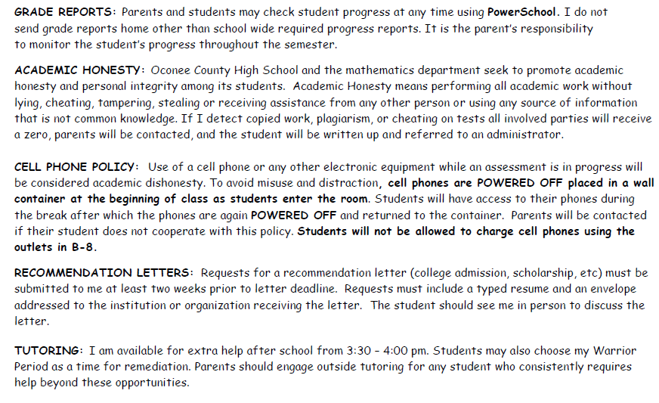

Slide 11
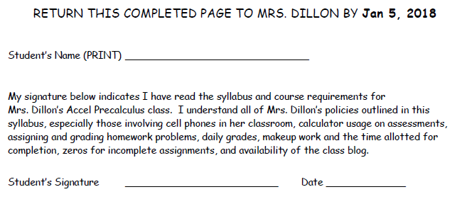

Slide 12
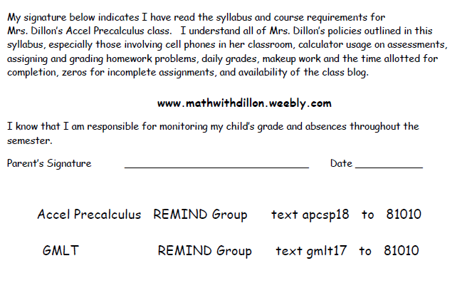

Slide 13
Each instructional day we will take a 5 minute break about half way the class period. You may get your phones, visit with class mates, use the bathroom, and/or get water during this time.
Cell phones should be placed in the caddy at the end of the break.

Slide 14
Accel Precalculus
Unit 1: Probability and Statistics
Lesson 1: Counting Principles
EQ: What are permutations and combinations and how are they used to solve counting problems?

Slide 15
Determine the number of ways a computer can randomly generate one or more such integers from 1 through 12 in which the integer is divisible by 4.
Results: 4, 8, 12
The computer can generate three integers from 1 through 12 which are divisible by 4.

Slide 16
From this list, you can see that a sum of 12 can occur in five different ways.

Slide 17
What does this mean in terms of the numbers selected?

Slide 18
**The difference between the counting problems in
examples 1 and 2 can be described by saying that the random selection in example 1 occurs with replacement, whereas the random selection in example 2 occurs without replacement, which eliminates the possibility of choosing two 6’s.

Slide 19
In how many ways can a ten-question
true-false exam be answered?(Assume no
questions are omitted.)

Slide 20
In how many ways can a ten-question true-false exam be answered?(Assume no questions are omitted.)
# of “events”
# of “outcomes”

Slide 21
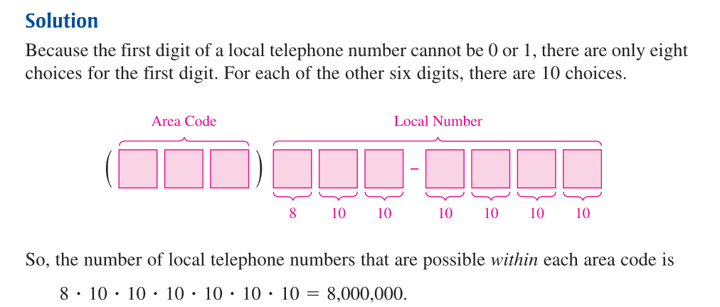
What does this change?

Slide 22
A lock will open when the right choice of
three numbers (from 1 to 40, inclusive) is
selected. How many different lock sequences
are possible?
What does this mean?

Slide 23
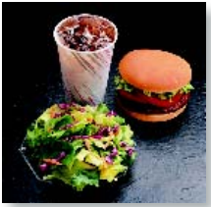
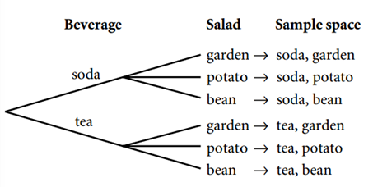
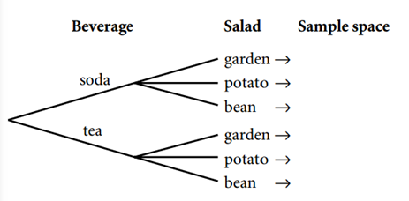
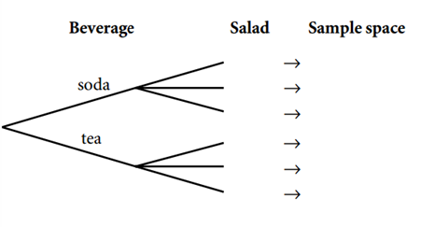
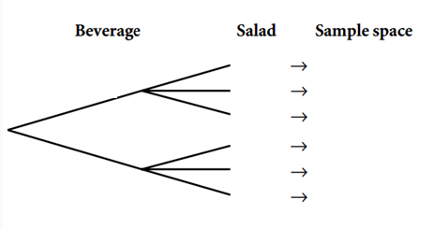
Tree Diagrams --- used to determine the outcomes and the size of the sample space for an event that is a combination of 2 or more events
Ex. A café’s lunch special is a hamburger meal. It comes with a choice of beverage (soda or tea) and a choice of salad( garden, potato, or bean). Create a tree diagram to determine how many choices are available for this lunch special.

Slide 24
What are some “numbers” that define you as a person?
______________________________________
______________________________________
______________________________________
In the above examples, does the order of the digits matter?

Slide 27
In how many ways can five children
line up in a row?
Why is a permutation appropriate in this scenario?

Slide 28
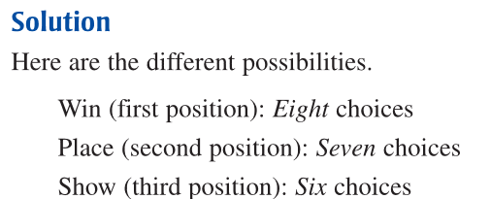

Slide 30
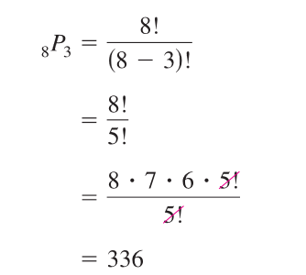
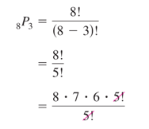
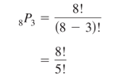

Slide 33
Find the distinguishable permutations of the letters A, A, G, E, E, E, M.
2
/
/
/
/
To use your graphing or scientific calculator you must use PARENTHESIS:

Slide 34
Day 2 Agenda:
Take up signature page.
Don’t forget to sign up for REMIND.
Accel Precalc REMIND group
81010 text @acpsp18
DG1 Friday.

Slide 35
Combinations --- subsets of a larger set in which
order is not important.
A B C A B D A B E
A C D A C E
A D E
B C D B C E
B D E
C D E
From this list, you can conclude there are 10 different ways that three letters can be chosen from five letters.

Slide 37
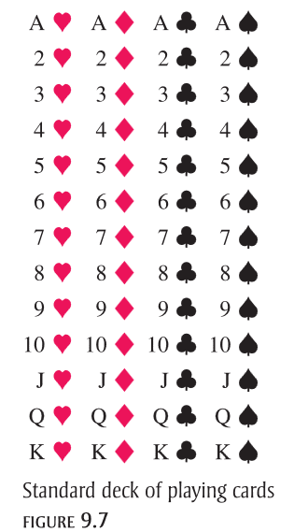
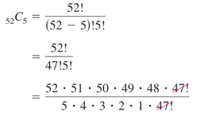
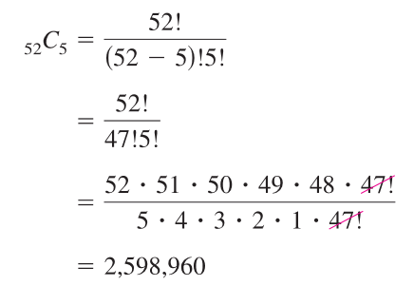

Slide 38
AB
AC
AD
AE
AF
BC
BD
BE
BF
CD
CE
CF
DE
DF
EF

Slide 39
Tree Diagrams illustrate the
Fundamental Counting Principle.
RECALL:

Slide 40
Why do you need to multiply?

Slide 41
292,600 six-member committees are possible.
Administrators
Students
Faculty

Slide 42
You may use your phone to take a picture of the textbook pages assigned for HW.
ASSIGNMENT:
p. 671 – 673 #9, 11, 16, 17, 19, 24, 33,
37, 46, 52, 58, 59
add 24c) “a boy must go first”
HW answers will be posted on the blog.

